Slide 1

Year 9 Information Evening
28 September 2022
Stepping Stones to Success
Succeeding Together

Slide 2
Aims of the Evening
To inform you about:
Key contacts
How to support your child’s transition to KS4
Key events
Monitoring Progress
Supporting Success
Developing Growth Mindset
Expectations
Notes:
2

Slide 3
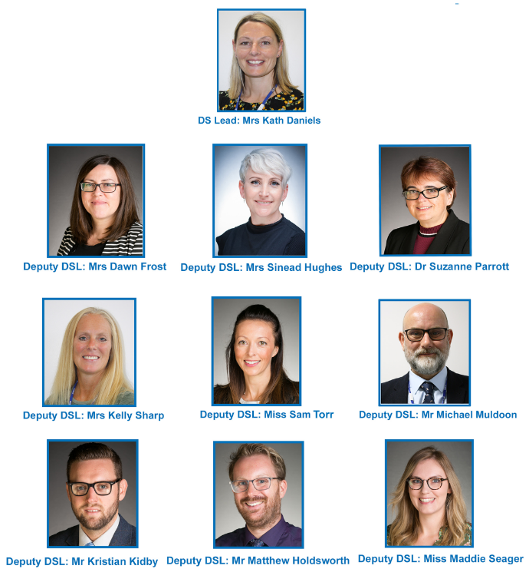
CCHSG Designated Safeguarding Team

Slide 4
“Never Acceptable”
Student wellbeing and safeguarding both in and outside school
Pastoral team available
Public transport “never acceptable” leaflets
Wellbeing cards
Abuse or harassment can be reported to neveracceptable@cchsg.com
Anonymous reporting via Whisper – access through our website https://www.cchsg.com/neveracceptable/

Slide 5
Year 9 & Upper School Pastoral Team
Form Tutors:
9C – Mrs. Clayton
9O – Mr. Glease
9L – Mr. Williams
9H – Mrs. Jefferies
9E – Mrs. Knight
9S – Mr. Snow
Mr Kidby: Year Leader Year 9
Mrs Ward: Pastoral Assistant

Slide 6

To give 100% whenever possible
To be kind and respectful to your peers and all staff
To create a supportive environment
To celebrate each other's success
To give 100% every day.
To be understanding
To provide accurate information
To always be approachable
To support the year group in as many activities as possible

Slide 7
Year 9 – The transition to KS4
The move to a three year KS4 curriculum presents an excellent opportunity for all students to:
Embed good practices and habits
Develop effective revision techniques
Understand their learning styles
Identify pressure points and learn to manage their time effectively
Understand the assessment objectives in each subject more comprehensively
Develop mastery of their subjects

Slide 8
Student
Success
School
Parent

Slide 9
Measuring Progress
KS2
KS4
Baseline Data:
KS2 SATs results
CATs
FFT
Additional data
Departmental baseline
Internal assessments
Examination Results:
Target Grades:
Realistic and aspirational
Progress
Checks
Notes:
9

Slide 10
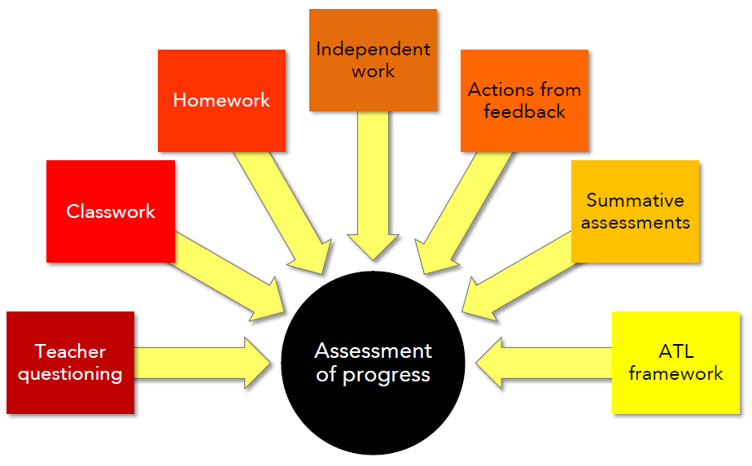
Measuring Progress
Formative Assessments
Notes:
10

Slide 11
Rewards
AWARDS
Subject postcards
Head of Year postcards
AtL Letters
Merit awards and certificates
Attendance certificates
Achievements in E-newsletter
Awards Assemblies
Sports Award Evening
Jack Petchey Awards

Slide 12

Year 9: What makes it important?
First step towards the adult world with examination based curriculum
Steps towards GCSE’s and meeting the challenges of Key Stage 4
Creating a platform for Year 10 and beyond

Slide 13

Year 9 Matrix
Enriching and diverse curriculum.
Co-curricular days throughout the year
Further develop enrichment including opportunities for additional qualifications/enrichment opportunities in finance, enterprise, languages, sport, drama, art, music and creative critical thinking including problem solving
DofE Bronze programme to be offered to Year 9 students

Slide 14

Supporting student wellbeing
Mr Kidby, Mrs Ward, Muldoon or the Form Tutor
Regular School Nurse drop-ins
Student Wellbeing ambassadors
EWMHS
KOOTH
MindEd
WARMS

Slide 15

Student
Sleep
Nutrition
Exercise/non-academic activities

Slide 16

Parent
Understanding
Recognise & encourage effort
Monitor
Environment
Communicate
Encourage work/life balance
Plan
Revision resources
The importance of reading

Slide 17


Slide 18
If you believe your child might be waking regularly to check social media during the night, here are some helpful tips to share with them, to try breaking the habit:
Adjust the light settings on your phone to reduce the amount of blue light shining through the screen. Most Apple devices now come with a “night shift mode” purposely designed to reduce the amount of blue light hitting your retinas before bedtime
Change your routine by find a new bedtime hobby – such as reading a book, taking a bath, or preparing your things for the next day. Don’t be tempted to check your phone again after performing your new hobby, just go straight to bed
Put your phone in a location where it cannot be seen or heard if it goes off. Maybe this could be on a desk across the room, or downstairs where you can find it in the morning?
Try to break the habit of unprompted device checking by practicing during the day time. Only check your phone when it alerts you to a new notification
Take a “digital detox” by turning your phone off altogether for certain hours of the day
Make sure your phone is silenced before bed, with notifications turned off or “do not disturb mode” activated

Slide 19
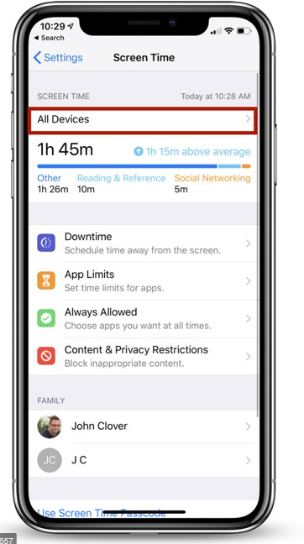
Screen-time Cap
Go to Settings
Scroll to Screen Time
Press App Limits
Set limit, e.g. Social Networking 30 minutes per day
Underneath App Limits it should say Use Screen Time Passcode

Slide 20
E-Safety, Courtesy & Kindness
Expectation – everyone is treated with respect. All are courteous, kind and considerate to others
Bullying is rare and is Never Acceptable
E-safety messages including dangers of social media, Peer on Peer Abuse are addressed
Personal safety
Never Acceptable anonymous reporting
Involvement of external agencies e.g. CEOP & Local Police
Out of School - Parents - you are responsible for your daughter’s behaviour and safety.

Slide 21
School
Support available:
Homework timetable
Subject staff
Pastoral staff
Senior staff mentor
Subject revision sessions
1:1 discussion with tutors
PSHCE programme
Wellbeing activities
External agencies

Slide 22

PSHCE Programme – Year 9
MADE study skills workshop
Taking Control – developing self-management
Mental Health and Wellbeing
Risks – including smoking and drugs
Careers
E-safety
Finance – budgets and business
British values – human rights/citizenship/diversity
Environment
Sexual health and relationships
First Aid
Notes:
22

Slide 23
Support: The importance of reading
There is a huge emphasis on reading comprehension in many examinations
Reading at home (fiction/non-fiction) and being asked questions about this will really help your daughter develop their understanding further
The more students read, the better they achieve…
In school – D.E.A.R. every Wednesday. Please ensure your child has a suitable and age appropriate reading material.

Slide 24
Supporting your child
Encourage good attendance
Support organisation
Maintain dialogue with the school
Contact Form Tutor/Head of Subject
Monitor Homework
Establish good study habits & regular revision
Revision resources
Encourage work/life balance
Reduce social media use

Slide 25
Key Pastoral Focus: 2022-2023 Attendance
Students are expected to attend every day that school is open. All schools have the responsibility to robustly manage and improve attendance
97% is the school attendance target. You will receive contact from the school when absence reaches a certain point:
  97% - conversation with the Form Tutor
  95% in school meeting with Form Tutor and Year Leader
  90% is formally categorised as a persistent absentee and will require a formal Attendance meeting, which may involve someone from the Local Authority Attendance Team
  Below 85% - regular meetings/monitoring and Action Plan put in place in conjunction with the local Authority
The Attendance Officer at CCHSG is Mrs Curtis
Morning registration closes at 08.48 – after that a student is late
Punctuality is as important as attendance
If you do not report your child’s absence by 08.30 we will ring – this is an important safeguarding measure, please do not be rude to the Attendance Officer, she is doing her job!
All absence and lateness needs to be tracked and followed up
Greater focus on parental and external agency involvement for 2022-2023

Slide 26
Key Focus: Attendance
Good attendance requires an important partnership between parents and the school
We thank you in advance for your endeavours to ensure that your child arrives in school every day they are able
We are no longer able to accept GP advice in cases of long-term illness, this needs to come from a consultant
Big plea – please avoid soft absences
Please note that schools cannot authorise any term time holidays. This includes instances when holidays run into term time.
Religious holidays are only authorised for one day and must be a day that the official religious body sanctions as a formal religious holiday. The DfE class this as a day when the student’s parents would be required by the religious
body to stay away from their employment in order to mark the occasion.

Slide 27
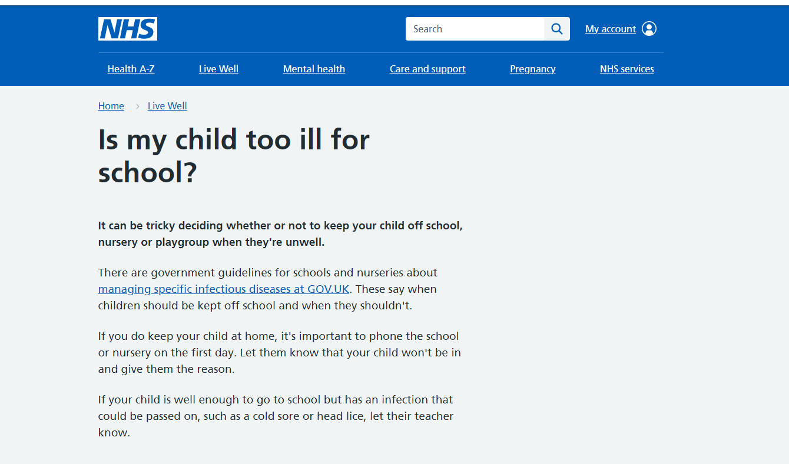

Slide 28
Catching up on missed school work
If students are not well enough to attend school – priority should be for them to rest and return to full health
Work missed should be completed on return to school and will not be set during illness
On return to school students can make their teachers aware in lesson or via email
All lessons and resources are available to students on SharePoint

Slide 29

New to CCHSG – Administering school based Paracetamol
We have acted on parental requests for the school to hold and hand out paracetamol. Parents quite rightly stated that if paracetamol had been administered in school, their child would not have needed to be sent home due to illness
We have gone through full due diligence checks including legal and medical advice
There will be a new policy sent home to parents detailing our parameters for handing out paracetamol in school
Parents will need to sign the consent and also give consent at the time, so that we can ascertain if the student has already had paracetamol
Paracetamol will only be issued four times per term to students
We will only give the correct dosage per age limit
Polite reminder that any other medication needs to come into the school and parents need to sign a medical consent form

Slide 30
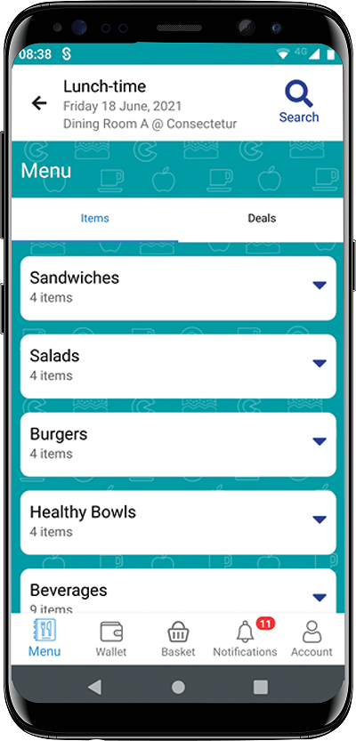
New this year- Civica Eats
To be launched in October
App to pre order lunchtime sandwiches, salads, drinks, burgers and salads
Links directly to parent pay

Slide 31
Expectations
Jewellery
  One pair of plain round studs in the lobe
  iWatches are not permitted
  No other jewellery is allowed
Not Acceptable
  Make up including eyebrows
  False eyelashes
  False nails
  Nail varnish
  Extreme hair styles or colours including Balayage
  Henna patterns on hands or nails
  Blue or black hair band, no additional hair accessories

Slide 32


Ankle socks

Slide 33
Communication
Weekly parent and student bulletin
School comms letters
E-newsletter
Twitter
Facebook

Slide 34
Communication
Form tutor
Heads of subject
Pastoral team
Exams Officer
Regarding
  Personal welfare
  Attendance
  Change in circumstance
  Illness
  Work

Slide 35

Stepping Stones to Success in Year 9
Notes:
35

Slide 36


Colchester County High School for Girls
2022

Slide 37
What is involved in DofE?
You achieve an Award by completing a personal programme of activities in four different sections:
Volunteering: undertaking service to individuals or the community
Physical: improving in an area of sport, dance or fitness activities
Skills: developing practical and social skills and personal interests
Expedition: planning, training for and completion of an adventurous journey in the local area

Slide 38

Bronze Award

Slide 39
How will I find the time?
What about my exams?
The programme is designed to fit around exam times and other school commitments
The DofE sessions are 1³/₄hrs on selected Fridays
You can have a break in the middle of the sections (i.e. at exam times)
Often you are already doing activities that are required
On expedition, bring your study with you..
..we will even carry it for you!

Slide 40
Important questions to ask yourself and your family before you enrol:
Q1 Am I fit enough to undertake a two day expedition carrying 11-13kg for at least 6 hours each day?
Q2 Can I ensure that I have walking boots/shoes?
Q3 Can I ensure that I have an adequate waterproof jacket (not showerproof or a lined ski jacket) and trousers?
Q4 After I have enrolled, will I avoid booking holiday dates that conflict with the expedition and equipment return dates?

Slide 41
Costs
The total cost including:
enrolment, school DofE sessions, 1 training day, a 2 day qualifying expeditions, and equipment hire is:
£195 - £245
depending on numbers

Slide 42
