Slide 1


Welcome to CCHSG
Year 9 Information Evening 2025

Slide 2


Aims of the evening
  Key contacts
  How to support your child’s transition to KS4
  Securing and supporting success
  Key Dates
  Building effective study habits
  Methods of communication

Slide 3
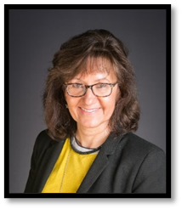
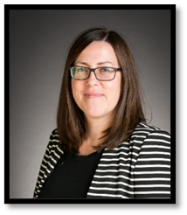
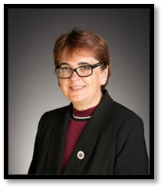

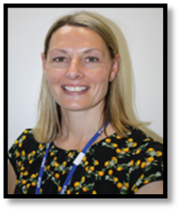


Senior Team Structure & Key Staff
Mrs Marshall
Dr Parrott
Mrs Frost
Associate Principal
Curriculum & Data
CEO & Executive Principal
Associate Principal
Overall Pastoral Lead
Mr Snow
Mrs Daniels
Mrs Ward
Mr Kidby
Head of Year 8 & 9
DSL , Head of Yr 10 & 11
Pastoral Assistant
Yr 9, 10, 11
SENCO

Slide 4

Here to listen: our safeguarding team

Slide 5
Year 9 Pastoral Team
9C | Mr Kennedy | nkennedy@cchsg.com
9O | Mrs Piggot | spiggot@cchsg.com
9L | Mrs Crozier Mrs Zambrano | kcrozier@cchsg.com lzambrano@cchsg.com
9H | Miss Williams | swilliams@cchsg.com
9E | Mr Deavers Miss Arora | ydeavers@cchsg.com parora@cchsg.com
9S | Mr Nachman | cnachman@cchsg.com
    Year Leader
    Mr Snow ssnow@cchsg.com
    SENCO
    Mr Kidby kkidby@cchsg.com
    Pastoral Assistant
    Mrs Ward jward@cchsg.com
    Associate Principal
    Mrs Frost – dfrost@cchsg.com

Slide 6
“Never Acceptable”
When young people are subjected to behaviour such as verbal or physical abuse, harassment and assault, it is NEVER ACCEPTABLE.
Students should report any incidents to the Pastoral team or DSL in a safe space
Anonymous reporting via Whisper – access through our website https://www.cchsg.com/neveracceptable/

Slide 7




Communication from the school
Weekly bulletin
School Comms letters
E-newsletter
Facebook

Slide 8
Communication
Form tutor
Heads of subject
Pastoral team
  Personal welfare
  Attendance
  Change in circumstances
  Illness

Slide 9
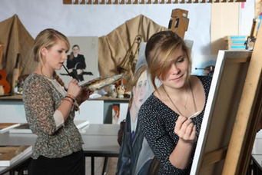

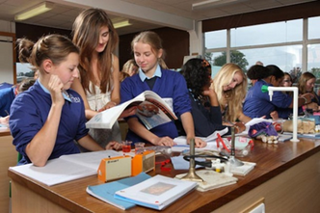
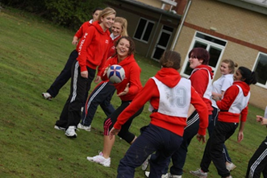
Partnering for Success
Supporting your child through their GCSEs

Slide 10
Year 9 – The transition to KS4
The move to a three-year KS4 curriculum presents an excellent opportunity for all students to:
Embed good practices and habits
Develop effective revision techniques
Understand their learning styles
Identify pressure points and learn to manage their time effectively
Understand the assessment objectives in each subject more comprehensively
Develop mastery of their subjects

Slide 11

The importance of Year 9
Why This Year Matters:
Send the foundation
A gateway to success
A year of significant personal growth.

Slide 12


Slide 13
How parents can support transition
Talk
Talk to students about their studies
Support
Support organisation
Encourage
Encourage good attendance
Make
Make sure they arrive to school on time
Contact
Contact Form Tutor
Monitor
Monitor homework
Establish
Establish good study habits and regular revision
Encourage
Encourage a work life balance
Reduce
Reduce social media use and encourage reading

Slide 14

Year 9 Matrix
Enriching and diverse curriculum.
The three-year Key Stage 4 curriculum enables students time to develop subject mastery, commit knowledge to long term memory, develop connections to new knowledge to use this knowledge fluently.
Enrichment days throughout the year - Computing, Creative Arts, Geography, History, the Holocaust, the environment, Religion and Worldviews, well-being and Enterprise Education
Students may request a change in GCSE option by contacting Mr Snow. The deadline for requesting a Friday 13th February

Slide 15
Monitoring & Reporting Progress
Progress Check 1 : 17 November
Parent Tutor Consultation Evening: 15 January
Progress Check 2: 9 March
Examination Week: April 28 – May 5
Examination results issued: 8 June
Reports issued: 6 July
AtL = Attitude to Learning
WAG = Working at Grade

Slide 16
Attitude to Learning (AtL)
Numbers 1 – 4 are awarded as follows:
Outstanding 1 | The student shows very high levels of engagement, especially in focused verbal articulation during lessons, is courteous, collaborates and cooperates in all lessons. An excellent, enthusiastic attitude to learning is shown through an exemplary behaviour for learning; all classwork and homework are completed to the highest standard, often going above and beyond expectations. They meet all deadlines and always have the correct equipment, including books/folders and art/science overalls.
Good 2 | The student is engaged in lessons, considerate, respectful and courteous to staff and other students. A good and positive attitude to learning is shown through good behaviour for learning; classwork and homework are completed to a good standard, most deadlines are met and the correct equipment, including books/folders and art/science overalls are regularly brought to lessons.
Requires improvement 3 | The student can respond promptly to teachers’ direction and work co-operatively with others. Any issues with behaviour for learning are low level; classwork and/or homework may not always be completed to the students’ level of ability, deadlines may be missed and the correct equipment and books/folders and art/science overalls are sometimes not brought to lessons.
Poor 4 | The student can lack engagement and their lack of self-discipline can, more than occasionally, reduce learning. Any issues with behaviour for learning are more noticeable; classwork and/or homework is often incomplete, deadlines are frequently missed and the correct equipment and books/folders and art/science overalls are not brought to lessons.

Slide 17
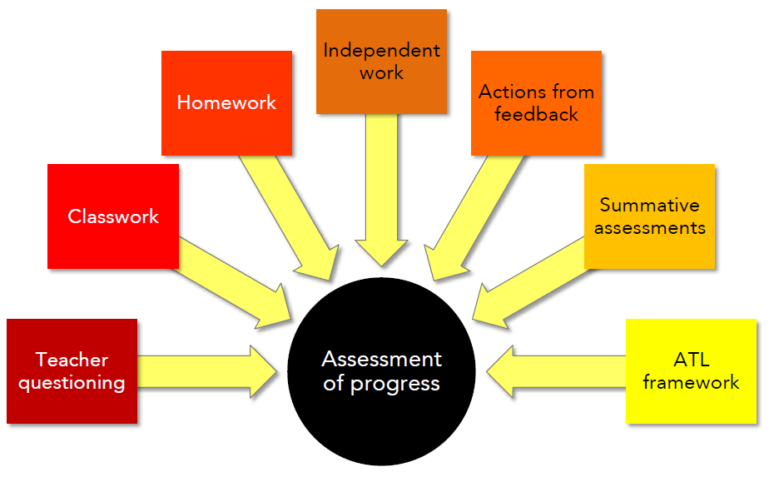
Measuring Progress
Formative Assessments
Notes:
17

Slide 18

PSHCE Programme – Year 9
MADE study skills workshop
Taking Control – developing self-management
Mental Health and Wellbeing
Risks – including smoking and drugs
Careers
E-safety
Finance – budgets and business
British values – human rights/citizenship/diversity
Environment
Sexual health and relationships
First Aid
Notes:
18

Slide 19

To give 100% every day.
To be understanding.
To provide accurate information.
To always be approachable.
To support the year group in as many activities as possible.
To give 100% whenever possible.
To be kind and respectful to your peers and all staff.
To create a supportive environment.
To celebrate each other's success.

Slide 20
Supporting Wellbeing
PSHCE programme
PE & Fitness
Healthy Lifestyles
Talking to others e.g. Wellbeing Ambassadors
Pastoral Team – Form Tutor, Year Leader and Pastoral Assistant
MHST Team
School Nurse
School Counsellor (by referral from Pastoral Team)
External Agencies Referrals

Slide 21



Support available in school
Study support lessons
Pastoral staff
Subject staff
e-Safety
Easter holiday revision
Extra-curricular clubs
Sixth Form mentors
PSHCE programme
Senior staff mentors
Well-being activites
1:1 tutor discussions
External agencies

Slide 22

Student Wellbeing support in school
  Form tutor
  Mr Snow, Mr Kidby, Mrs Ward, or Mrs Frost
  Mental Health Support Team (MHST) - previously WARMS
  YES
  School Nurse
  School Counsellor
  Student Wellbeing ambassadors
  CAMHS (by referral) - NHS mental health support
  KOOTH - online mental health support
  SHOUT - text support service

Slide 23

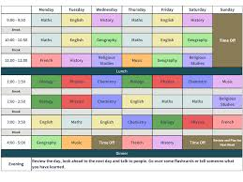
Building Successful Study Habits
The Power of Routine:
Encourage a consistent weekly timetable
A dedicated quiet workspace, free from distractions
Work in focussed bursts – The Pomodoro technique
The role of Active Learning
Encourage breaks and sleep
The biggest thing you can do is to help establish good habits now. It’s about ‘little and often’ rather than cramming.

Slide 24



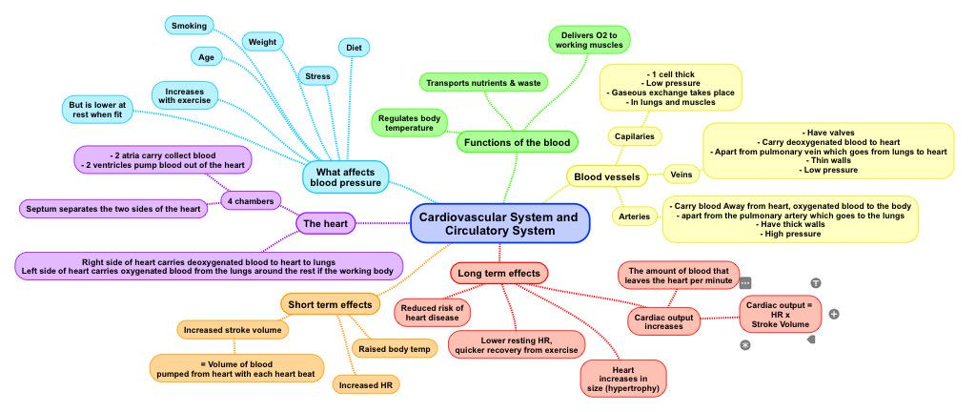
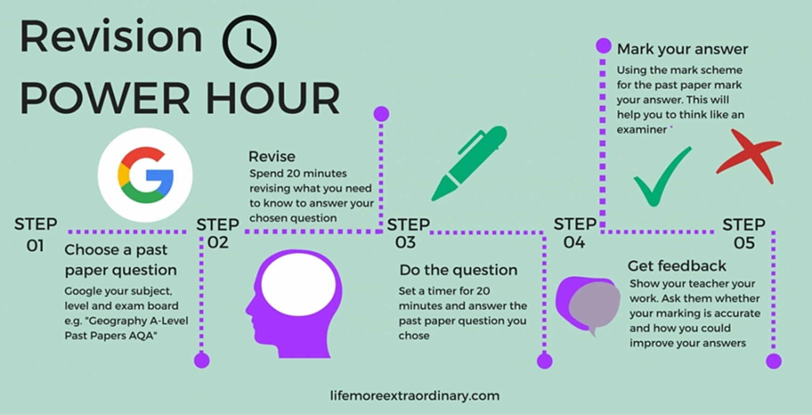
Smart Revision
Mind Maps & Flashcards
Blurting
Past Papers
Revision Power Hour
Teach someone else
Group study
Seneca, Cognito, BBC Bitesize, Quizlet, Maths Genie, Corbett Maths
Teachers as a resource

Slide 25

Staying well during revision and exams
1. Take a moment to breathe, whether in an exam, before or after.
6. Remember, results do not define you!
7. Find a revision space and style that works for you.
2. Ask school for support.
8. Work at your own pace.
3. Balance revision with socialising and relaxing.
9. Practise timing yourself when you revise.
4. Keep a self care routine.
10. Plan in some treats to reward yourself as you go.
5. Eat well and exercise to keep you energised.

Slide 26

Reading at home
Regular reading
Reading out loud to you
Modelling reading
Sparking interest and taking an interest in what they are reading

Slide 27
The Importance of Reading
There is a huge emphasis on reading as one of the keys to success across many subjects in the school supporting their understanding of questions, texts and development of vocabulary for their writing
Reading at home, fiction or non-fiction, and being asked questions about this will really help your child to develop their understanding further
In form time every week we have a Drop Everything and Read (DEAR) morning and students are required to bring a book. However, we recommend that students bring a reading book with them everyday.

Slide 28

Reading has impact!

Slide 29
Key Pastoral Focus: Attendance
Students are expected to attend every day that school is open. All schools have the responsibility to robustly manage and improve attendance.
97% is the school attendance target. You will receive contact from the school when absence reaches a certain point:
  97% - conversation with the Form Tutor
  95% in school meeting with Form Tutor and Year Leader
  90% is formally categorise as a persistent absentee and will require a formal Attendance meeting, which may involve someone from the Local Authority Attendance Team
  Below 85% - regular meetings/monitoring and Action Plan put in place in conjunction with the local Authority
The Attendance Officer at CCHSG is Mrs Foxell.
Morning registration closes at 08.48 – after that a student is late (L). After 09.35 it is coded U.
Punctuality is as important as attendance
If you do not report your child’s absence by 08.30 we will ring – this is an important safeguarding measure, please do not be rude to the Attendance Officer, she is doing her job!
All absence and lateness needs to be tracked and followed up.
Greater focus on parental and external agency involvement for 2024-2025.
Rolling 10 week window for unauthorised absence.

Slide 30
National Threshold for absence:
There is a single consistent national threshold for when a penalty notice must be considered by all schools in England of 10 sessions (usually equivalent to 5 school days) of unauthorised absence within a rolling 10 school week period.
These sessions do not have to be consecutive and can be made up of a combination of any type of unauthorised absence.
The 10-school week period can span different terms or school years.

Slide 31

Key Focus: Attendance
Good attendance requires an important partnership between Parents and the school
Greater focus on parental and external agency involvement
We thank you in advance for your endeavours to ensure that your child arrives in school every day they are able.
We are no longer able to accept GP advice in cases of long-term illness, this needs to come from a consultant
Big plea – please avoid soft absences
Please note that schools cannot authorise any term time holidays

Slide 32
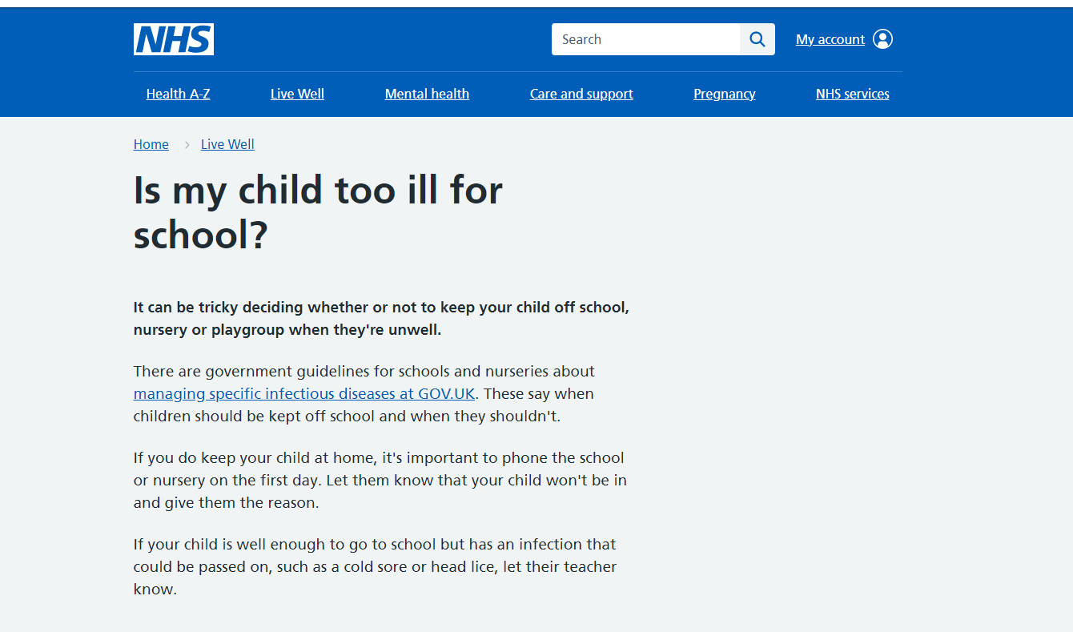

Slide 33
Tips for Parents to Support Attendance
👨‍👩‍👧 Encourage a consistent morning routine.
📅 Schedule appointments outside school hours.
🗣 Talk about the importance of daily attendance.
📞 Communicate with school if your child is struggling.
🎯 Set goals and celebrate attendance milestones together.

Slide 34

Punctuality & Attendance
Morning registration closes at 08.48 – after that, a student is late
Punctuality is as important as attendance
You need to report your child’s absence by 08.30.
All absence and lateness needs to be tracked and followed up.

Slide 35
Number of lates: | Sanction (by whom):
Students who have 3 recorded late marks (non-major transport failure related) | Breaktime detention (Form Tutor)
Students who have 4-10 recorded late marks (non-major transport failure related) | Lunchtime detention per late mark (Year Leader)
Students who have 11 or more late marks (non-major transport failure related) | Afterschool detention per late mark and a formal Meeting with parents (Year Leader). Students may be placed on a punctuality contract.

Slide 36



Catching up on missed schoolwork
If students are not well enough to attend school – priority should be for them to rest and return to full health.
Work missed should be completed on return to school and will not be set during illness.
On return to school students can make their teachers aware in lesson or via email. All lessons and resources are available to students on request from their teachers.

Slide 37
Communicating Achievements
Subject postcards
Year Leader postcards
AtL Letters
Merit awards and certificates
Attendance certificates
Achievements in E-newsletter
Awards Assemblies
Sports Award Evening
Jack Petchey Awards

Slide 38
CCHSG AWARDS merit system
Academic.
Wider school and extra-curricular activities.
Attendance of school clubs.
Role model – Doing the right thing.
Determination - Showing resilience and effort.
Social – Helping others in the community.
AWARDS total | To be awarded:
50 | Bronze award
100 | Silver award
150 | Gold award
200 | Platinum award

Slide 39

Merits to be awarded for the following categories:
Academic
Wider school/extra-curricular
Attendance at clubs and societies
R ole Model – Doing the right thing
Determination – Effort
Social – Helping others
Award categories Year 7 – Year 13 | AWARDs required in academic year | Students awarded with:
Bronze | 50 | Certificate & badge
Silver | 100 | Certificate & badge
Gold | 150 | Certificate & badge (enter prize draw)
Platinum | 200 | Certificate & badge (enter prize draw)

Slide 40
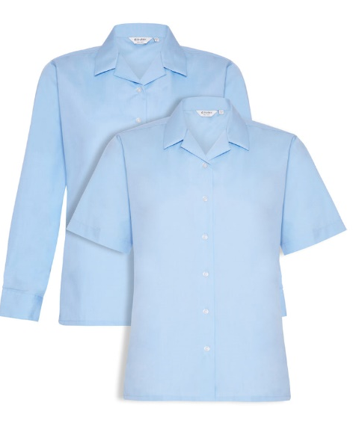

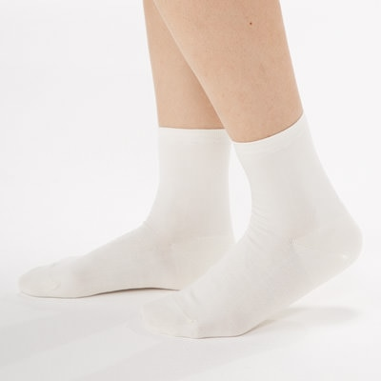

Uniform Reminders
  One pair of plain studs in each ear lobe
  No other jewellery is allowed
  Students can wear a watch
  Socks must be ankle socks
  Students should be wearing a revere collar blouse
  Students can wear a cardigan, but it must be navy blue V neck
  Extreme hair styles or colours are not permitted
  Students should be wearing a blue or black hair band other colours or accessories are not permitted
  Students should have their phones switched off and in their bags before walking through the school gate

Slide 41
Expectations - Not part of the CCHSG Uniform
Make up including eyebrows
False eyelashes/ Eyelash extensions
False nails
Nail varnish
Extreme hair styles or colours including Balayage
Henna patterns on hands or nails
Blue or black hair band, no additional hair accessories

Slide 42


e-Safety messages for parents of 14-18 year olds
e-Safety concerns are growing as children spend more time online. We have an abundance of information on our school's website to help parents navigate this.

Slide 43


Slide 44


Slide 45



Who to contact
Form tutor - for personal welfare, attendance, change in circumstance or illness.
Heads of Department - for subject related queries or work.
Pastoral team/Year leader- for additional wellbeing concerns.

Slide 46




Slide 47
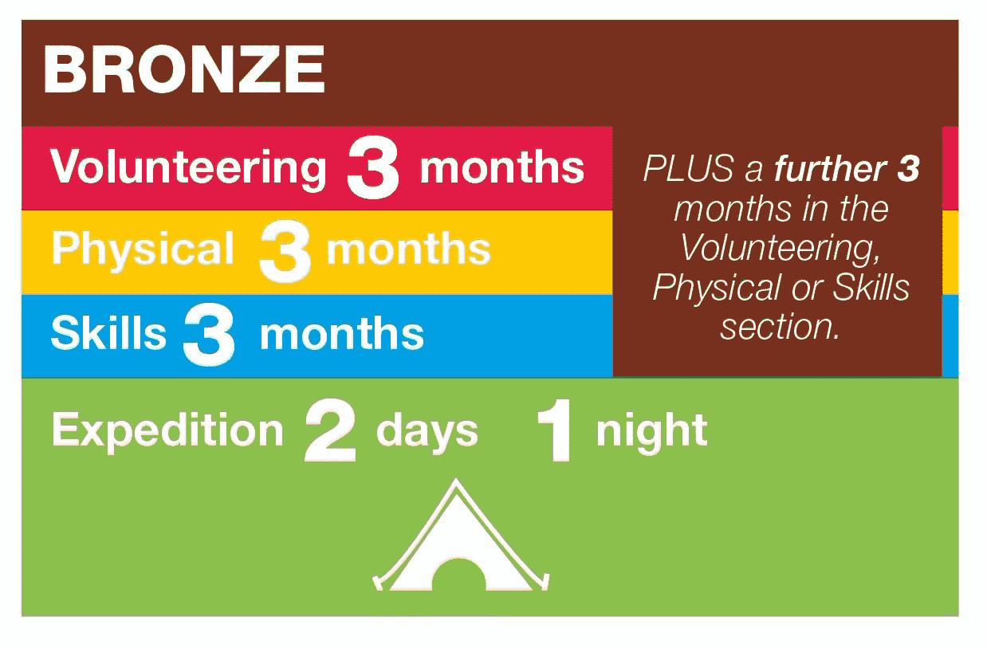
Activities and Timescale
It will take you at least 6 months to complete your Bronze programme

Slide 48
Why do DofE?
Essential skills for life and work
Develop essential emotional and social skills and attributes for work and life such as resilience, problem-solving, team-working, and communication.
Enhance your CV and career opportunities
Activities and volunteering opportunities completed through the DofE provide unique qualities to your CV and university or job applications.
The DofE gives talking points to expand upon in an interview setting.
Make a difference
Participants gave a staggering 5.2 million hours of volunteering as part of their DofE activities in April 2024-March 2025!
Challenge yourself
If it was easy, everyone would do it!

Slide 49
How will I find the time? What about my exams?
The programme fits around exam times and other school commitments
The DofE sessions are 1hr 45mins on selected Tuesdays & Fridays
You can have a break in the middle of the sections (i.e. at exam times)
Often you are already doing activities that are required
On expedition, bring your study with you..
…we will even carry it for you!

Slide 50
The Application Process
An offer booklet will be e-mailed home.
Please make sure that this is read carefully by your parents/guardians and yourselves.
Please pay particular attention to the dates and ensure you are able to attend these dates.
As part of the offer booklet, there will be a link to an application form to fill in.
As part of this form, there will be a section to fill in asking you why you wish to participate in the Bronze DofE.
This will be used to select/reject participants if we are oversubscribed (max. 126 places for Bronze - 2 groups of 63).

Slide 51
Cost
The total cost including:
£250 - £350 (depending on numbers)
Enrolment
School DofE sessions
Training weekend
2 day qualifying expeditions
Equipment hire

Slide 52


Slide 53


Slide 54

Thank you for listening
Please refer to your Information Booklet for further detail and if you have any questions contact your Form Tutor

Slide 55


Success is a journey.
You just need to stay on the path.

