Slide 1

Year 8 Information Evening
01 October 2025
Notes:
SSN

Slide 2

Aims of the Presentation
Pastoral Support & Wellbeing
Curriculum (including PSHCE)
Looking ahead to KS4
Monitoring & reporting progress
Rewards
Support
Expectations (including attendance)
e-Safety
Communication
  Preparing for Success –
  Building Effective Learning Habits!
Notes:
SSN

Slide 3
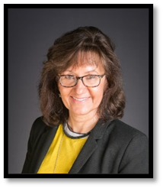
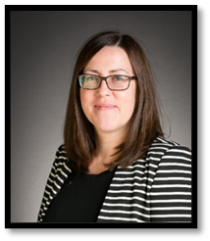
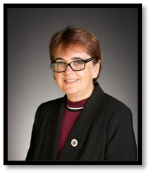

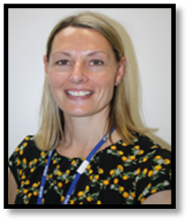
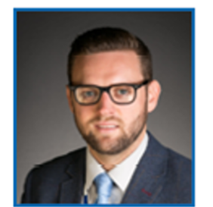

Senior Team Structure & Key Staff
Mrs Marshall
Dr Parrott
Mrs Frost
Associate Principal
Curriculum & Data
CEO & Executive Principal
Associate Principal
Overall Pastoral Lead
Mr Snow
Mrs Daniels
Miss Patrick
Mr Kidby
Head of Year 8 & 9
DSL
Head of Year 10 & 11
Pastoral Assistant
SENCO

Slide 4

Here to listen: our safeguarding team

Slide 5
Year 8 Pastoral Team
  Year 9 Tutor Team
8C | Mr Guille aguille@cchsg.com
8O | Miss Sifford lsifford@cchsg.com
8L | Mrs Steele msteele@cchsg.com
8H | Miss Freeman lfreeman@cchsg.com
8E | Mrs Watkins swatkins@cchsg.com
8S | Mr Garland jgarland@cchsg.com
    Year Leader Mr Snow ssnow@cchsg.com
    Pastoral Assistant Miss Patrick jpatrick@cchsg.com
    Pastoral Lead Years 7-9 Mr Kidby kkidby@cchsg.com
    Associate Principal Mrs Frost dfrost@cchsg.com
Notes:
SSN
Form Tutors have the role of “First Responders” and work closely with the Pastoral Team to help identify issues and support students. Students are aware of the Pastoral Team and Safeguarding Team with posters around the school to help them identify those members of staff and how to contact them.
The student planner also provides advice and gives details of support organisations and useful contacts; The Student Voice Teamwork with the Safeguarding Team to help ensure the content and advice is appropriate and updated annually.

Slide 6
Keeping in Touch
Edulink One platform
Weekly bulletin
E-newsletter
Website
Email
Notes in Student Planner
Letter/Telephone
Tell us about achievements outside school
Notes:
SSN

Slide 7
Communication
Form tutor
Heads of subject
Pastoral team
  Personal welfare
  Attendance
  Change in circumstances
  Illness
Notes:
SSN
In terms of more specific communication we will contact you directly via email or telephone. Please ensure that should you have a change of details that you let the office know as soon as possible. Please do contact the school, if necessary, the form tutor and myself will be the first point of contact for anything pastoral. There is a list of the heads of department of each subject within your booklet should you have any subject specific queries.

Slide 8
“Never Acceptable”
When young people are subjected to behaviour such as verbal or physical abuse, harassment and assault, it is NEVER ACCEPTABLE.
Students should report any incidents to the Pastoral team or DSL in a safe space
Anonymous reporting via Whisper – access through our website https://www.cchsg.com/neveracceptable/
Notes:
SSN
Explain what whisper is

Slide 9
Supporting Wellbeing
PSHCE programme
PE & Fitness
Healthy Lifestyles
Talking to others e.g. Wellbeing Ambassadors
Pastoral Team – Form Tutor, Year Leader and Pastoral Assistant
MHST Team
School Nurse
School Counsellor (by referral from Pastoral Team)
External Agencies Referrals
Notes:
SSN
At Colchester County High School for Girls, we pride ourselves on our pastoral support and there are a number of things that we have in place within school. Our extensive PSCHE programme, which we will cover in more depth later in the evening has a focus around health and wellbeing. Regular PE and healthy lives sessions contribute to wellbeing as well as the option to refer to our MHST team and the school counsellor. Any referral will be made in liaison with yourselves.

Slide 10

PSHCE Programme – Year 8
Taking Control – developing self-management
Mental Health and Wellbeing
Risks – including smoking and drugs
Careers
E-safety
Finance – budgets and business
British values – human rights/citizenship/diversity
Environment
Sexual health and relationships
First Aid
Notes:
SSN
The PSHCE curriculum at Colchester County High School for Girls is designed to:
equip students with knowledge and skills that will enable them to make informed decisions about their wellbeing, health and relationships and to build their self-efficacy
develop student’s capacity to make sound decisions when facing risks
support students to develop resilience, to know how and when to ask for help, and to know where to access support.
Topics that are covered in Year 9 include:
Research skills and online learning
Bullying, peer pressure and cyber-bullying
Family, friends and well-being
Finance – including how to budget and ethical shopping
Relationship and Sex Education including FGM
10

Slide 11

To give 100% every day.
To be understanding.
To provide accurate information.
To always be approachable.
To support the year group in as many activities as possible.
To give 100% whenever possible.
To be kind and respectful to your peers and all staff.
To create a supportive environment.
To celebrate each other's success.
Notes:
SSN
I thought it was important that I showed you, as parents, what I have shown year 9 students in their first assembly this year. I have made a big point in ensuring that they know that this is a fresh tart for each and everyone of them and anything that they may have done previously that they are not particularly proud of it is important that they learn the lessons from this and move forward. This slide highlights the expectations I have of them as individuals but also my commitment as a year leader and of the form tutors too.

Slide 12
Embed Key Skills
The move to a three year KS4 curriculum presents an excellent opportunity for all students to:
Embed good practices and habits
Develop effective revision techniques
Understand their learning styles
Identify pressure points and learn to manage their time effectively
Understand the assessment objectives in each subject more comprehensively
Develop mastery of their subjects
Notes:
KKI

Slide 13
How parents can support transition
Talk to students about their studies
Support organisation
Encourage good attendance
Make sure they arrive to school on time
Contact Form Tutor
Monitor homework
Establish good study habits and regular revision
Encourage a work life balance
Reduce social media use and encourage reading
Notes:
KKI
You as parents can support your child’s transition to key stage 4 by encouraging open communication and providing a supportive environment in which they can be helped to set goals. Ensuring that your child is organised and is attending school. If students are not in school, they are missing out on learning. Do contact your form tutors if you have any queries about anything that impacts your child within the school. There is a homework timetable printed in the back of the booklet so you can monitor your child's homework but also aid them with their revision and to embed good study habits. On the first day of the year we had MADE training, this helps students with study skills and gives them practical tips that they can apply across a range of their subject, and I would encourage you to have a conversation with your child about what they gained from the day and where they can apply those skills. It is incredibly important that our young learners do achieve a positive work life balance and do take part in many of the opportunities afforded to them and also allow them time to switch off and recover. As we mentioned previously the impact of social media can be detrimental and we do encourage all of our students to read for pleasure.

Slide 14
Student
Success
School
Parent
Notes:
KKI

Slide 15
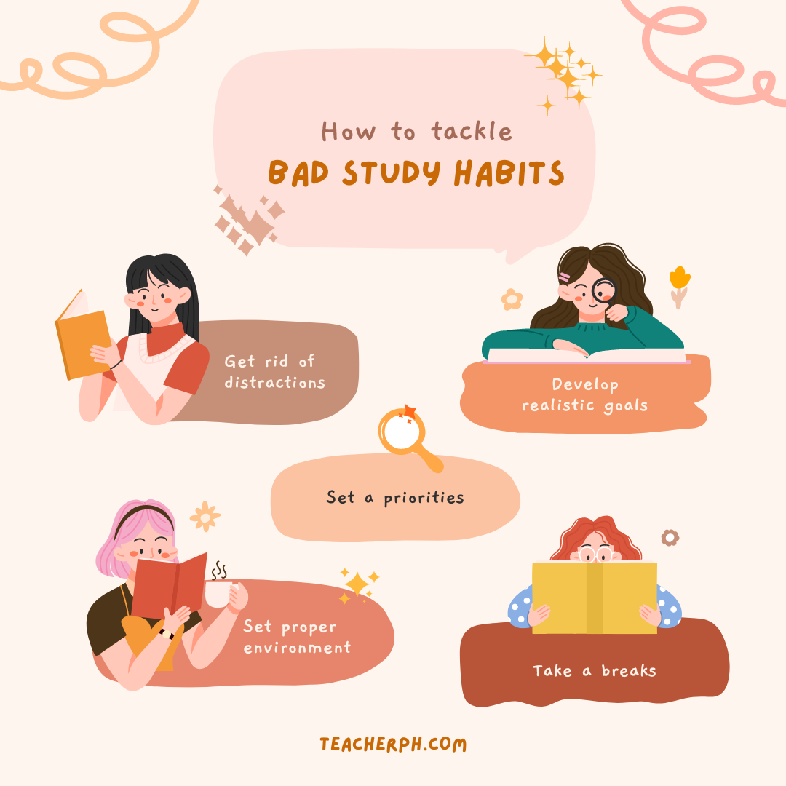
Notes:
KKI

Slide 16

Reading at home
Regular reading
Reading out loud to you
Modelling reading
Sparking interest and taking an interest in what they are reading
Notes:
KKI

Slide 17
The Importance of Reading
There is a huge emphasis on reading as one of the keys to success across many subjects in the school supporting their understanding of questions, texts and development of vocabulary for their writing
Reading at home, fiction or non-fiction, and being asked questions about this will really help your child to develop their understanding further
In form time every week we have a Drop Everything and Read (DEAR) morning and students are required to bring a book. However, we recommend that students bring a reading book with them everyday.

Slide 18
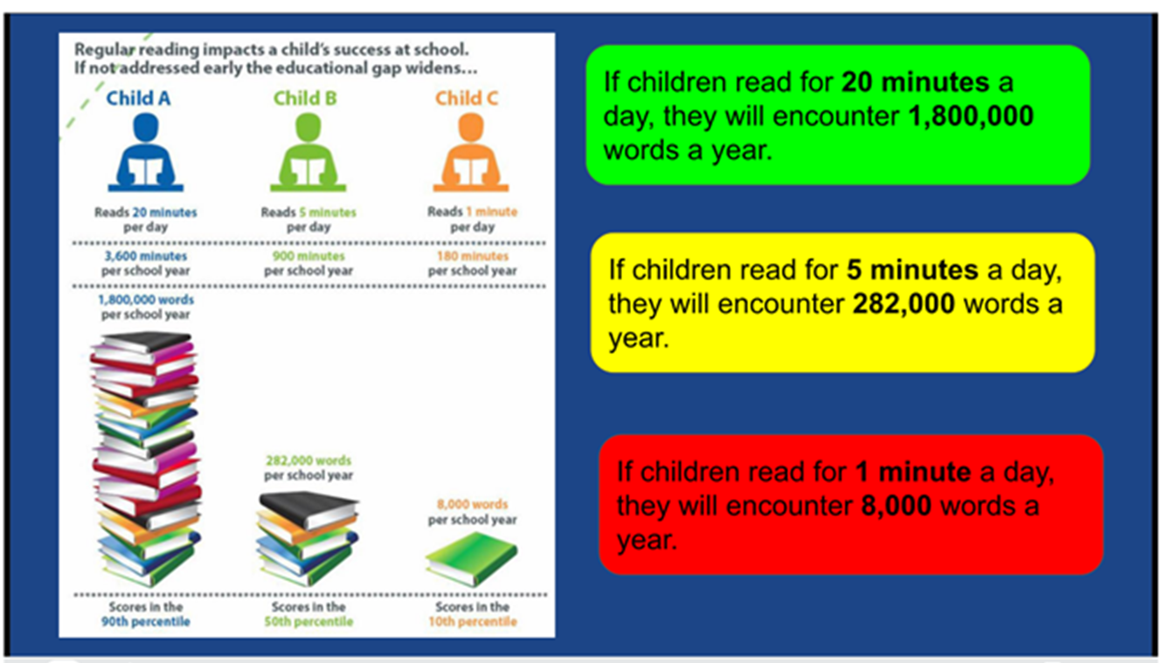
Reading has impact!
Notes:
KKI

Slide 19

Student
Sleep
Nutrition
Exercise/non-academic activities
Notes:
KKI
We do want our students to ensure that they prioritise these three aspects of their well-being: sleep, nutrition and exercise. Adequate sleep allows students to recharge their minds and bodies enhancing their ability to concentrate and retain information. A balanced and nutritious diet provides the necessary fuel for their growth and cognitive function. Regular exercise not only promotes physical health but also boosts mood, reduces stress, and improves overall mental well-being. By prioritizing these pillars of well-being, students can maximise their potential and excel in their academic pursuits.

Slide 20

Year 9 Matrix
Enriching and diverse curriculum.
The three-year Key Stage 4 curriculum enables students time to develop subject mastery, commit knowledge to long term memory, develop connections to new knowledge to use this knowledge fluently.
Enrichment days throughout the year - Computing, Creative Arts, Geography, History, the Holocaust, the environment, Religion and Worldviews, well-being and Enterprise Education
Notes:
KKI
The Year 9 Matrix blends the transition between the accelerated two year Key Stage 3 programme and the three year Key Stage 4 programme. The Key Stage 3 programme has been designed to provide students with a broad base of knowledge and skills on which to build. The curriculum in Year 9 is “fluid” with the opportunity to explore a different GCSE option if required. The three year Key Stage 4 curriculum enables students time to develop subject mastery, commit knowledge to long term memory, develop connections to new knowledge in order to use this knowledge fluently.
The Matrix consists of a flexible and balanced curriculum, the co-curriculum, STEM opportunities, trips and visits, optional instrument lessons and a programme of enrichment days. The Matrix provides opportunities for students to access subject areas they may no longer be formally studying as part of their GCSE preferences. The enrichment days will focus on Computer Science, Creative Arts, Geography, History, the environment, Religion and Worldviews, well-being and Enterprise Education. Selected students will also complete the AQA Level 2 Project Qualification. Some elements of The Matrix may lead to opportunities to take additional qualifications, for example the Level 2 Youth Chinese Test.

Slide 21
Looking ahead to KS4
Options:
History / Geography
German French /Latin/Spanish
Art / Computer Science / Drama / Music / Psychology / Physical Education / Religious Education
Core subjects:
English Language
English Literature
Mathematics
Biology
Chemistry
Physics
KS4 EVENING 12TH MARCH
Notes:
KKI

Slide 22
Attitude to Learning (AtL)
Numbers 1 – 4 are awarded as follows:
Outstanding 1 | The student shows very high levels of engagement, especially in focused verbal articulation during lessons, is courteous, collaborates and cooperates in all lessons. An excellent, enthusiastic attitude to learning is shown through an exemplary behaviour for learning; all classwork and homework are completed to the highest standard, often going above and beyond expectations. They meet all deadlines and always have the correct equipment, including books/folders and art/science overalls.
Good 2 | The student is engaged in lessons, considerate, respectful and courteous to staff and other students. A good and positive attitude to learning is shown through good behaviour for learning; classwork and homework are completed to a good standard, most deadlines are met and the correct equipment, including books/folders and art/science overalls are regularly brought to lessons.
Requires improvement 3 | The student can respond promptly to teachers’ direction and work co-operatively with others. Any issues with behaviour for learning are low level; classwork and/or homework may not always be completed to the students’ level of ability, deadlines may be missed and the correct equipment and books/folders and art/science overalls are sometimes not brought to lessons.
Poor 4 | The student can lack engagement and their lack of self-discipline can, more than occasionally, reduce learning. Any issues with behaviour for learning are more noticeable; classwork and/or homework is often incomplete, deadlines are frequently missed and the correct equipment and books/folders and art/science overalls are not brought to lessons.
Notes:
KKI

Slide 23
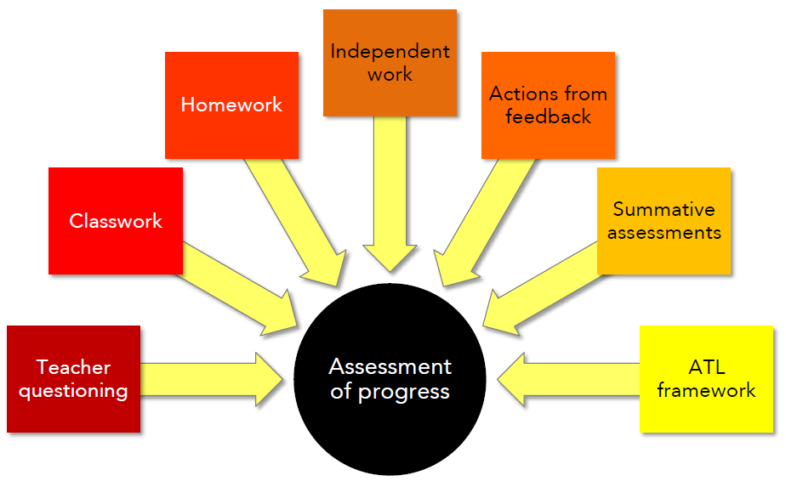
Measuring Progress
Formative Assessments
Notes:
KKI
23

Slide 24
School
Support available:
Homework timetable
Subject staff
Pastoral staff
Senior staff mentor
Subject revision sessions
1:1 discussion with tutors
PSHCE programme
Wellbeing activities
External agencies
Notes:
KKI

Slide 25
Communicating Achievements
Subject postcards
Year Leader postcards
AtL Letters
Merit awards and certificates
Attendance certificates
Achievements in E-newsletter
Awards Assemblies
Sports Award Evening
Tell us about your child’s achievements outside school so that we can celebrate them!
Notes:
KKI

Slide 26
CCHSG AWARDS merit system
Academic.
Wider school and extra-curricular activities.
Attendance of school clubs.
Role model – Doing the right thing.
Determination - Showing resilience and effort.
Social – Helping others in the community.
AWARDS total | To be awarded:
50 | Bronze award
100 | Silver award
150 | Gold award
200 | Platinum award
Notes:
KKI

Slide 27

Merits to be awarded for the following categories:
Academic
Wider school/extra-curricular
Attendance at clubs and societies
R ole Model – Doing the right thing
Determination – Effort
Social – Helping others
Award categories Year 7 – Year 13 | AWARDs required in academic year | Students awarded with:
Bronze | 50 | Certificate & badge
Silver | 100 | Certificate & badge
Gold | 150 | Certificate & badge (enter prize draw)
Platinum | 200 | Certificate & badge (enter prize draw)
Notes:
KKI

Slide 28
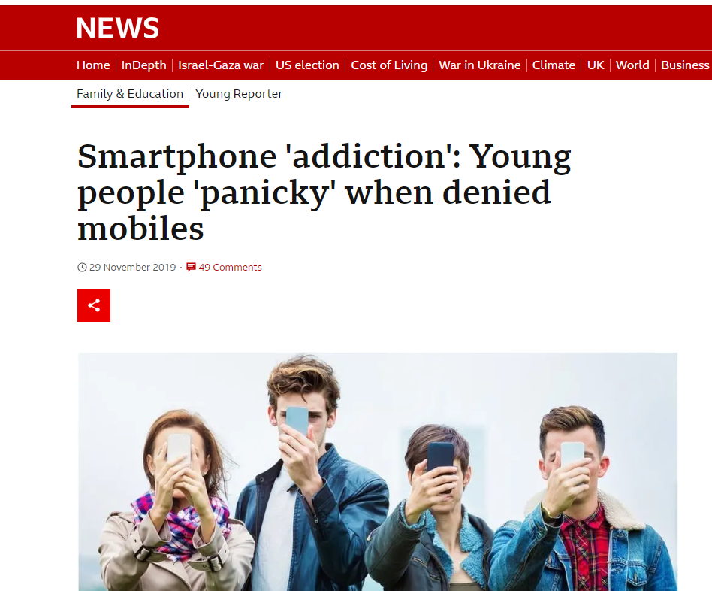
Notes:
KKI

Slide 29

Notes:
KKI

Slide 30

Notes:
KKI

Slide 31
e-Safety – What a Parent can do to help…
Outside of School - Parents - you are responsible for your child’s behaviour and safety!
Monitoring and reducing use of Apps - set screentime
Safety settings in Apps – allow you to filter appropriate content and set high security settings
Age restrictions – many Apps and online services have appropriate age restrictions. For example, WhatsApp requires a minimum age of 16.
Attend our e-Safety evening for parents/check out the school website.
Notes:
KKI

Slide 32
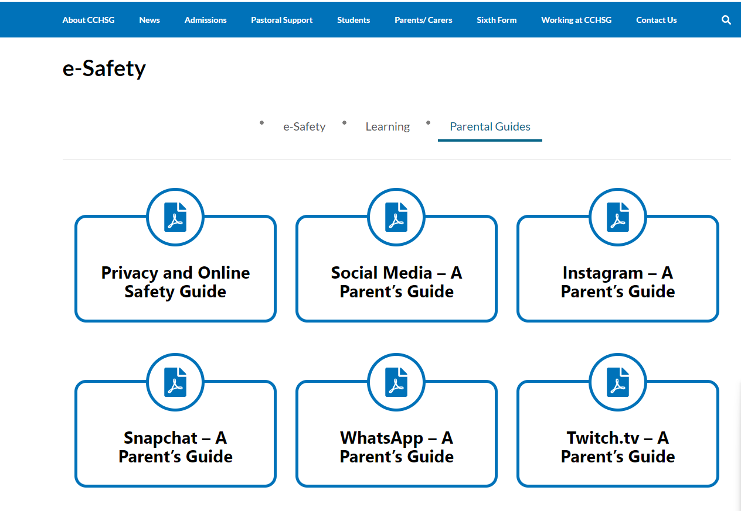
Notes:
KKI

Slide 33
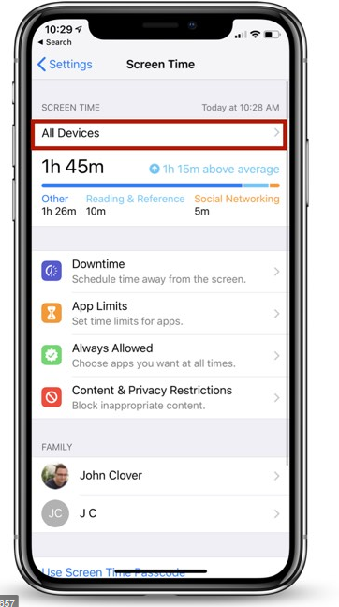
Screen-time Cap
Go to Settings
Scroll to Screen Time
Press App Limits
Set limit, e.g. Social Networking 30 minutes per day
Underneath App Limits it should say Use Screen Time Passcode
Notes:
KKI

Slide 34
Key Pastoral Focus: Attendance
Students are expected to attend every day that school is open. All schools have the responsibility to robustly manage and improve attendance.
97% is the school attendance target. You will receive contact from the school when absence reaches a certain point:
  97% - conversation with the Form Tutor
  95% in school meeting with Form Tutor and Year Leader
  90% is formally categorise as a persistent absentee and will require a formal Attendance meeting, which may involve someone from the Local Authority Attendance Team
  Below 85% - regular meetings/monitoring and Action Plan put in place in conjunction with the local Authority
The Attendance Officer at CCHSG is Mrs Foxell.
Morning registration closes at 08.48 – after that a student is late (L). After 09.35 it is coded U.
Punctuality is as important as attendance
If you do not report your child’s absence by 08.30 we will ring – this is an important safeguarding measure, please do not be rude to the Attendance Officer, she is doing her job!
All absence and lateness needs to be tracked and followed up.
Greater focus on parental and external agency involvement for 2024-2025.
Rolling 10 week window for unauthorised absence.
Notes:
DFR

Slide 35
National Threshold for absence:
There is a single consistent national threshold for when a penalty notice must be considered by all schools in England of 10 sessions (usually equivalent to 5 school days) of unauthorised absence within a rolling 10 school week period.
These sessions do not have to be consecutive and can be made up of a combination of any type of unauthorised absence.
The 10-school week period can span different terms or school years.
Notes:
DFR

Slide 36

Key Focus: Attendance
Good attendance requires an important partnership between Parents and the school
Greater focus on parental and external agency involvement
We thank you in advance for your endeavours to ensure that your child arrives in school every day they are able.
We are no longer able to accept GP advice in cases of long-term illness, this needs to come from a consultant
Big plea – please avoid soft absences
Please note that schools cannot authorise any term time holidays
Notes:
DFR
We have detected patterns of soft absence last year across our student body e.g. students off with a cold for a week or having the whole day off for a dental appointment. We will chase absence. If a student is ill, they will not be set work online. They are off school ill and need to recover. Work can be caught up with when they are back. The pastoral team are happy to help students catch up with work accrued due to illness.

Slide 37
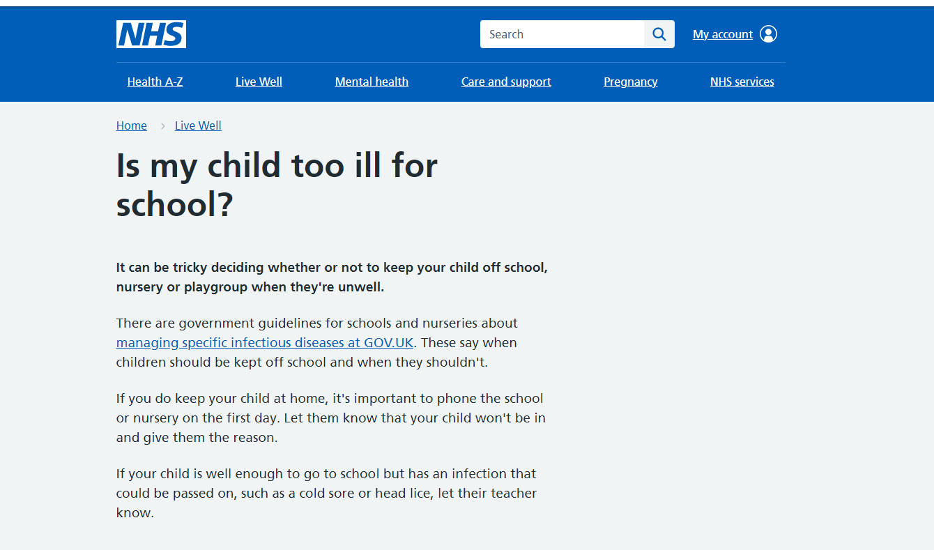
Notes:
DFR

Slide 38
Tips for Parents to Support Attendance
👨‍👩‍👧 Encourage a consistent morning routine.
📅 Schedule appointments outside school hours.
🗣 Talk about the importance of daily attendance.
📞 Communicate with school if your child is struggling.
🎯 Set goals and celebrate attendance milestones together.

Slide 39

Punctuality & Attendance
Morning registration closes at 08.48 – after that, a student is late
Punctuality is as important as attendance
You need to report your child’s absence by 08.30.
All absence and lateness needs to be tracked and followed up.

Slide 40
Number of lates: | Sanction (by whom):
Students who have 3 recorded late marks (non-major transport failure related) | Breaktime detention (Form Tutor)
Students who have 4-10 recorded late marks (non-major transport failure related) | Lunchtime detention per late mark (Year Leader)
Students who have 11 or more late marks (non-major transport failure related) | Afterschool detention per late mark and a formal Meeting with parents (Year Leader). Students may be placed on a punctuality contract.

Slide 41


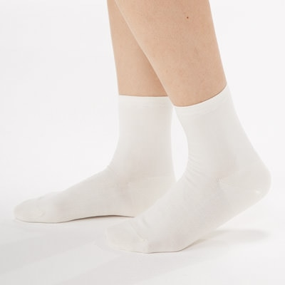

Uniform Reminders
  One pair of plain studs in each ear lobe
  No other jewellery is allowed
  Students can wear a watch
  Socks must be ankle socks
  Students should be wearing a revere collar blouse
  Students can wear a cardigan, but it must be navy blue V neck
  Extreme hair styles or colours are not permitted
  Students should be wearing a blue or black hair band other colours or accessories are not permitted
  Students should have their phones switched off and in their bags before walking through the school gate
Notes:
SSN

Slide 42
Expectations - Not part of the CCHSG Uniform
Make up including eyebrows
False eyelashes/ Eyelash extensions
False nails
Nail varnish
Extreme hair styles or colours including Balayage
Henna patterns on hands or nails
Blue or black hair band, no additional hair accessories
Notes:
SSN
It is important for students to wear their uniform in the correct manner and to keep it looking smart, even when you are on your way to or from school. As a member of Colchester County High School for Girls students uniform will say a great deal about you to visitors, members of the public and other members of the school and students should be proud to wear it. Students will need to always wear your blazer and ask permission in class to remove it.

Slide 43
Year 8 Form Group Mix
At the end of Year 8 students will be reorganised into new Form Groups for the start of Year 9
New core groups for GCSE options allows an opportunity to also mix the Form Groups
An opportunity to mix with different students within the Year Group
We know that as students get older they start to mix with students from other Form Groups anyway
The positive reaction we have had from students in previous years
We have made changes to the process in response to student concerns
Notes:
SSN

Slide 44
Key School Procedures and Protocols
First aid and Medication
At CCHSG we have first aid trained members of staff who are always on call to deal with first aid issues.
Students should speak to a member of staff who can assist them.
Parents will be contacted by the office to collect their child if needed.
Students must not contact their parent directly as this can cause worry and confusion between staff, students and parents.
If your child has an accident or injury outside of school – contact us so that we can put measures in place to support them.
Paracetamol Policy – details to be sent home soon
Notes:
SSN

Slide 45

Stepping Stones to Success in Year 8
Notes:
SSN
45

Slide 46

Thank you for listening
Please refer to your Information Booklet for further detail and if you have any questions contact your Form Tutor
Notes:
SSN

