Slide 1

Welcome to the
Year 7
Information Presentation 2025
Colchester County High School for Girls

Slide 2

Welcome to CCHSG
The start of your 7 Year journey with us!

Slide 3
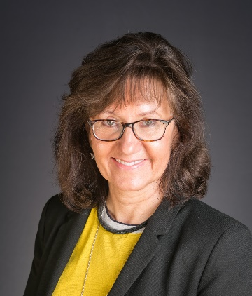
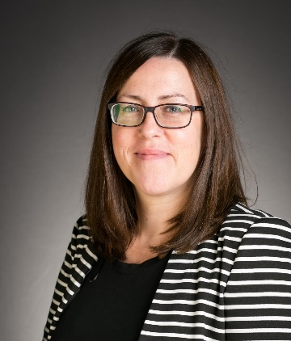
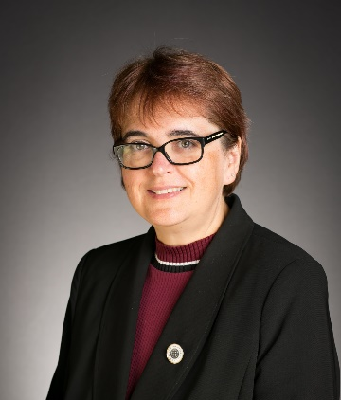
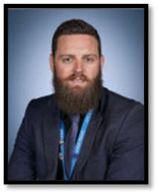
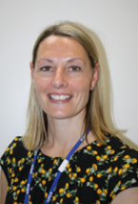
Senior Team Structure at CCHSG
Mrs Marshall
CEO & Executive Principal
Mrs Frost
Associate Principal
Overall Pastoral Lead
Dr Parrott
Associate Principal
Curriculum & Data
Mr Kidby
SENCO
Mrs Daniels
DSL

Slide 4

Aims of the Evening
Expectations and Transition to Secondary school
Safeguarding policy and procedure
School Procedures
Pastoral support and wellbeing
Curriculum & examinations
Reporting progress
Awards & Rewards
Attendance – Key focus
Anti-bullying
PSHCE
Careers
Communication
Bushcraft Residential Trip
Stepping into Year 7:
  tips for a successful transition

Slide 5
Year 7 Pastoral Team
  Year 7 Tutor Team
7C | Miss. R. Dennis & Miss. G. Armour
7O | Mlle. A. Prevost
7L | Mr. J. Walsh
7H | Miss. M. Raymond
7E | Mr. E. Glease
7S | Miss. Z. Anthony
    Year Leader & SENCO
    Mr Kidby - kkidby@cchsg.com
    Senior Leadership Team Pastoral link
    Mrs Sharp
    Associate Principal - Pastoral
    Mrs Frost
    Pastoral Assistant
    Miss Patrick
    DSL
    Mrs Daniels

Slide 6


Supporting Transition to
Secondary School
Uniform
Organisation
Homework
Time management
Wellbeing

Slide 7
How parents can support transition
Make sure they arrive to school on time
Support organisation
Contact Form Tutor
Monitor homework
Encourage good attendance
Establish good study habits and regular revision
Encourage a work life balance
Reduce social media use

Slide 8

CCHSG Designated Safeguarding Team

Slide 9
Anti-Bullying & E-Safety
Outside of School - Parents - you are responsible for your child’s behaviour and safety!
Monitoring and reducing use of Apps - set screentime
Safety settings in Apps – allow you to filter appropriate content and set high security settings
Age restrictions – many Apps and online services have appropriate age restrictions. For example, WhatsApp requires a minimum age of 16.
E-safety evening for parents

Slide 10
Anti-Bullying & E-Safety
Expectation – students are respectful, polite, kind and considerate.
The use of WhatsApp groups are counterproductive and often problematic.
Zero tolerance to bullying both in school and online.
Zero tolerance to appearing in your school uniform in online photographs or videos.
Anti-bullying and e-safety messages continually promoted through PSHCE and Assemblies.
Encourage students to use online school platforms to communicate with each other about school and homework such as Teams rather than social media or online messaging services.

Slide 11
“Never Acceptable”
When young people are subjected to behaviour such as verbal or physical abuse, harassment and assault, it is NEVER ACCEPTABLE.
Students should report any incidents to the Pastoral team or DSL in a safe space
Anonymous reporting via Whisper – access through our website https://www.cchsg.com/neveracceptable/

Slide 12
Supporting Wellbeing
PSHCE programme
PE & Fitness
Healthy Lifestyles
Talking to others e.g. Wellbeing Ambassadors
Pastoral Team – Form Tutor, Year Leader and Pastoral Assistant
MHST Team
School Nurse
School Counsellor (by referral from Pastoral Team)
External Agencies Referrals
YES

Slide 13
PSHCE Programme – Year 7
(Personal, Social, Health & Citizenship Education)
Introduction to CCHSG and PSHCE
Being an aspirational student
Friendships, bullying and e-safety
Healthy lifestyle
Research skills
Creating Success
Careers
Finance
Dangers of smoking, alcohol and drugs
Resilience and exam preparation
Relationships and Sex Education (RSE)
RSE in Year 7 focuses on healthy relationships. If you have any questions or concerns, please contact me directly kkidby@cchsg.com

Slide 14

Careers – Supporting KS4 Pathways
Students are given the opportunity to investigate different career opportunities and to consolidate their awareness of the myriad of opportunities ahead of them in life.
They are made aware of the opportunities ahead at 13+, 16+, 18+ and post-degree.
Students across the school are welcome to join a range of societies that give an insight into different career paths.
CCHSG Careers Lead
External Careers Advisor
Careers Library & Interactive ICT Resources

Slide 15
Year 7 Curriculum & Examinations
All subjects begin KS3 programme following the national curriculum – further details are in the ‘Curriculum Outline’ in the information booklet
Students also get to study Creative & Critical Thinking, Healthy Living (on rotation across the year), PSHCE and Core PE.
Homework expectations and timetable
in their planners, your information
booklet and on the website.

Slide 16
The Year 9 Matrix
At CCHSG we have a two year Key Stage 3 programme and a three year Key stage 4 programme.
The three year Key Stage 4 curriculum enables students time to develop subject mastery, commit knowledge to long term memory, develop connections to new knowledge in order to use this knowledge fluently.
The Year 9 Matrix is ‘fluid’ and blends the transition between KS3 and KS4 giving the students an opportunity to explore a different GCSE option if required.
The Matrix provides opportunities for students to access subject areas they may no longer be formally studying as part of their GCSE preferences. The enrichment days will focus on Computer Science, Creative Arts, Geography, History, the environment, well-being and Enterprise Education. It also includes STEM opportunities, trips and visits and optional instrument lessons.

Slide 17
Key Dates
Progress Check 1 (AtL only): 20 October
Year 7 Welcome Party: 10 October
Y7 Parent Tutor Consultation Evening: 6 November (Online)
Progress Check 2 (AtL and WAS): 2 February
Y7 Parent Consultation Evening (7C,O,L): 10 February
Y7 Parent Consultation Evening (7H,E,S): 26 February
Y7 Examination Week: 18 – 22 May
Examination results issued: 22 June
Bushcraft Residential Trip: 8 – 10 July
Y7 Reports issued: 13 July
AtL = Attitude to Learning
WAS = Working at Step

Slide 18
Attitude to Learning (AtL)
Numbers 1 – 4 are awarded as follows:
1 = Outstanding | The student shows very high levels of engagement, especially in focused verbal articulation during lessons, is courteous, collaborates and cooperates in all lessons. An excellent, enthusiastic attitude to learning is shown through an exemplary behaviour for learning; all classwork and homework are completed to the highest standard, often going above and beyond expectations. They meet all deadlines and always have the correct equipment, including books/folders and art/science overalls.
2 = Good | The student is engaged in lessons, considerate, respectful and courteous to staff and other students. A good and positive attitude to learning is shown through good behaviour for learning; classwork and homework are completed to a good standard, most deadlines are met and the correct equipment, including books/folders and art/science overalls are regularly brought to lessons.
3 = Requires improvement | The student can respond promptly to teachers’ direction and work cooperatively with others. Any issues with behaviour for learning are low level; classwork and/or homework may not always be completed to the students’ level of ability, deadlines may be missed, and the correct equipment and books/folders and art/science overalls are sometimes not brought to lessons.
4 = Poor | The student can lack engagement, and their lack of self-discipline can, more than occasionally, reduce learning. Any issues with behaviour for learning are more noticeable; classwork and/or homework is often incomplete; deadlines are frequently missed, and the correct equipment and books/folders and art/science overalls are not brought to lessons.

Slide 19
Monitoring & Reporting Progress
STEPS:
Based on reformed curriculum assessment requirements
In Y7, most are moving though 4 to 5, but may achieve 6.
Sub- steps:
Each Step is divided into sub-steps .3, .6 or .9
.9 is working at the top of the step
.6 is working in the middle of the step
.3 is working at the bottom of the step

Slide 20
Working at Measure/Step (WAS)
Target Measure/Step
Each subject – Cognitive Abilities Test score, Fisher Family Trust data and teacher assessment.
The School Target Measure provides an indication of the most likely Step the student should achieve by the end of the current school year in that subject.
N.B. Creative and Critical Thinking is a non-National Curriculum subject and uses a Progress Measure of Pass/ Merit/ Distinction.
Each subject – classwork, homework and formal assessments taken into consideration.
It is the Step at which the student is currently working.

Slide 21

Merits to be awarded for the following categories:
Academic
Wider school/extra-curricular
Attendance at clubs and societies
R ole Model – Doing the right thing
Determination – Effort
Social – Helping others
Award categories Year 7 – Year 13 | AWARDs required in academic year | Students awarded with:
Bronze | 50 | Certificate & badge
Silver | 100 | Certificate & badge
Gold | 150 | Certificate & badge (enter prize draw)
Platinum | 200 | Certificate & badge (enter prize draw)

Slide 22
Rewards
Subject postcards
Year Leader postcards
AtL Letters
Merit badges and certificates
Attendance certificates
Achievements in E-newsletter
Awards Assemblies
Sports Award Evening
Jack Petchey Awards
Tell us about your child’s achievements outside school so that we can celebrate them!

Slide 23

Reading at home
Regular reading
Reading out loud to you
Modelling reading
Sparking interest and taking an interest in what they are reading

Slide 24
The Importance of Reading
There is a huge emphasis on reading as one of the keys to success across many subjects in the school supporting their understanding of questions, texts and development of vocabulary for their writing
Reading at home, fiction or non-fiction, and being asked questions about this will really help your daughter develop their understanding further
In form time every week we have a Drop Everything and Read (DEAR) morning and students are required to bring a book. However, we recommend that students bring a reading book with them everyday.
Accelerated Reader Programme

Slide 25
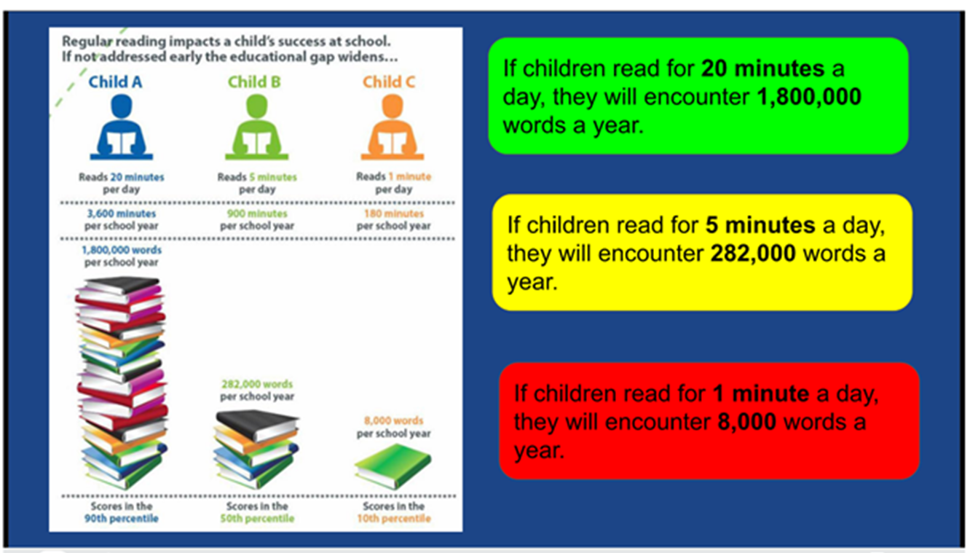
Reading has impact!

Slide 26
Key Pastoral Focus: 2025-2026 : Attendance
Students are expected to attend every day that school is open. All schools have the responsibility to robustly manage and improve attendance.
97% is the school attendance target. You will receive contact from the school when absence reaches a certain point:
  97% - conversation with the Form Tutor
  95% in school meeting with Form Tutor and Year Leader
  90% is formally categorise as a persistent absentee and will require a formal Attendance meeting, which may involve someone from the Local Authority Attendance Team
  Below 85% - regular meetings/monitoring and Action Plan put in place in conjunction with the local Authority
The Attendance Officer at CCHSG is Miss Foxell
Morning registration closes at 08.48 – after that a student is late
Punctuality is as important as attendance
If you do not report your child’s absence by 08.30 we will ring – this is an important safeguarding measure, please do not be rude to the Attendance Officer, she is doing her job!
All absence and lateness needs to be tracked and followed up.
Greater focus on parental and external agency involvement for 2024-2025.

Slide 27

Key Focus: Attendance
Good attendance requires an important partnership between Parents and the school
Greater focus on parental and external agency involvement for 2024-2025
We thank you in advance for your endeavours to ensure that your child arrives in school every day they are able.
We are no longer able to accept GP advice in cases of long-term illness, this needs to come from a consultant
Big plea – please avoid soft absences
Please note that schools cannot authorise any term time holidays
Notes:
We have detected patterns of soft absence last year across our student body e.g. students off with a cold for a week or having the whole day off for a dental appointment. We will chase absence. If a student is ill, they will not be set work online. They are off school ill and need to recover. Work can be caught up with when they are back. The pastoral team are happy to help students catch up with work accrued due to illness.

Slide 28
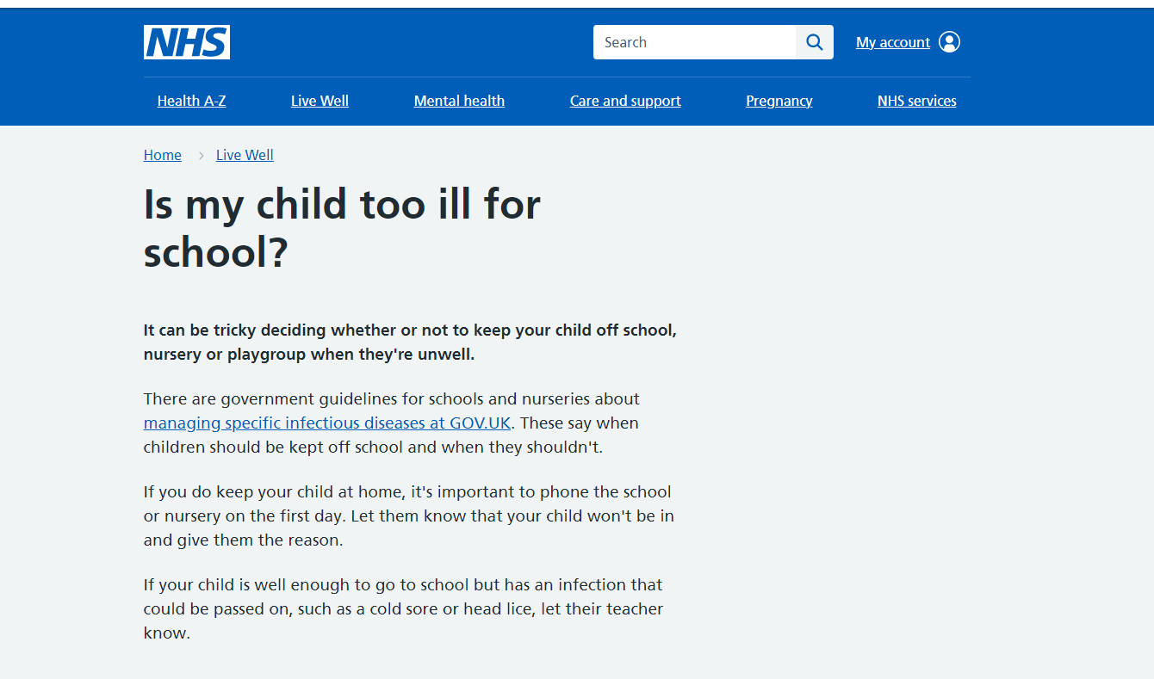

Slide 29
Catching up on missed school work
If students are not well enough to attend school – priority should be for them to rest and return to full health.
Work missed should be completed on return to school and will not be set during illness.
On return to school students can make their teachers aware in lesson or via email. All lessons and resources are available to students on SharePoint.

Slide 30
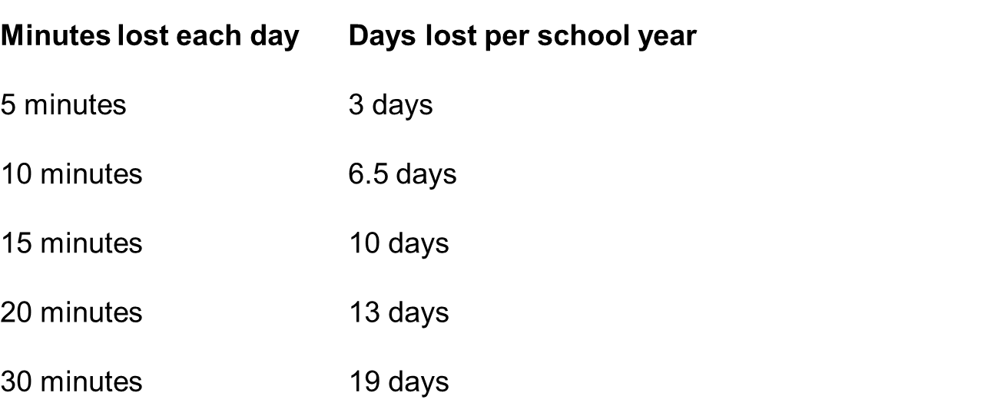
Impact of poor punctuality
Being late 10 mins every day for one year is equal to 33 hours - approximately 6 days!
Notes:
30

Slide 31
Expectations – Punctuality
In form by 8:45am
Lates
  2 in a week Pastoral Detention
  This progresses to afterschool sanctions

Slide 32
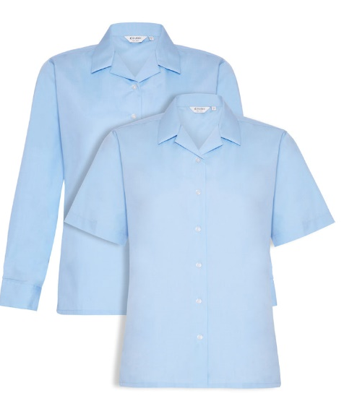



Uniform Reminders
  One pair of plain studs in each ear lobe
  No other jewellery is allowed
  Students can wear a watch
  Socks must be ankle socks
  Students should be wearing a revere collar blouse
  Students can wear a cardigan, but it must be navy blue with pale blue stripes at the cuff
  Extreme hair styles or colours are not permitted
  Students should be wearing a blue or black hair band other colours or accessories are not permitted
  Students should have their phones switched off and in their bags before walking through the school gate

Slide 33
Key School Procedures and Protocols
First aid and Medication
At CCHSG we have first aid trained members of staff who are always on call to deal with first aid issues.
Students should speak to a member of staff who can assist them.
Parents will be contacted to collect their child if needed.
Students must not contact their parent directly as this can cause worry and confusion between staff, students and parents.
If your child has an accident or injury outside of school – contact us so that we can put measures in place to support them.

Slide 34

Policy: Administering school-based Paracetamol
We have acted on parental requests for the school to hold and hand out paracetamol. Parents quite rightly stated that if paracetamol had been administered in school, their child would not have needed to be sent home due to illness.
We have gone through full due diligence checks including legal and medical advice
After this information evening the policy will be sent home to parents detailing our parameters for handing out paracetamol in school.
Parents will need to sign the consent and also give consent at the time, so that we can ascertain if the student has already had paracetamol.
Paracetamol will only be issued four times per term to students
We will only give the correct dosage per age limit
Polite reminder that any other medication needs to come into the school and parents need to sign a medical consent form

Slide 35
Key School Procedures and Protocols
Parent Pay
We operate a cashless system at CCHSG.
All payments are made through the Parent Pay system.
Any items that require payment will be placed on to your account with a description.
If you have any issues with ParentPay please contact the office or our finance department.

Slide 36
Keeping in Touch
Edulink One platform
Weekly bulletin
E-newsletter
Website
Email
Notes in Student Planner
Letter/Telephone
Tell us about achievements outside school

Slide 37


Slide 38



Slide 39
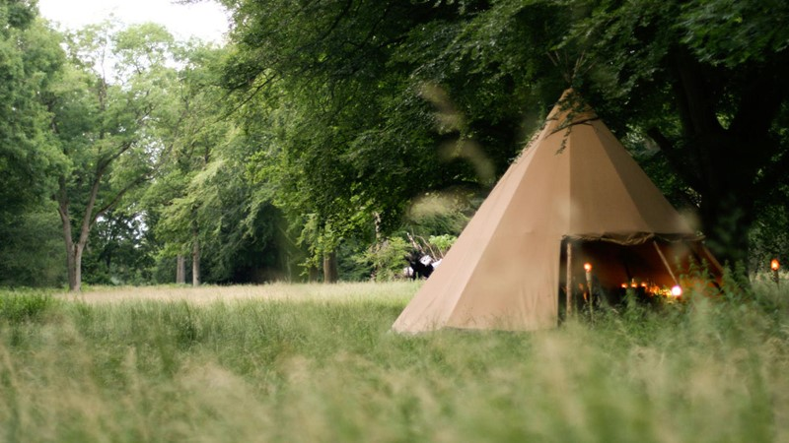

Year 7 Residential Experience
Aims to build teamwork, resilience and wellbeing

Slide 40
Details
3-day residential trip in July – details will be sent out in the coming weeks via Edulink letter.
Location: Boughton Woods, Northamptonshire
All students encouraged to attend

Slide 41
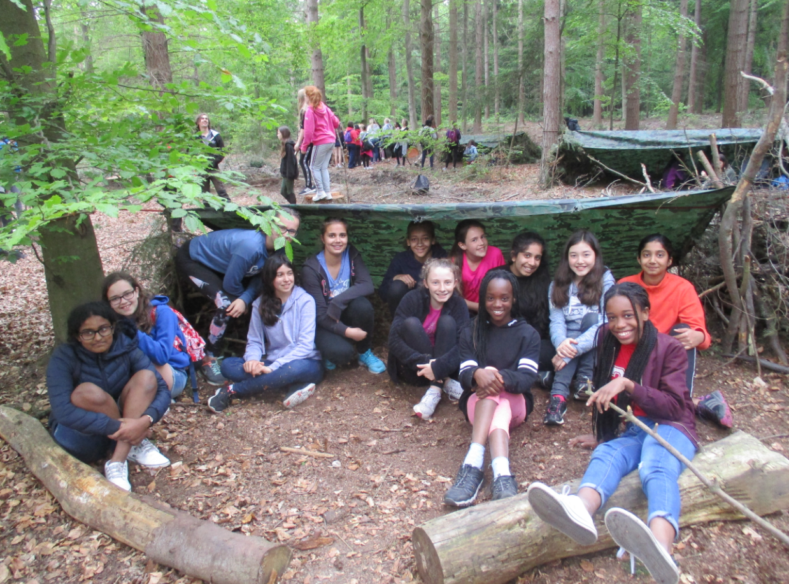
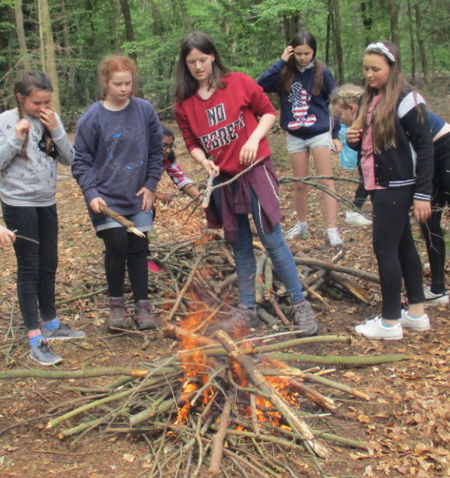
What do students get up to at Bushcraft?
Activities might include:
learning first aid skills
Build and maintain a fire
How to fillet a salmon
Archery
Axe throwing
Building a shelter which many
students choose to sleep in

Slide 42

Thank you for listening
Please refer to your Information Booklet for further detail and if you have any questions contact your Form Tutor

