Slide 1
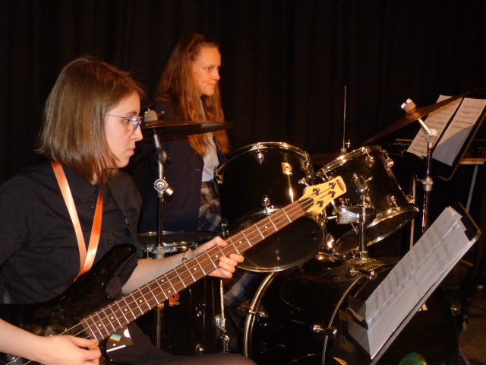
A Level Music
Beyond Music A Level
Why A Level Music?

Slide 2
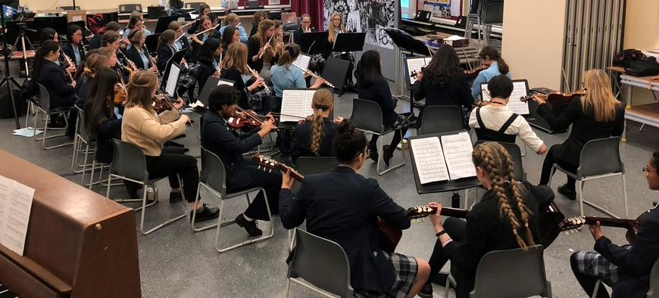
What our A Level Music students say:
Excerpt from an A Level student performance
Music Co-curricular Opportunities & Department Facilities

Slide 3
Further opportunities in Music
School Musical Productions
Concerts both inside and outside school
Recitals and Workshops
Running a club
Lunchtime clubs

