Slide 1
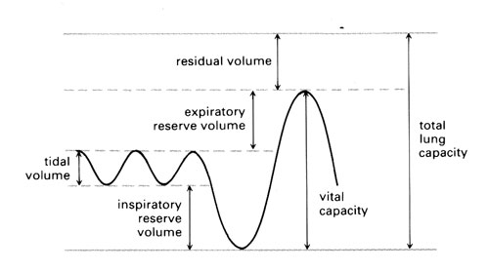
Revision: Interpreting a Spirometer Trace

Slide 2
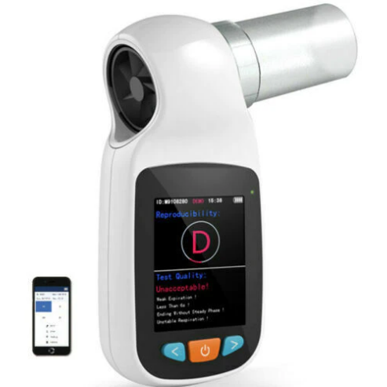
Spirometer
Lung volumes are measured using a spirometer.
This consists of a chamber filled with oxygen that floats on a tank of water.
A person breathes through a mouthpiece and tube connected to the chamber.
Breathing in takes oxygen out of the chamber, which sinks down. Breathing out pushes air into the chamber, causing it to rise up.
During the movements of the chamber, the lung volumes may be seen and measured.

Slide 3
Key Terms
The volume of air inspired or expired/exchanged per breath. The average tidal volume is 0.5 litres (500 ml).
This increases during exercise.
Tidal Volume
The amount of air that could be breathed in after tidal volume during a deep breath in.
This decreases during exercise.
Inspiratory Reserve Volume
The amount of air that could be breathed out after tidal volume during a forcible breath out. This decreases slightly during exercise.
Expiratory Reserve Volume
The volume of air left in the lungs after maximal expiration. This air helps to keep the lungs partially inflated to protect the microscopic structures from being damaged.
No change to this volume during exercise.
Residual Volume

Slide 4
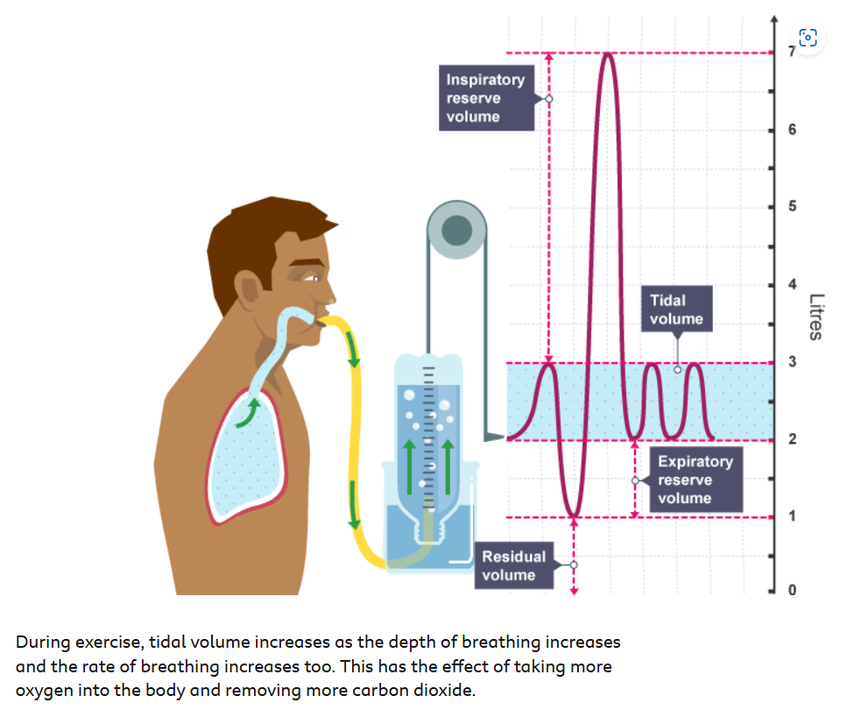
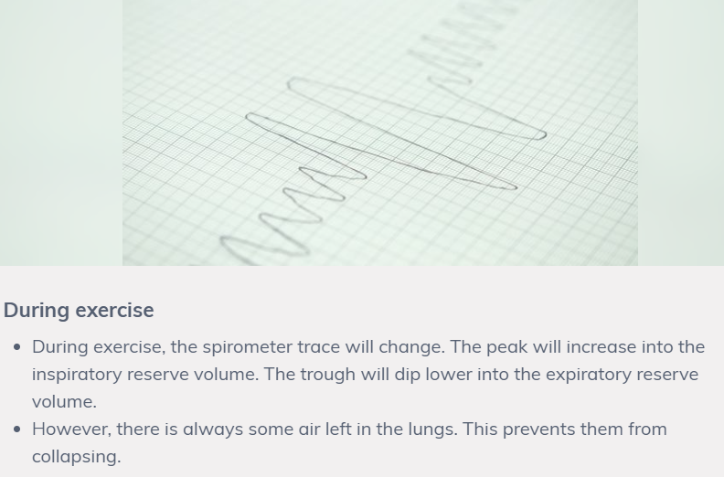
During Exercise

