Slide 1
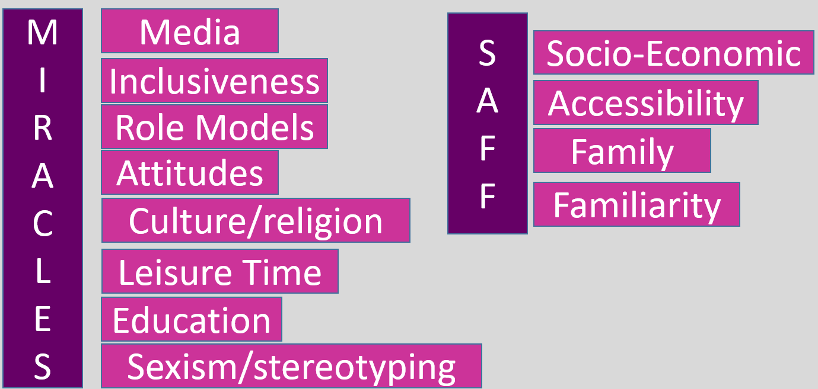
Social Groups: People who interact with one another, share similar characteristics, and have a sense of unity / togetherness.
Engagement Patterns: Trends / tendencies in involvement.
Barrier to participation: An obstacle that prevents a group within society from participating in sport or physical activity and therefore reduces overall levels of participation.
Stereotype: Widely held but fixed and oversimplified idea of a particular type of person e.g. females.
FIVE SOCIAL GROUPS YOU NEED TO KNOW
1) Gender – main focus of women’s participation.
There are a number of barriers that affect participation rates for women:
Stereotypical Views:
Women lack the strength or endurance to play the same sports as men.
Women who play sport are not feminine.
Playing sport prevents a women's ability of giving birth.
Women who play sport develop muscles and become more ‘man like’. This leads to female performers having their sexuality questioned.
A women's role is as a carer and manager of the home.
Due to these stereotypical other barriers have been created which put some women off playing sport. They are:
Male Dominated Culture in Sport:
Women have less media coverage, receive less money and have less role models to look up to.
Support from Peers and Family:
Women get less support from their peers and family. Young girls often need to choose between playing sport or being part of a friendship group, and are put under pressure by their peers to be more like them.
Body Image:
The media portrays women as feminine and objects of desire. Women who choose to play sport do not follow these views and as a result their sexuality is often questioned.
Facilities / Funding:
Facilities for women have developed more slowly than those for men. There are less clubs / sports for women to get involved with. Funding for women's sport is also much less then their male counterparts, however this is gradually improving.
Discrimination: The unjust or prejudicial treatment of different groups of people, especially on the grounds of race, age or gender.
2) Ethnicity
ETHNIC GROUP
A group of people who share common origins – be they racial, religious or cultural
Barriers Affecting Participation
Live in poorer areas in the country – less facilities / lack of money for equipment
Sporting prejudices / stereotypes that already exist e.g. African-Caribbeans are seen to have less swimming ability.
Family commitments resulting in less time to participate in sport.
In many sports there are a lack of role models for black / ethnic people to look up to and aspire to.
Discrimination – Many people don’t take part in sports as they are afraid of being racially abused.
Examples of how ethical issues effects a person’s participation?
Muslim women have to keep their bodies covered up preventing them from doing sports e.g. gymnastics / swimming.
During Ramadan people are not allowed to eat food during daylight hours. This means that during the day they may have little energy when taking part in sports. Also they must eats at night instead of train.
Muslim / Islamic men are expected to pray at there local mosque every day. This reduces the amount of time they can spend playing sport.
5) Family / Friends / Role models
Family
Positive:
Parents will encourage their children to take part in certain sports / activities
Children rely on their parents to get them to the sport / activity.
Parents / brothers or sisters may play a sport which you may watch resulting in you getting involved in.
Negative:
Some parents may not provide support or encouragement due to safety concerns over participation or lack of interest in sport or may have had a negative experience of the sport (earlier in life).
Some parents may pressure young people to concentrate on academic work rather that practical physical activity.
Some parents cannot supply financial support / in the form of equipment or kit / coaching / transport.
Friends
Positives:
People are more likely to play sports / for teams that their friends play for.
Peers / friends often encourage other children to take part in their sport as they understand / appreciate the benefits that can be gained from the activities.
Negatives:
• Peers might not be interested in the activity. As they are not interested / they may encourage friends not to train / take part in sport.
• Verbally pressure friends by saying they are better going out with them or that they will not be their friend.
Role Models
What is a role model? A person looked up to by others as an example to be copied.
Positive:
Encourage people to play sports so by increasing numbers participating.
Their good behaviour can positively effect the behaviour of children who look up to them.
Negative:
Poor behaviour can be seen by children as the correct way to behave.
Can lead to people copying behaviour e.g. taking drugs, swearing at officials.
Socio-cultural influences and Commercialisation
4)Age
All school children participate in sport but when they leave school participation often drop. This is referred to as ‘post-school drop out’
Older people often take part is less sport due to family and work commitments as well economic issues which they might have.
Also as people get older their fitness levels often decline, resulting in participation levels dropping.
3) Disability
A physical or mental condition that limits a person’s movements, senses or activities.
Three main categories of disability:
-Mobility impairments -Sensory impairments -Mental impairments
Having a disability can limit the type of physical activity that you can take part it. Many sports centres nowadays have facilities for disabled people which has led to a increase in opportunities to take part.
What prevents disabled people from taking part in sport?
Lack of facilities in the local area.
Lack of clubs / teams.
Lack of media coverage (apart from when the Paralympics is on)
Knowledge of activities available in local area e.g. advertising.
Post-school drop out: The reduction in participation levels in young adults after they leave full-time education
Integration: Involving the full participation of all people in community life, but usually referring to disabled people.
Adapted Sports: Competitive sports for individuals with disabilities. While they often parallel. Existing sports played by able-bodied athletes, there may be some modifications in the equipment and rules to meet the needs of the participants.
Benefits of Integration
Reduced possibilities of discrimination
Less stereotyping
Fewer barriers

Slide 2
The Golden Triangle: The financial relationship between sport, sponsorship and the media.
Sport, Performer and Spectator
Sport is not shown in the media or is linked to a negative issue e.g. drugs
Sport, Performer and Spectator
Media
Radio, newspapers, magazines, books, internet; major impact through television.
Sports watched or read about by people e.g. home on TV, in the newspaper.
Sponsorship –
a form of advertising to increase sales of a product.
Teams / facilities / performers / events are sponsored by companies so people will see their name / product (increase publicity)
Sport/team/performer
Shown through media.
More money to spend on players / equipment / facilities, resulting in performances increasing in standard.
Spectators
Buy merchandise / sponsors equipment or product and media products.
Sport, team or performer is playing well they receive positive media attention.
Less money to spend on players, equipment and facilities
Sport, Performer and Spectator
Sport, team or performer can afford better facilities, equipment or players
Positive
Negative
Media
Sponsors
Media
Sponsors
Media
Sponsors
Due to media coverage businesses invest in the sport, team or performer
Due to poor media coverage businesses will not invest money in the sport, team or performer
Commercialisation: To manage or exploit (an organisation / activity) in a way designed to make a profit / introducing new products to the market to make a profit (through Sponsorship and media coverage)
How Commercialisation affects the Performer
Positive
Allows athletes to earn income as a full time job.
Performers gain maximum exposure to promote their personal brand.
Can lead to additional roles post playing career within the sport.
Relieves financial worries
Can afford / get higher quality equipment so performance will improve
Facilities, for example could be provided free of charge so can train more effectively / often
Negative
Increased amount of pressure
Encourages deviant behaviour due to the pressure of success. This could result in performers cheating to win.
Generally, favours male over female and able bodied over disabled.
Sponsorship might be short term.
Performers may have to advertise a product that they do not like.
The performer has additional commitments that might detract from training / sponsors may make demands / loss of control;
May have to use equipment from the sponsor that might not be the best;
Any negative publicity may result in a loss of sponsorship e.g. Tiger Woods
How Commercialisation affects the Sport
Positive
Raises the profile of the sport due to increased exposure. This will result in more people wanting to participate.
Change in formats to make them more exciting.
Provides an increased level of funding / income to improve resources, coaching, equipment and facilities.
Gives the sport financial security for a period of time.
Attracts the best players in the world to that sport.
Improvement in coaching opportunities ;
Standards of play / performance improves ;
Create more role models.
Negative
Commercialisation tends to support the popular sports leaving the ‘lesser’ sports to lose out.
If sports are not in the media they do not attract sponsors resulting in less people taking part in the sport
The influence of TV has caused an increase in adverts and TV timings and lost some of sports traditions.
Media influences when games are played.
Lower attendances at events as it is seen on TV.
Negative publicity on a sport e.g. cycling and drugs, means they will struggle for sponsors. This will also lead to less people wanting to play the sport.
How Commercialisation affects the Spectators
Positive
Offers a wider choice of sports available to watch; More opportunities to watch different sports
Better facilities / stadiums to watch the sports.
Viewing experience has been enhanced due to investment into technology and audience participation e.g. large TV screens at games
More exciting games due to more money being placed into a sport.
Due to new rules, more exciting games e.g. 20 / 20 cricket.
More information given allowing in spectators being more knowledgeable.
More role models for them to see.
Negative
Encourages spectating not participating.
Can become very expensive for fans/spectators. E.g. ticket prices, pay for view events, merchandise.
Matches can be played at times / places inconvenient for some people.
Can affect viewing experience due to increased TV breaks and time outs.
Media coverage can promote events leading to problems accommodating all of those who wish to attend e.g. difficult
to get tickets for FA Cup Final or Wimbledon finals.
Media coverage can decrease the number of people attending because
they can watch it in comfort at home/ e.g. large number of live football
matches on TV on Sunday and Mondays or more televised rugby union.
Five Ways Technology is used
Making Decisions: Officials will use decision making technology to prevent wrong decisions, eg Hawkeye in tennis
Enhance Performance: Performance can allow for enhanced performance through heart rate monitors, monitoring diet / calorie counter
Analysing Performance: Analysis of performance can allow photos / videos / biomechanics
Rehabilitation: Rehabilitation through ice baths, hypoxic tents
Safety Reasons: Safety implications relating to cycle helmets, goal keeper protection in hockey
Impact of Technology on Spectators
Creates excitement for the audience whilst they wait on decisions so it is a positive
Audience can join in / interactive element by cheering / clapping / creates atmosphere
Can frustrate spectators who do not like waiting or feel the entertainment has been interrupted
Prevents unruly behaviour / hooliganism as the decision has been made by technology / less controversial
Makes the event last longer / more value for money • Less likely to criticise officials
Performers recover quicker so spectators get to see their favourites more often
Spectators can get involved in the analysis of their favourite performers, eg statistics / performance analysis
Technology enhanced performers can perform to a higher standard which audiences will enjoy
Impact of Technology on Performers
Greater care and support through the use of technology / prolonged career
Quicker recovery rate means less time on the treatment table / more time performing
Better understanding about their performance
Over reliance on technology to understand performance / recovery is a negative
Less frustrated with the official as the decision has been reviewed / proved / fairer outcome for the performers
Reliance on technology to keep up with other competitors can cost money
Easier to analyse competitors
Impact of Technology on Officials
Help make the correct decisions and ensure fairness.
Take the pressure off having to make a decision and can ease the tension of players and spectators.
Takes away a part of the referees job and can undermine decisions made.
Impact of technology on the Sport
Introduction of technology into the sport itself can make it more interesting and attract a larger audience and in turn bigger sponsorship deals.
How Commercialisation affects the Officials
Positive
Due to large media involvement and investment in some sports, officials have been able to become professional.
Negatives
Increased scrutiny on decisions made, which can result in them getting criticism leading to increased pressure and potentially being dropped / losing their job.

