Slide 1
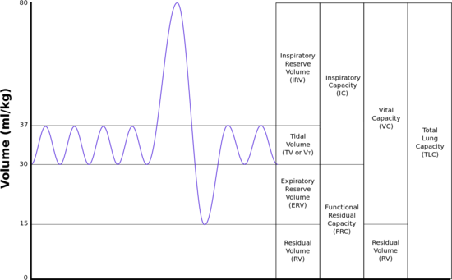
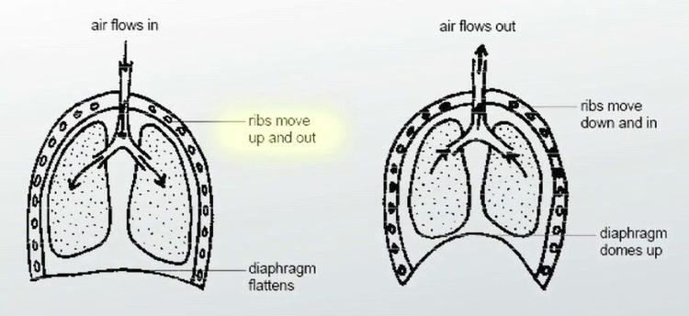
Function:
to bring oxygen into the body and remove carbon dioxide.
Alveoli:
These are small air sacs found in the lungs.
This is were gaseous exchange takes place within the respiratory system.
Oxygen enters the blood stream to be sent to the heart.
Carbon dioxide replaces the oxygen (exchanged) in the alveoli so that it can be removed from the body.
Key features of the Alveoli:
Alveoli walls are only one cell thick and are moist – easy to exchange gases
They are very small, however their are millions within the lungs – large surface area
Covered with huge network of capillaries – constant blood supply
Aerobic Respiration (exercise):
Energy is created with the presence of oxygen.
Used for low intensity, long duration activities.
Very effective method of producing energy. However the process is slow and gradual, much slower than anaerobic.
Key Terms:
Respiratory rate - breathes per minute
Tidal volume – amount of air inhaled / exhaled per breath
Minute Volume= Respiratory Rate x Tidal Volume– amount of air inhaled per minute
Residual volume = the volume of air that remains in the lungs after maximal expiration.
Expiratory reserve volume (ERV) = the additional air that can be forcibly exhaled after the expiration of a normal tidal volume.
Inspiratory reserve volume (IRV) = the additional air that can be forcibly inhaled after the inspiration of a normal tidal volume.
Anaerobic Respiration (exercise):
Energy is created without the presence of oxygen.
This is not an efficient process as it produces 1/20th as much energy as aerobic respiration.
However the process is three times as quick so energy can be produced for high intensity (explosive) activities performed over a short period of time.
After a short period of time performance drops as lactic acid builds up, resulting in oxygen debt.
Spirometer Trace
Oxygen Debt
The amount of oxygen needed to break down the lactic acid within the body.
Lactic acid is produced due to the body not having enough oxygen to break down the glucose. This means that the glucose is only partially broken down.
Oxygen is paid back when the performer has stopped working
Respiratory System
Inspiration / Expiration
Inspiration (How we breathe in):
The diaphragm contracts and flattens.
The intercostal muscles contract which causes the rib cage to rise.
Both these actions cause the chest cavity to increase in size / volume.
This reduces the pressure in the chest cavity, due to this the air passes from the higher pressure outside of the lungs to the lower pressure inside the lungs.
This causes the lungs to expand and fill the chest cavity
Expiration (How we breathe out):
The diaphragm relaxes and bulges up, returning to its original dome shape.
The intercostal muscles also relax causing the ribs cage to lower.
Both these actions cause the chest cavity to decrease in size / volume.
The reduction in the size of the chest cavity increases the pressure of the air in the lungs and causes it to be expelled.
The air passes from the high pressure in the lungs to the low pressure in the bronchi and trachea.
During Exercise the following happens:
Respiratory rate - Increases
Tidal volume – increases
Minute Volume= increases
Residual volume = stays the same.
Expiratory reserve volume (ERV) = decreases
Inspiratory reserve volume (IRV) = decreases
Exam Example:
11) As soon as we start to exercise our breathing rate and depth of breathing increases.
(a) Explain two reasons why the respiratory system responds in this way when
beginning exercise.
1. Explanation 1: Increased/more demand for oxygen (1) to supply (working) muscles/because need (more) energy for exercise/removal of lactate/removal of lactic acid (1)
2. Explanation 2: More carbon dioxide is produced during exercise (1) therefore there is an increased need to remove carbon dioxide (1)
Additional muscles used during inspiration and expiration during exercise:
During inspiration:
When exercising the PECTORALS and STERNOCLEIDOMASTOID muscles contract assisting the performer inhale air. These allow the chest cavity to further increase in size (have a larger volume) so more air can enter the lungs.
During expiration:
When exercising the ABDOMINAL muscles contract assisting the performer exhale air. They help force air out of the lungs faster and so speed up expiration.

Slide 2
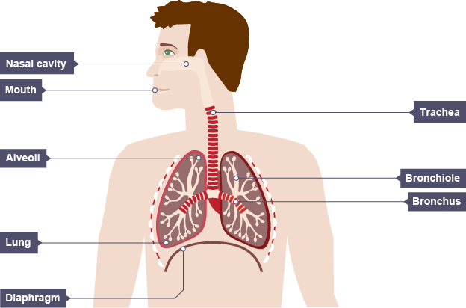
The Pathway of Air into the Body
When we breathe in, air moves through the mouth and nose.
It then travels down the trachea. The inner surface of the trachea is covered in tiny hairs called CILIA, which catch particles of dust. The trachea is kept open by RINGS OF CARTILAGE.
Near the lungs the trachea divides into two tubes called bronchi (one enters left lung and the other the right).
Once in the lungs the bronchi split into smaller bronchi before dividing into even smaller tubes called bronchioles.
At the end of each bronchiole are openings to the alveoli. There are usually several alveoli coming from one bronchiole, forming a little clump that resembles a cluster of grapes.
At the alveoli gaseous exchange occurs. Capillaries carrying blood surround each alveoli resulting in oxygen being passed into the bloodstream from the alveoli in exchange for carbon dioxide which passes from the blood stream into the alveoli.

