Slide 1
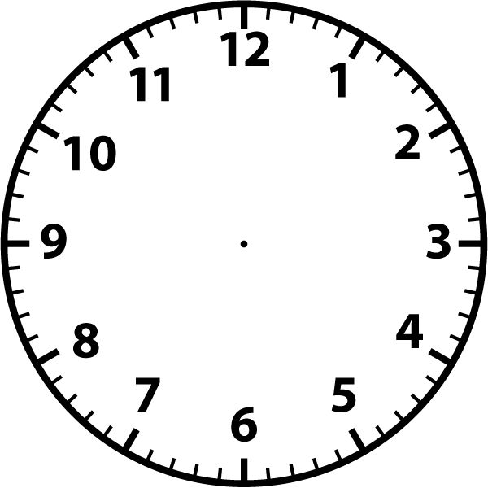
What is the definition of a skill?
Give 3 examples of a skill
What is the definition of an ability?
Give 3 examples of an ability
Describe the skill classifications of open V closed
Name 3 examples of a gross skill
Name 3 examples of an externally paced skill
Classification of Skills
Describe the skill classifications of gross V fine
Name 3 examples of an open skill
Name 3 examples of a closed skill
Name 3 examples of a self paced skill
Name 3 examples of an externally paced skill
Describe the skill classifications of self paced V externally paced
Name 3 examples of a basic skill
Name 3 examples of a complex skill
Describe the skill classifications of basic V complex

Slide 2
Describe a performance goal
Describe an outcome goal
In a sporting activity of your choice give an example of a performance and outcome goal
What type of goal should a beginner avoid and justify why?
S
M
A
R
T
In a sporting example of your choice, apply SMART to a specific target linked to the sport
What do you understand by the acronym SMART?
  Goal setting and SMART targets
Describe ‘S’ from the acronym SMART
Describe ‘T’ from the acronym SMART
Describe ‘R’ from the acronym SMART
Describe ‘A’ from the acronym SMART
Describe ‘M’ from the acronym SMART

Slide 3
What are the four stages of the information processing model?
Describe the first stage of the information processing model
Describe the second stage of the information processing model
What do you understand by the term selective attention?
  Basic Information Processing Model
In a sporting activity of your choice, describe the four stages of the information processing model making clear reference to a specific skill
Describe the third stage of the information processing model
Describe the fourth stage of the information processing model
What are the two types of feedback?

Slide 4
What are the four types of guidance?
Describe one type of guidance?
Describe a second
type of guidance
What types of guidance are most suited to beginners and elite athletes? Justify your answers
  Types of
  Guidance
In a sporting activity of your choice, describe how all four types of guidance could be used
Describe a third type of guidance
Describe a fourth type of guidance

Slide 5
Describe intrinsic feedback
Give an example
Describe extrinsic feedback
Give an example
Describe positive feedback
Give an example
Is this suitable for a beginner? Justify your answer
Is this suitable for a beginner? Justify your answer
Is this suitable for a beginner? Justify your answer
  Types of
  Feedback
Is this suitable for a beginner? Justify your answer
Is this suitable for a beginner? Justify your answer
Describe knowledge of performance
Give an example
Describe knowledge of results
Give an example
Is this suitable for a beginner? Justify your answer
Describe negative feedback
Give an example

Slide 6
What is the definition of arousal?
Draw the inverted U theory.
Correctly labelling X axis as the arousal level and Y axis as the performance level
Describe the inverted U theory
  Arousal Levels & Stress Management Techniques
Skill | Arousal Level
Rugby tackle
Putting in golf
Lay up in basketball
Throwing a dart
Shot putt
Smash shot in badminton
In the skills named above, state whether they would need high or low levels of arousal, dependent on whether they are gross or fine skills
Name and describe the 3 stress management techniques used to control arousal

Slide 7
What is the difference between direct and indirect aggression? Use specific definition
Name 2 examples of direct aggression from a sporting activity of your choice
Name 2 examples of indirect aggression from a sporting activity of your choice
What are the two personality types known as?
What do you understand by the terms tangible and intangible?
Name 3 characteristics of one of the personality types
  Mental Preparation for Sport
Describe both types of motivation
Name 3 characteristics of the second personality type
Which is the most important type of motivation and why?
Name 3 sporting activities the second personality type might participate in
Name 3 sporting activities one of the personality types might participate in
What do you understand by the term motivation?
What are the two types of motivation?

Slide 8
Race
Family, friends & peers
Disability
  Engagement Patterns
State 10 social groups that may be affected from participating in sport
Gender
Age

Slide 9
Role models
Accessibility
Media Coverage
Sexism
Adaptability
Culture
  Engagement Patterns
Attitudes
Family Commitments
Socio-Economic Factors
Education
Familiarity
Leisure Time

Slide 10
Describe commercialisation
Sketch the golden triangle and label the 3 points
Define the term sponsorship
Name 3 types of sponsorship
Define the term media
Name 5 types of media
Positive & negative impacts of sponsorship & media on:
Performer
Sport
Official
Spectator/audience
Sponsor
Positive & negative impacts of sponsorship & media on:
Performer
Sport
Official
Spectator/audience
Sponsor
  Commercialisation
 | Positive | Negative
Performer
Sport
Official
Spectator/ audience
Sponsor
 | Positive | Negative
Performer
Sport
Official
Spectator/ audience
Sponsor

Slide 11
Pros and Cons of taking PEDs
Blood Doping
Pros Cons
Peptide Hormones
Beta Blockers
PEDs
For each PED state what it is, who might use it, reasons for using it and the side effects
Diuretics
Stimulants
Anabolic agents
Narcotic Analgesics

Slide 12
Describe the term etiquette
Give an example from the sporting activity of cricket
What are the positive impacts of having spectators at sporting events?
Why does hooliganism occur at sporting events?
Describe the term sportsmanship
Give a sporting example from the sporting activity of tennis
  Conduct of Performers
Describe the term gamesmanship
Give a sporting example from the sporting activity of tennis
What strategies are employed to combat hooliganism at sporting events?
Describe the term contract to compete
Give a sporting example from the sporting activity of netball
What are the negative impacts of having spectators at sporting events?

Slide 13
What impact would sports participation have on your physical health ad wellbeing?
What impact would sports participation have on your fitness?
  Physical, Social & Mental Health, Wellbeing & Fitness
What impact would sports participation have on your mental health and wellbeing?
What impact would sports participation have on your social health and wellbeing?

Slide 14
Define a sedentary lifestyle
Which somatotype would be most suited to sumo wrestling? Justify your answer
Which somatotype would be most suited to swimming? Justify your answer
Which somatotype would be most suited to high jump? Justify your answer
Label the 3 shapes
Name 5 consequences of leading a sedentary lifestyle
  Consequences of a Sedentary Lifestyle
Define obesity
Name the three somatotypes
Obesity and it’s effect on performance
Obesity and it’s effect on physical health
Obesity and it’s effect on mental health
Obesity and it’s effect on social health

Slide 15
How many calories should a male consume on a daily basis?
How many calories should a female consume on a daily basis?
Name 5 reasons why your calorie intake might change
Name the 5 components of a balanced diet
What % should be consumed of the following components?
Carbohydrates
Fats
Proteins
What is energy measured in?
  Diet, Nutrition & Hydration
What are the consequences of dehydration?
Why are carbohydrates important to a performer’s diet?
Why are vitamins and minerals important to a performer’s diet?
Define dehydration
Why are fats important to a performer’s diet?
Why is protein important to a performer’s diet?

