Slide 1
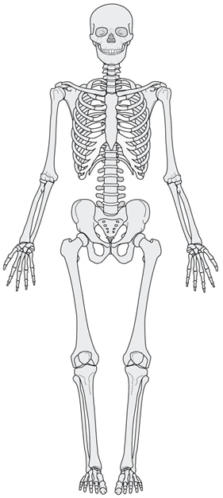
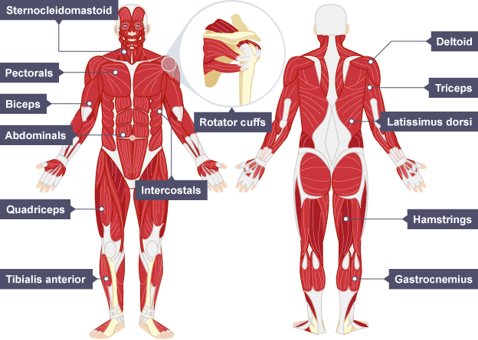
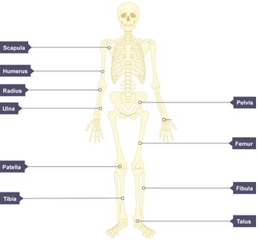
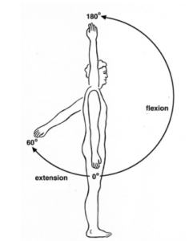

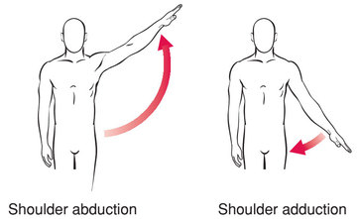
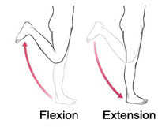
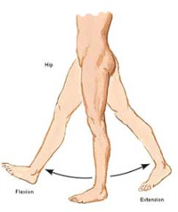
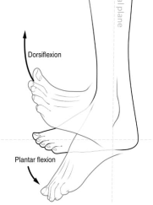
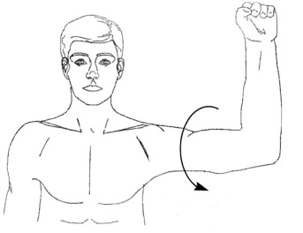
Cranium
Scapula
Sternum
Humerus
Ribs
Ulna
Vertebrae
Radius
Pelvis
Femur
Patella
Gluteals
Tibia
Fibula
Talus
Hip Flexors
Types of Muscle Contraction
Isotonic Contractions
These contractions occur when there is movement of the body. The ends of the muscles move closer together to cause the movement.
Isometric Contractions
This type of contraction takes place when the body is being held in the same position. The length of the muscle during these contractions stays the same length.
Isotonic Concentric Contraction occurs when the muscle shortens e.g. biceps contracting concentrically during the upwards phase of a bicep curl / triceps contracting concentrically during the upwards phase of a press-up
Isotonic Eccentric Contraction occurs when the muscle lengthening (antagonist) is under tension. An eccentric contraction provides the control of a movement on the downward phase and it works to resist the force of gravity e.g biceps contracting eccentically when lowering the weight in a bicep curl / triceps contracting eccentically during the downwards phase of a press-up.
Flexion and extension at the shoulder
- The Deltoid causes flexion at the shoulder
- The Latissimus dorsi causes extension at the shoulder
Flexion and extension at the elbow
- The Biceps cause flexion at the elbow
- The Triceps cause extension at the elbow
Flexion and extension at the knee
- The Hamstrings cause flexion at the knee
- The Quadriceps cause extension at the knee
Flexion and extension at the hip
- The Hip Flexors cause flexion at the hip
- The Gluteals cause extension at the hip
Flexion and extension at the ankle
- The Tibialis Anterior causes dorsiflexion at the ankle
- The Gastrocnemius cause plantar flexion at the ankle
Abduction and Adduction at the shoulder
- The deltoid causes abduction at the shoulder
- The Pectorals / Latissimus Dorsi cause adduction at the shoulder
Rotation of the Shoulder
- The Rotator Cuff causes rotation at the shoulder

Slide 2
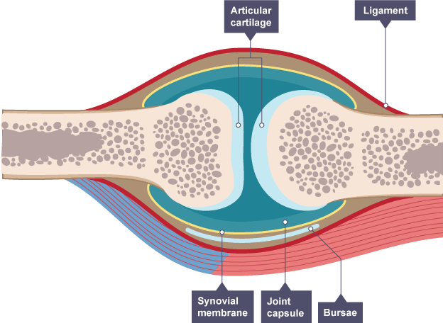
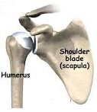
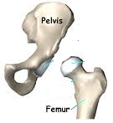
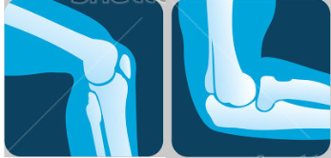
Function of the Skeleton
Support: the bones are solid and rigid. They keep us upright and hold the rest of the body – the muscles and organs – in place.
Movement: the skeleton helps the body move by providing anchor points for the muscles to pull against.
Structural shape and points for attachment: the skeleton gives us our general shape such as height and build. The skeleton also provides anchorage points for the muscles to attach via tendons, so when muscles contract movement occurs.
Protection: certain parts of the skeleton enclose and protect the body’s organs from external forces e.g. the brain is inside the cranium. This function is especially important in activities that involve contact. E.g. rugby, boxing.
Production of Blood Cells: the bone marrow in long bones and ribs produce red and white blood cells.
Mineral Storage: bones store several minerals e.g. calcium, which can be released into the blood when needed.
Types of Bones
FLAT bones protect vital organs e.g. cranium protects your brain, ribs protect heart and lungs.
LONG bones enable gross (large) movements e.g. femur, tibia and fibula in the leg which allow us to run, humerus, radius and ulna in arm which allows us to throw a ball.
SHORT bones enable fine (small) movements e.g. fingers allowing you to spin a cricket ball.
Types of Bones
FLAT bones protect vital organs e.g. cranium protects your brain, ribs protect heart and lungs.
LONG bones enable gross (large) movements e.g. femur, tibia and fibula in the leg which allow us to run, humerus, radius and ulna in arm which allows us to throw a ball.
SHORT bones enable fine (small) movements e.g. fingers allowing you to spin a cricket ball.
Bones Located at Joints
Head and Neck = Cranium and Vertebrae
Shoulder = Scapula and Humerus
Chest = Ribs and Sternum
Elbow = Humerus, Radius, Ulna
Hip = Pelvis, Femur
Knee = Femur, Tibia, Patella
Ankle = Tibia, Fibula, Talus
How do MUSCLES WORK?
Muscles can only PULL they cannot push. This means that they must work in pairs to allow parts of the body to move back and forth. THESE PAIRS ARE CALLED ANTAGONISTIC PAIRS.
Antagonistic Pairs
A muscle must work in partnership with another muscle to allow movement to occur.
The muscle that causes the movement (the pulling muscle) is called the AGONIST or PRIME MOVER. When this muscle contracts in becomes shorter.
During this time the other muscle within this partnership is relaxing. This muscle is called the ANTAGONIST and is lengthening while it relaxes.
EXAMPLES:
When we flex our elbow the bicep is the agonist and the tricep is the antagonist. However these roles are reversed when the elbow extends ,with the tricep becoming the agonist and the bicep becoming the antagonist.
When dorsiflexion occurs in our ankle the tibialis anterior is the agonist and the gastrocnemius is the antagonist. However these roles are reversed when plantar flexion occurs at the ankle, with the gastrocnemius becoming the agonist and the tibialis anterior becoming the antagonist.
Synovial Joints
Synovial Fluid
Musculo-skeletal System
Types of Joint
Ball and Socket Joint
Tendon
Location in Body: Shoulder and Hip
Type of Movement Allowed by Joint: Flexion, Extension, Adduction, Abduction, Rotation
Ligaments
Attaches bone to bone to keep the joint stable eg knee when kicking the ball or restricts movement/prevents movement to stop injury.
Cartilage
Found between bones and prevents friction by stopping the bones from rubbing together.
Synovial Membrane
Secrets synovial fluid.
Synovial Fluid
Is produced by the synovial membrane and helps lubricate the joint.
Joint Capsule
This is lined with synovial membrane. It encloses the joint making sure the cartilage and synovial fluid remain in place.
Bursae
Fluid filled sac providing cushion between bones and tendons. This stops friction at the joint.
Tendons
Attach muscle to bone. When a muscle contracts to move a joint, it is the tendon which pulls on the bone, keeps muscles/bones stable or holds join in place.
BICEPS | TRICEPS
HAMSTRINGS | QUADRICEPS
GASTROCNEMIUS | TIBIALIS ANTERIOR
HIP FLEXORS | GLUTEALS
DELTOID | LATISSIMUS DORSI
Hinge Joint
Femur
Humerus
Radius
Patella
Knee
Ulna
Elbow
Location in Body: Knee and Elbow
Type of Movement Allowed by Joint: Flexion and Extension
Fibula
Tibia

