Slide 1
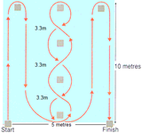

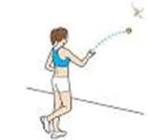
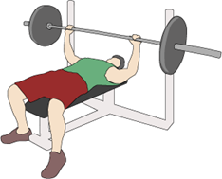
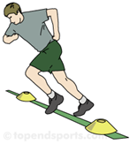
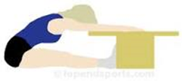
FITNESS TESTING REVISION

Slide 2
Reasons for Fitness Testing
Fitness Testing
There are tests for each type of fitness. Fitness testing measures a performer's ability and is beneficial to both the performer and the coach in highlighting areas for improvement.
To identify strengths and or weaknesses in a performance.
To evaluate the success of a training programme.
To monitor improvement, e.g. in strength.
To show a starting level of fitness.
To inform training requirements.
To compare against norms of the group/national averages.
To motivate and sets goals.
To provide variety to a training programme.

Slide 3
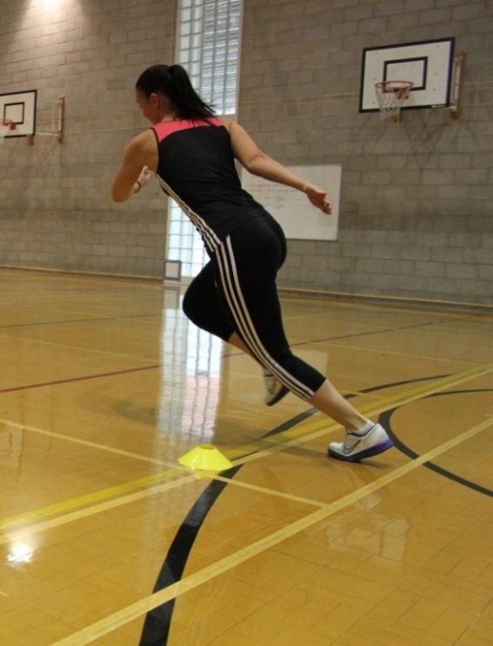
Multi Stage Fitness Test for Cardiovascular Endurance (Aerobic Power)
This test is an indication of a performer’s Cardiovascular endurance and can be used to estimate VO₂ max.
Normative data for Ages 14-16:
Protocol:
20 metre distance to be marked out with cones.
Athlete must arrive at the cone before the beep and wait. On the beep the athlete can resume running. The level and number of shuttles are recorded.
 | Men (level/shuttle) | Women (level/shuttle)
Excellent | L12 S7 and > | L10 S9 and >
Above average | L11 S2 | L9 S1
Average | L8 S9 | L6 S7
Below average | L7 S1 | L5 S1
Poor | < L6 S6 | < L4 S7
Notes:
Photo: © PE Resources Bank

Slide 4
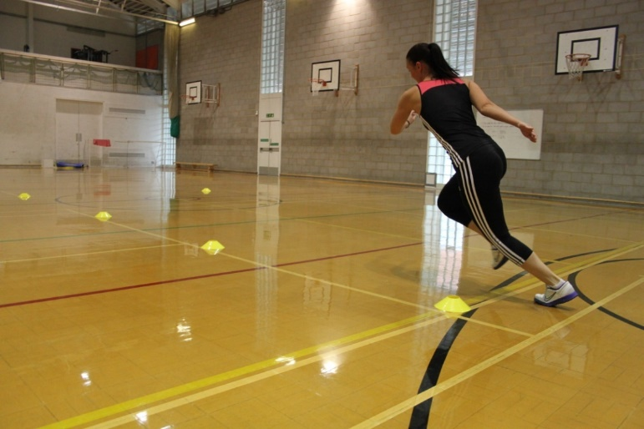
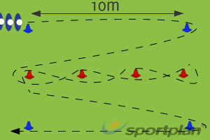
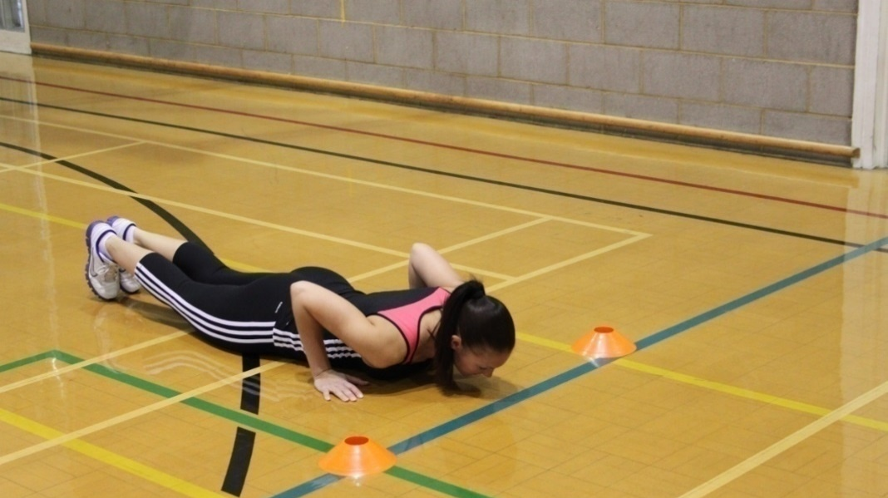
Illinois Agility Test for Agility
Measures the agility of the performer as well as speed.
Protocol:
Performers start at the first cone. On the whistle pupils should follow the course in the diagram and finish at the end cone. Performers are timed from start to finish.
Normative data for 16-19 Year olds :
Gender | Excellent | Above Average | Average | Below Average | Poor
Male | <15.2 secs | 15.2 - 16.1 secs | 16.2 - 18.1 secs | 18.2 - 19.3 secs | >19.3 secs
Female | <17.0 secs | 17.0 - 17.9 secs | 18.0 - 21.7 secs | 21.8 - 23.0 secs | >23.0 secs
Notes:
Photo: © PE Resources Bank
Diagram: © Sportplan

Slide 5
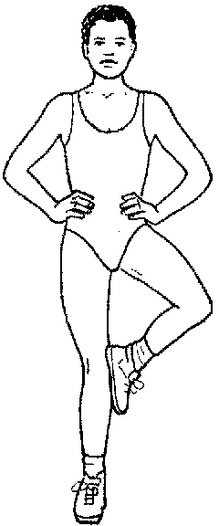
Stork Balance Test for Balance
Measures the development of the athlete's ability to maintain a state of equilibrium (balance) in a static position.
Protocol:
Athlete lifts the right leg, places the sole of the right foot against the side of the left kneecap. The athlete raises the heel of the left foot to stand on their toes.
The athlete is timed holding this position for as long as possible.
Rating | Males (seconds) | Females (seconds)
Excellent | >50 | >30
Above Average | 41-50 | 23-30
Average | 31-40 | 16-22
Below Average | 20-30 | 10-15
Poor | <20 | <10
Normative data for 16-19 year olds:
Notes:
Photo: © PE Resources Bank

Slide 6

Wall toss test for Coordination
The test is designed to monitor the ability of the athlete's vision system to coordinate the information received.
Protocol:
Athlete is to stand 2 metres from a wall.
A tennis ball is thrown with their right hand against the wall and caught with the left hand. The ball is then thrown with the left hand and caught with the right hand.
This cycle of throwing and catching is repeated for 30 seconds. The number of catches is recorded.
Normative data:
Age | Excellent | Above Average | Average | Below Average | Poor
15-16 years | >35 | 30 - 35 | 25 - 29 | 20 - 24 | <20
Notes:
Photo: © PE Resources Bank

Slide 7
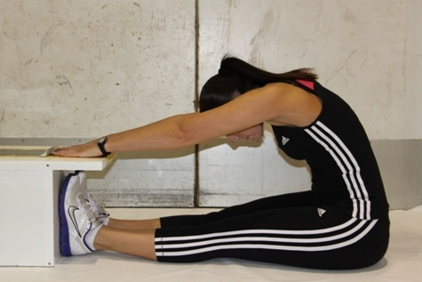
Sit and Reach Test for Flexibility
Measures the range of movement at the hips/torso.
Protocol:
Legs straight with feet touching the box.
Push marker as far as possible without bending your knees.
Normative data for a sit and reach test for 16-19 year olds:
Gender | Excellent | Above average | Average | Below average | Poor
Male | >14 | 11 - 14 | 7 - 10 | 4 - 6 | <4
Female | >15 | 12 - 15 | 7 - 11 | 4 - 6 | <4
Notes:
Photo: © PE Resources Bank

Slide 8
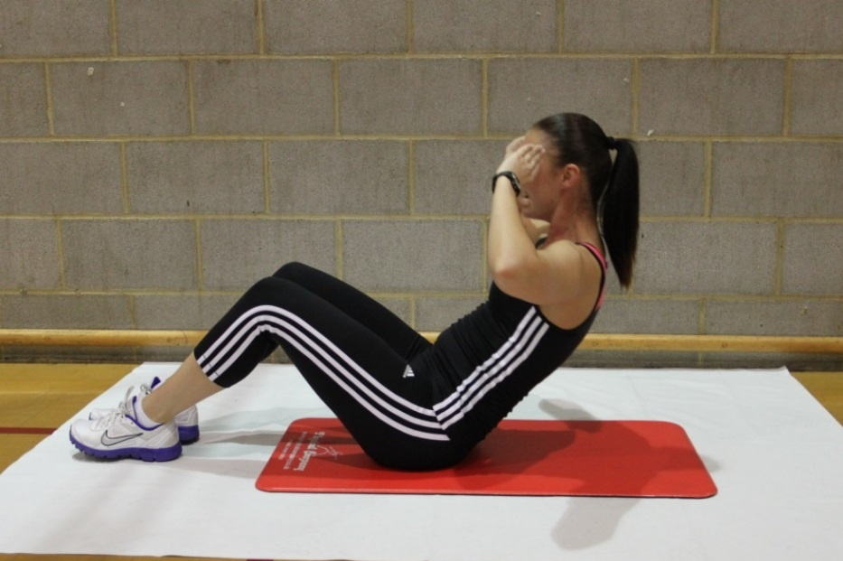
Sit-Up Bleep Test for Muscular Endurance
The sit-up bleep test assesses muscular endurance of the abdominals.
Protocol:
Athlete performs sit ups in time with the bleep test signals to the point of exhaustion.
The level of fitness reached depends on the level reached.
Normative data 16-19 year olds:
Stage | Number of sit ups Cumulative | Male | Female
1 | 20 | Poor | Poor
2 | 42 | Poor | Fair
3 | 64 | Fair | Fair
4 | 89 | Fair | Good
5 | 116 | Good | Good
6 | 146 | Good | Very Good
7 | 180 | Very Good | Excellent
8 | 217 | Excellent | Excellent
Notes:
Photo: © PE Resources Bank

Slide 9
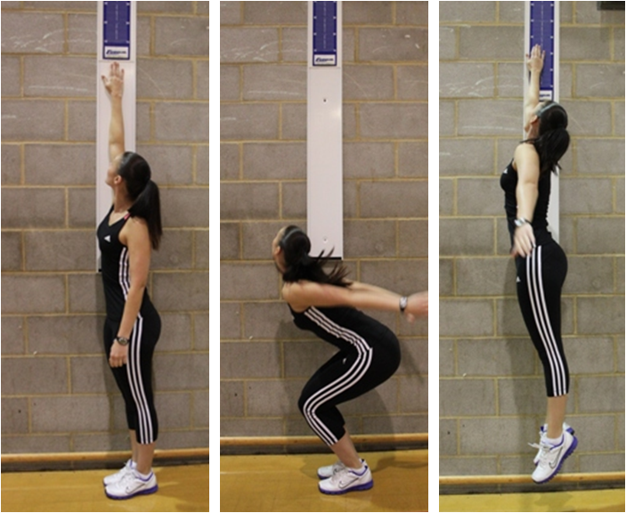
Vertical Jump Test for Power/Explosive Strength
Protocol:
Performers to reach up to highest point without going onto tiptoes.
Jump vertically and touch highest point on the wall/board.
The score is the difference between the 2 measurements
Normative data for 16-19 year olds:
Gender | Excellent | Above average | Average | Below average | Poor
Male | >65cm | 50 - 65cm | 40 - 49cm | 30 - 39cm | <30cm
Female | >58cm | 47 - 58cm | 36 - 46cm | 26 - 35cm | <26cm
Notes:
Photo: © PE Resources Bank

Slide 10
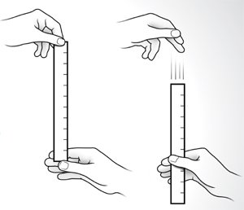
Ruler Drop Test for Reaction Time
The ruler drop test monitors an athlete's reaction time to a stimulus.
Protocol:
A ruler is held by the assistant between the outstretched index finger and thumb of the athlete's dominant hand.
Ensure the top of the thumb is level with the zero centimetre line on the ruler.
Ruler is released and measurement (cm) is taken from the point caught on the ruler.
Normative data for 16-19 year olds:
Excellent | Above Average | Average | Below Average | Poor
<7.5cm | 7.5 - 15.9cm | 15.9 - 20.4cm | 20.4 - 28cm | >28cm
Notes:
Photo: © PE Resources Bank

Slide 11
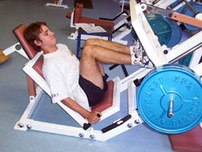
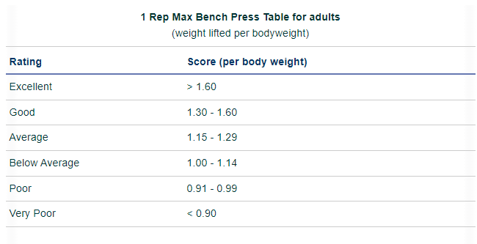
One Rep Max Test for Maximal Strength
This test measures the maximum strength of various muscle groups.
Protocol:
Athlete should attempt to perform one full repetition of the stated exercise at the highest possible weight.
The weight should be recorded.
1RM divided by body weight
Notes:
Photo: © http://www.topendsports.com/testing/tests/1rm.htm

Slide 12
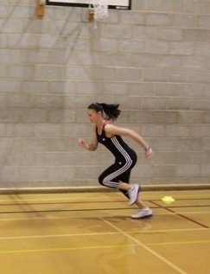
30m Sprint Test for Speed
Protocol:
Performers to cover a straight 30m from a standing start.
The time taken should be accurately recorded.
Normative data 16-19 year olds:
Time to run 30 meters (in seconds)
Rating | Men | Women
Very good | < 4.80 | < 5.30
Good | 4.80 - 5.09 | 5.30 - 5.59
Average | 5.10 - 5.29 | 5.60 - 5.89
Fair | 5.30 - 5.60 | 5.90 - 6.20
Poor | > 5.60 | > 6.20
Notes:
Photo: © PE Resources Bank

Slide 13
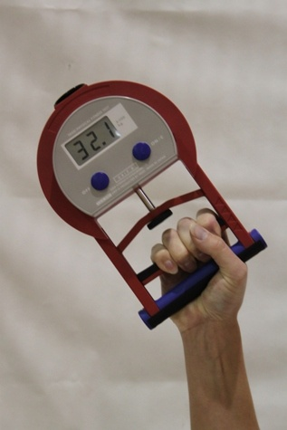
Hand Grip Dynamometer for Strength
Measures the strength of the performer hand grip strength in one action.
Protocol:
Start with your hand up and bring down to side while pulling in handle.
Do not swing your hand.
Normative data 16-19 year olds:
Gender | Excellent | Good | Average | Fair | Poor
Male | >56 | 51-56 | 45-50 | 39-44 | <39
Female | >36 | 31-36 | 25-30 | 19-24 | <19
Notes:
Photo: © PE Resources Bank

Slide 14
Use of test data
All the fitness tests provide which can be compared to . These normative scores are indicators of how the participant has performed in comparison to the general population. Fitness tests are only relevant when the scores are compared to normative data.
However, highly trained athletes may find that normative comparisons are no longer relevant to their own progress. An athlete such as Katarina Johnson-Thompson will only be interested in how her fitness data compares to other athletes and specifically to her own previous fitness test performances. As a result, Katarina’s ongoing fitness can be tracked and action can be taken exactly when and where it is needed most.
Validity and reliability
With all of these tests it is essential to judge both the validity and reliability of the process.
Validity refers to the test measuring what is claimed to measure. It is difficult to justify whether the handgrip dynamometer test measures whole body strength rather than just lower arm and hand strength. Likewise, the multi-stage fitness test is a more appropriate test for distance runners compared to swimmers or cyclists as the test involves running.
Reliability requires that the test should produce similar results each time the test is taken unless there has been a significant change in the fitness level of the participant. It is essential that fitness tests be completed with the scientific found in experimental practices, especially with regard to the accuracy of timing and measurement.

Slide 15
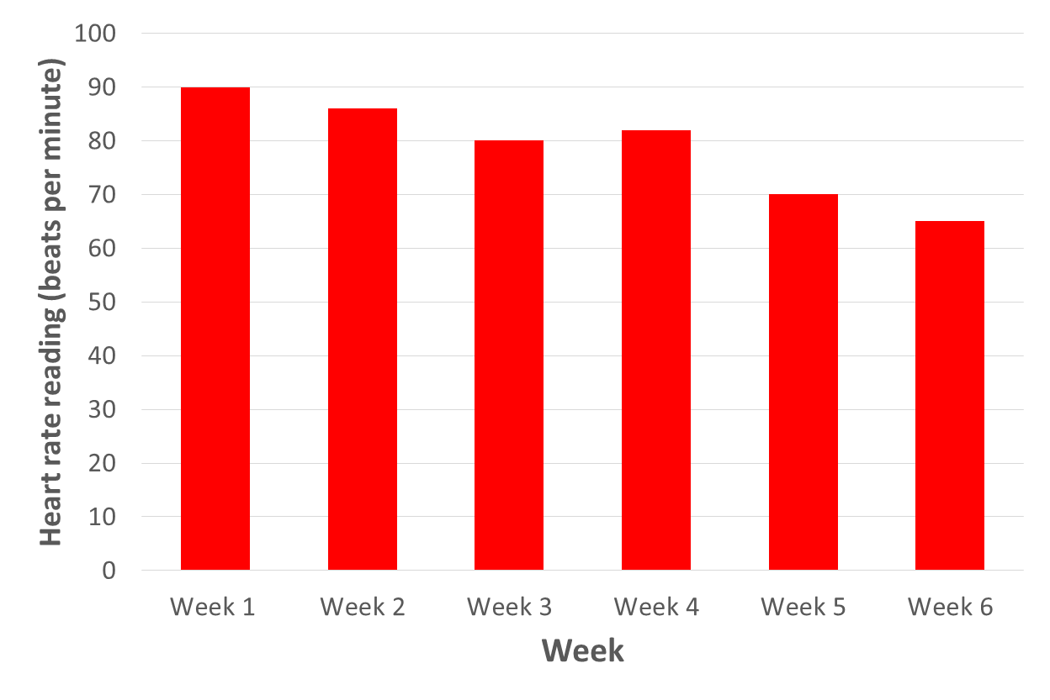
Presentation of Data and Recording Units
Data can be presented in a variety of formats; pie chart, bar chart, line graph or in a data table.
In addition, the units used for a recording may differ.
Units may be:
Seconds
Minutes
cm
Numbers
Levels

Slide 16
How data is collected in sporting activities
Data in sport can be obtained using both qualitative and quantitative methods.
Quantitative data collection – This refers to actual values and readings which in turn are compared to national averages. i.e. heart rate readings
Qualitative data collection – This refers to open-ended testing procedures and less structured protocols.
i.e. interviews/observations

Slide 17
