Slide 1
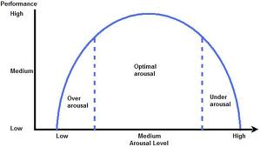
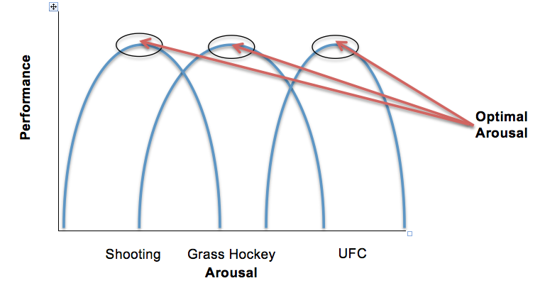
Arousal:
Physical and mental state of alertness / excitement varying from deep sleep to intense excitement
Inverted U Theory
Varying Optimal Arousal Levels
Fine Skills that involve precise movements (linked to accuracy) require a low optimal level of arousal.
Gross skills that involve large muscle movements ( linked to power and strength) require a high level of arousal.
Controlling Arousal Levels:
Deep breathing is a physical / somatic technique which involves the performer exaggerating their breaths in and out.
Mental rehearsal, visualisation and imagery are all cognitive techniques done in the performers mind to control arousal. Mental rehearsal involves the performer picturing themselves performing the skill perfectly before attempting it e.g. goal kick in rugby. Visualisation and imagery involves the performer imagining themselves in a calm, relaxing environment.
Positive self-talk is a mental / cognitive technique whereby the performer talks to themselves in their head. This reassures the performer that they can do it or that they are doing well.
All the methods help the performer control their arousal and focus their thoughts on the task ahead of them
Explaining the inverted U theory and its link to performance levels:
As arousal levels increase so does performance.
Up to the optimal level where performance is high.
If arousal continues to increase further, performance will decrease as the performer will become over aroused.
Arousal, Aggression, Motivation and Personality Types
Aggression
Direct Aggression is when there is actual physical contact between performers e.g. rugby tackle
Indirect Aggression does not involve physical contact. The aggressive act is taken out on a object to gain an advantage over an opponent e.g. smash in badminton, bowling a bouncer in cricket.
Motivation
Motivation is the drive to succeed or the desire to achieve something.
Intrinsic Motivation
The drive that comes from within the performer. The reward is a feeling of pride, self satisfaction or general achievement.
Extrinsic Motivation
The drive experienced by a performer when striving to achieve a reward. The external reward is provided by an outside source or person and can be divided into two categories:
Tangible rewards – certificates, trophies, medals etc.
Intangible rewards – praise or feedback from others, applause from the crowd.
Which is best intrinsic or extrinsic motivation?
Intrinsic motivation is seen as a more effective motivational tool due to:
Performers becoming too reliant on extrinsic motivation. This means they only play for the reward / fame / money.
Intrinsic motivation is more likely to lead to continued effort and participation. This basically means the performer playing for pride is more likely to keep persisting and continue participating over time.
The overuse of extrinsic can undermine the strength of intrinsic. Basic players forget why they play the sport and if they are unsuccessful they fall out of love (lose interest) with the activity.
Personality Types
INTROVERTS
Introvert characteristics = quiet, passive, reserved, shy, thoughtful and solitary.
Introverts sporting preferences = individual sports, sports that require concentration / precision (fine skills), sports that require a lower level of arousal e.g. archery, pistol shooting.
EXTROVERTS
Extrovert characteristics = sociable, active, talkative, out-going, enjoy interaction with others, enthusiastic, prone to boredom when isolated.
Extroverts sporting preferences = team sports, sports that require little concentration, fast paced sports, sports that use mainly gross skills, sports that require a higher level of arousal e.g. rugby player.

