Slide 1
Typical exam questions
1. Elliott plays football for OCR FC. He wants to create a program to store the results of each football match they play and the names of the goal scorers. Elliott wants individual players from the team to be able to submit this information. Define what is meant by abstraction. [2] Give one example of how abstraction could be used when developing this program. [1]

Slide 2
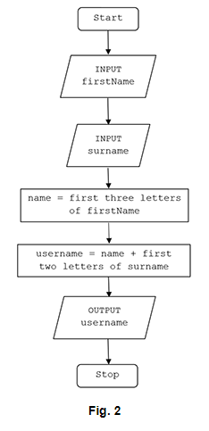
Typical exam questions
2. A program creates usernames for a school. The first design of the program is shown in the flowchart in Fig. 2. For example, using the process in Fig. 2, Tom Ward’s username would be TomWa. State, using the process in Fig. 2, the username for Rebecca Ellis. [1]

Slide 3
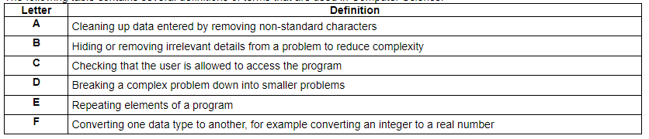
Typical exam questions
3. The following table contains several definitions of terms that are used in Computer Science. Write the letter of the definition that matches each keyword in each space. [4] Decomposition .................. Abstraction .................. Input sanitisation .................. Casting ..................

Slide 4
Typical exam questions
4. There is a subroutine, HEX(), that takes a denary number between 10 and 15 and returns the corresponding hexadecimal number. E.g. HEX(10) would return “A”, HEX(15) would return “F”. Write an algorithm, using the subroutine HEX(), to convert any whole decimal number between 0 and 255 into a 2 digit hexadecimal number. [4]

Slide 5
Typical exam questions
5. Jim is writing a program to calculate the wages of workers in a teddy bear factory. The wages earned by a worker is either £2 for every teddy bear they have made or £5 for every hour they have worked, whichever is larger. Write an algorithm that: [6] allows the user to input the number of teddy bears made and the number of hours worked calculates the wages for the number of teddy bears made calculates the wages for the number of hours worked outputs the larger of the two results.

Slide 6
Typical exam questions
6. An infinite loop is where a section of a program repeats indefinitely. Using pseudocode, write an algorithm that will use a count-controlled loop to print out the numbers 1 to 10 in ascending order. [3]

Slide 7

Typical exam questions
7. Willow has created a hangman program that uses a file to store the words the program can select from. A sample of this data is shown in Fig. 3. Show the stages of a bubble sort when applied to data shown in Fig. 3.

Slide 8
Typical exam questions
8. OCR Land is a theme park aimed at children and adults. Entrance tickets are sold online. An adult ticket to OCR Land costs £19.99, with a child ticket costing £8.99. A booking fee of £2.50 is added to all orders. OCR Land regularly emails discount codes to customers. Each discount code includes a check digit as the last character. A list of valid discount codes is shown below. [NIC12B, LOR11S, STU12M, VIC08E, KEI99M, WES56O, DAN34S] State one reason why a binary search would not be able to be used with this data. [1] Give the name of one searching algorithm that would be able to be used with this data. [1]

Slide 9
Typical exam questions
9. The following names of students are stored in an array with the identifier studentnames. studentnames = ["Rob", "Anna", "Huw", "Emma", "Patrice", "Iqbal"] Describe the steps that a linear search would take to find Anna in studentnames. [4]

Slide 10
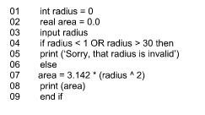
Typical exam questions
10. The area of a circle is calculated using the formula Π × r2, where Π is equal to 3.142 and r is the radius. Finn has written a program to allow a user to enter the radius of a circle as a whole number, between 1 and 30, and output the area of the circle. Identify two variables used in the program.[2]
Answer: radius area Marks: 2

Slide 11
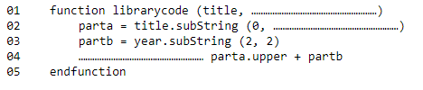
Typical exam questions
11. A library gives each book a code made from the first three letters of the book title in upper case, followed by the last two digits of the year the book was published. For example, “Poetry from the War”, published in 2012 would be given the code POE12. Complete the following pseudocode for a function definition that will take in the book title and year as parameters and return the book code. [3]

Slide 12
Typical exam questions
12. Victoria is writing a program using a high level language to display the meaning of computer science acronyms that are entered. The code for her first attempt at this program is shown below. 01 a = input(“Enter an acronym”) 02 if a == “LAN” then 03 print(“Local Area Network”) 04 elseif a == “WAN” then 05 print(“Wide Area Network”) 06 …………………………………………………………………………………………… 07 …………………………………………………………………………………………… 08 endif Complete the code above to print out an “unknown” message if any other acronym is entered by the user. [2]

Slide 13
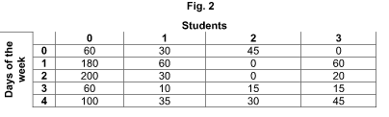
Typical exam questions
13. Heath is researching how long, to the nearest minute, each student in his class spends playing computer games in one week (Monday to Friday). He is storing the data in a 2D array. Fig. 2 shows part of the array, with 4 students. For example, student 1, on Monday (day 0), played 30 minutes of computer games. Identify a data type that could be used to store the number of minutes in this array. [1] State why this data type is the most appropriate. [1]

Slide 14
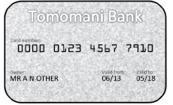
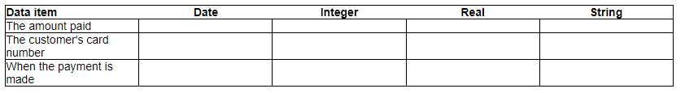
Typical exam questions
14. When customers pay using a card such as the one below, shops use computer systems to process the payment. Tick one box in each row, to show which of the data types given is the most appropriate data type for each of the following data items. [3]

Slide 15
Typical exam questions
15. OCR Land is a theme park aimed at children and adults. Entrance tickets are sold online. An adult ticket to OCR Land costs £19.99, with a child ticket costing £8.99. A booking fee of £2.50 is added to all orders. A function, ticketprice(), takes the number of adult tickets and the number of child tickets as parameters. It calculates and returns the total price to be paid. Use pseudocode to create an algorithm for the function ticketprice(). [6]

Slide 16
Typical exam questions
16. The following names of students are stored in an array with the identifier studentnames. studentnames = ["Rob", "Anna", "Huw", "Emma", "Patrice", "Iqbal"] A school uses the array to call an attendance register every morning. Write an algorithm using iteration to: [6] display the name of each student one at a time from studentnames take as input whether that student is present or absent display the total number of present students and number of absent students in a suitable message, after all student names have been displayed.

Slide 17
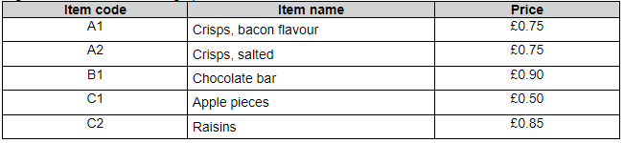
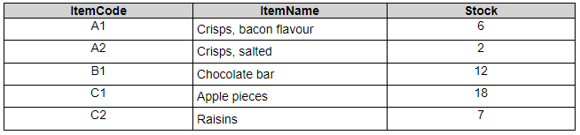
Typical exam questions
A vending machine has the following options available. Users insert coins into the vending machine and then enter the two character item code of their selection. If the user has inserted enough money, the vending machine will release the chosen item and output any change required. If the user enters an invalid item code then a suitable error message is displayed. A vending machine stores the quantity of items available in a database table called ITEMS. The current contents of ITEMS is shown: Complete the following SQL statement to display the item code for all items that have fewer than 10 in stock. [4] SELECT FROM

Slide 18
Typical exam questions
18. A library gives each book a code made from the first three letters of the book title in upper case, followed by the last two digits of the year the book was published. For example, “Poetry from the War”, published in 2012 would be given the code POE12. Functions and procedures are both examples of sub programs. Describe one difference between a function and a procedure. [2] Describe two benefits to a programmer of using sub programs. [4]

Slide 19
Typical exam questions
Elliott plays football for OCR FC. He wants to create a program to store the results of each football match they play and the names of the goal scorers. Elliott wants individual players from the team to be able to submit this information. Describe two examples of defensive design that should be considered when developing this program. [4]

Slide 20
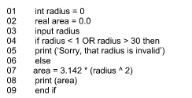
Typical exam questions
20. The area of a circle is calculated using the formula Π × r2, where Π is equal to 3.142 and r is the radius. Finn has written a program to allow a user to enter the radius of a circle as a whole number, between 1 and 30, and output the area of the circle. Explain, using examples from the program, two ways Finn can improve the maintainability of the program.

Slide 21
Typical exam questions
21. A teacher researches the length of time students spend playing computer games each day. The teacher writes a program to add up and print out the total number of minutes student 2 played computer games over 5 days (Monday to Friday). total = 0 total = total + minsPlayed[2,0] total = total + minsPlayed[2,1] total = total + minsPlayed[2,2] total = total + minsPlayed[2,3] total = total + minsPlayed[2,4] print(total) Refine the program to be more efficient. Write the refined version of the algorithm. You must use either: OCR Exam Reference Language, or a high-level programming language that you have studied. [4]

Slide 22
Typical exam questions
22. OCR Tech is an online shop that sells electronics such as TVs and game consoles. An item is classified as "In demand" if OCR Tech have between 5 and 25 inclusive in stock. A program is written that allows the user to input the current stock level and output whether the item is in demand or not. stocklevel = input("Enter stock level") if stocklevel >= 5 or =< 25 then print(Not in demand) else print(In demand) endif The program contains syntax and logic errors. Refine the program to correct the errors and write the refined version of the program. You must use either: OCR Exam Reference Language, or A high-level programming language that you have studied

Slide 23
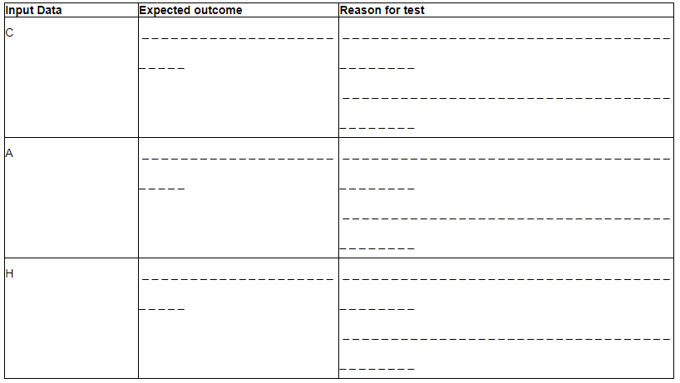
Typical exam questions
23. Charley is writing a program for music students. To make sure that there are no logic errors in the program, Charley uses a test plan. The program uses the letters in the following list to represent musical notes. C D E F G A B When the user inputs a letter from this list, the program outputs the next three notes in the list. If it gets to the end of the list, it starts again from the beginning, so the next note after B is C. Complete the test plan below by stating, for each input data, the expected outcome and a reason for the test. [6]

Slide 24

Typical exam questions
Complete the truth table below for the Boolean statement p = NOT (A AND B). [2]

Slide 25

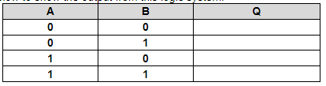
Typical exam questions
25. The logic diagram below (Fig. 2) shows a system made up of two connected logic gates. (i) Label the names of the two gates on the diagram on the right. [2] Complete the truth table below to show the output from this logic system. [4]

Slide 26
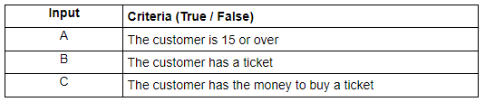
Typical exam questions
26. A cinema uses the following criteria to decide if a customer is allowed to see a film that has a 15 rating: Customers have to be 15 years of age or older to see the film. They also need to either have a ticket or have the money to buy a ticket. The table shows the inputs to the system that will output whether the customer can watch the film. Draw this system using logic gates. [2]

Slide 27
Typical exam questions
27. An algorithm is written in a high‐level language. The high level code must be translated into machine code before a computer processor can execute it. Describe two methods of translating high level code into machine code. [4]

Slide 28
Typical exam questions
28. Dru writes the following program using a high-level language. 01 function newscore(a,b) 02 temp = a*b 03 temp = temp + 1 04 return temp 05 endfunction 06 score = 18 07 name = "Dru" 08 print (score) 09 print ("name") 10 print (newscore(score,2)) 11 print (score) Describe the advantages of writing a program in a high-level language instead of in assembly language. [2]

Slide 29
Typical exam questions
29. Graeme is a freelance programmer. He has written a program for a client and gives the client both the high level code and the machine code of the program. Describe what is meant by High level code [2] Machine code [2] State why Graeme needs a compiler. [1]

Slide 30
Typical exam questions
30. Finn uses an IDE (Integrated Development Environment) to write his programs. Identify two features of an IDE that Finn might use. [2]

Slide 31
Typical exam questions
31. Victoria creates a program using an Integrated Development Environment (IDE). Describe two tools or facilities that an IDE commonly provides. [4]

Slide 32
Typical exam questions
Jim is writing a program to calculate the wages of workers in a teddy bear factory. Jim uses an Integrated Development Environment (IDE) to create the program. Describe two tools in an IDE that can help Jim when creating the program. [4]

