Slide 1
Typical exam questions
1. Elliott plays football for OCR FC. He wants to create a program to store the results of each football match they play and the names of the goal scorers. Elliott wants individual players from the team to be able to submit this information. Define what is meant by abstraction. [2] Give one example of how abstraction could be used when developing this program. [1]
Answer: i)1 mark per bullet to max 2 Removing / hiding / obscuring unnecessary detail Focusing on the important detail Simplifies the problem // reduces complexity // Easy to solve / understand ii)1 mark per bullet to max 1 Suitable example of what can be focused on (e.g. player name, match results, goals scored) Suitable example of what to remove/hide (anything relevant that is not results/goals scored) Suitable example of a simplification made Marks: i) 2 AO1 1a (1) AO1 1b (1) ii) 1 AO2 1a (1) Guidance: i)Accept answers relating to using fewer computational resources Must be the programmer making the decision. ii)Mark first answer only Allow any suitable example of abstraction as long it is relevant to the system. Allow either first name or surname to be removed as an example, but do not allow both to be removed.

Slide 2
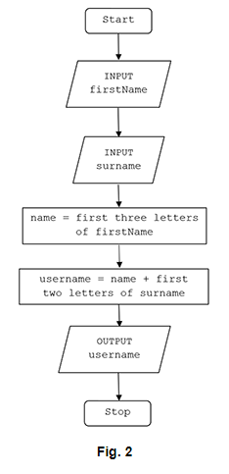
Typical exam questions
2. A program creates usernames for a school. The first design of the program is shown in the flowchart in Fig. 2. For example, using the process in Fig. 2, Tom Ward’s username would be TomWa. State, using the process in Fig. 2, the username for Rebecca Ellis. [1]

Slide 3
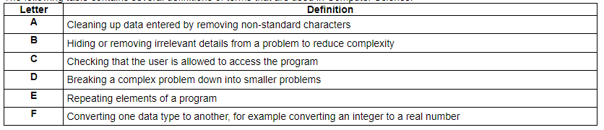
Typical exam questions
3. The following table contains several definitions of terms that are used in Computer Science. Write the letter of the definition that matches each keyword in each space. [4] Decomposition .................. Abstraction .................. Input sanitisation .................. Casting ..................
Answer: 1 mark for each letter Decomposition D Abstraction B Input Sanitisation A Casting F Marks: 4 AO1 1a(4)

Slide 4
Typical exam questions
4. There is a subroutine, HEX(), that takes a denary number between 10 and 15 and returns the corresponding hexadecimal number. E.g. HEX(10) would return “A”, HEX(15) would return “F”. Write an algorithm, using the subroutine HEX(), to convert any whole decimal number between 0 and 255 into a 2 digit hexadecimal number. [4]
Answer: Taking a number as input Using HEX subroutine correctly Calculating Digit 1 Calculating Digit 2 INPUT decimal digitl = decimal DIV 16 IF digitl>=10 THEN digit1 = HEX(digit1) digit2 = decimal - (digit1*16) IF digit2>=10 THEN digit2=HEX(digit2) Marks: 4 Guidance: 1 mark for each bullet. There are no marks associated with data types or conversions of data types. If used, a flowchart should represent the bulleted steps in the answer column.

Slide 5
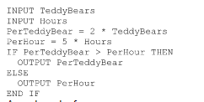
Typical exam questions
6. Jim is writing a program to calculate the wages of workers in a teddy bear factory. The wages earned by a worker is either £2 for every teddy bear they have made or £5 for every hour they have worked, whichever is larger. Write an algorithm that: [6] allows the user to input the number of teddy bears made and the number of hours worked calculates the wages for the number of teddy bears made calculates the wages for the number of hours worked outputs the larger of the two results.
Answer: e.g. Award marks for: Inputting teddybears and hours 2 * number of teddy bears 5 * hours Comparing the two answers Outputting the piece rate if it is greater Outputting the hour rate if it is greater. Marks: 6 Guidance: If correctly calculated but not output give benefit of doubt once

Slide 6
Typical exam questions
6. An infinite loop is where a section of a program repeats indefinitely. Using pseudocode, write an algorithm that will use a count-controlled loop to print out the numbers 1 to 10 in ascending order. [3]
Answer: 1 mark per bullet, max 3. FOR loop used That outputs the counter variable loops 10 time Marks: 3 Guidance: Example algorithm for i = 1 to 10 print i next Do not accept WHILE loop for first mark, although other marks can be accessed. No need for next If candidate manually increments counter within FOR loop, do not award bullet point 3. Accept pseudocode that suggests looping 10 times, even if this may not function correctly in a specific language.

Slide 7

Typical exam questions
7. Willow has created a hangman program that uses a file to store the words the program can select from. A sample of this data is shown in Fig. 3. Show the stages of a bubble sort when applied to data shown in Fig. 3.

Slide 8
Typical exam questions
8. OCR Land is a theme park aimed at children and adults. Entrance tickets are sold online. An adult ticket to OCR Land costs £19.99, with a child ticket costing £8.99. A booking fee of £2.50 is added to all orders. OCR Land regularly emails discount codes to customers. Each discount code includes a check digit as the last character. A list of valid discount codes is shown below. [NIC12B, LOR11S, STU12M, VIC08E, KEI99M, WES56O, DAN34S] State one reason why a binary search would not be able to be used with this data. [1] Give the name of one searching algorithm that would be able to be used with this data. [1]
Answer: i) Not in order / sorted ii) Linear (search) Marks: i) 1 AO2 1b (1) ii) 1 AO1 1b (1) Guidance: i)Mark first answer only | Examiner’s Comments This question required candidates to understand that one of the pre-requisites of a binary search is that the data must be in some form of order. Where this was understood, candidates were able to identify that the data presented was not in order and so could be searched using this algorithm. Extremely common wrong answers included that only numeric data could be used or that data had to be in binary. Misconception A binary search can be carried out on non-numeric data. If the data is ordered in some way (e.g. alphabetically) then this algorithm will be able to efficiently find data. ii)Mark first answer only Allow other valid searching algorithms as long as they work on an unsorted list (e.g front and back search)

Slide 9
Typical exam questions
9. The following names of students are stored in an array with the identifier studentnames. studentnames = ["Rob", "Anna", "Huw", "Emma", "Patrice", "Iqbal"] Describe the steps that a linear search would take to find Anna in studentnames. [4]
Answer: 1 mark per bullet to max 6 Access “Rob” / studentnames[0]… …does not equal “Anna” // not desired item // move on Access “Anna” / studentnames[1] …does equal “Anna” // stop // item found Marks: 4 AO2 1b(4) Guidance: Answer must refer to this array, not a generic description of linear search. “Access first item” is NE for BP1 or BP3. Must refer to this scenario

Slide 10
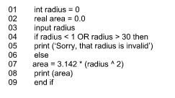
Typical exam questions
10. The area of a circle is calculated using the formula Π × r2, where Π is equal to 3.142 and r is the radius. Finn has written a program to allow a user to enter the radius of a circle as a whole number, between 1 and 30, and output the area of the circle. Identify two variables used in the program.[2]
Answer: radius area Marks: 2

Slide 11
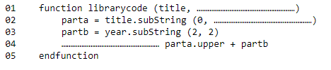
Typical exam questions
11. A library gives each book a code made from the first three letters of the book title in upper case, followed by the last two digits of the year the book was published. For example, “Poetry from the War”, published in 2012 would be given the code POE12. Complete the following pseudocode for a function definition that will take in the book title and year as parameters and return the book code. [3]
Answer: 1 mark per filled gap, max 3 01 function librarycode(title, year) 02 parta = title.substring(0, 3) 03 partb = year.substring(2, 2) 04 return parta.upper + partb 05 endfunction Marks: 3 Guidance: i)Ignore capitalisation. Allow librarycode = for 3rd mark – this is an equivalent in some languages for returning a value (eg. Visual Basic).

Slide 12
Typical exam questions
12. Victoria is writing a program using a high level language to display the meaning of computer science acronyms that are entered. The code for her first attempt at this program is shown below. 01 a = input(“Enter an acronym”) 02 if a == “LAN” then 03 print(“Local Area Network”) 04 elseif a == “WAN” then 05 print(“Wide Area Network”) 06 …………………………………………………………………………………………… 07 …………………………………………………………………………………………… 08 endif Complete the code above to print out an “unknown” message if any other acronym is entered by the user. [2]
Answer: 1 mark per bullet, max 2. else print (“unknown”) Marks: 2 Guidance: Accept logically correct equivalents for else (e.g. elseif a!=“LAN“ and/or a !=“WAN“). Do not allow elseif on its own Accept other keywords for print (e.g. “output”) as long as the intention is clear. Accept other messages as equivalent to “uknown” (e.g. “not known” / “error”)) Message to be printed must be in quotes. Allow “else then”.

Slide 13
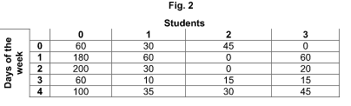
Typical exam questions
13. Heath is researching how long, to the nearest minute, each student in his class spends playing computer games in one week (Monday to Friday). He is storing the data in a 2D array. Fig. 2 shows part of the array, with 4 students. For example, student 1, on Monday (day 0), played 30 minutes of computer games. Identify a data type that could be used to store the number of minutes in this array. [1] State why this data type is the most appropriate. [1]
Answer: i) Integer ii) It is a whole number / no decimals / to the nearest minute. Marks: i) 1 ii) 1 Guidance: i) Any data type that stores a whole number onl

Slide 14
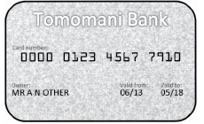
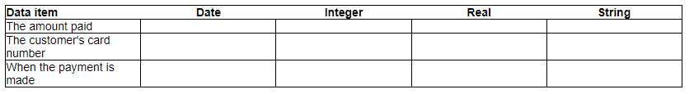
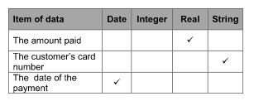
Typical exam questions
14. When customers pay using a card such as the one below, shops use computer systems to process the payment. Tick one box in each row, to show which of the data types given is the most appropriate data type for each of the following data items. [3]
Answer: Marks: 3 Guidance: 1 mark per row

Slide 15
Typical exam questions
15. OCR Land is a theme park aimed at children and adults. Entrance tickets are sold online. An adult ticket to OCR Land costs £19.99, with a child ticket costing £8.99. A booking fee of £2.50 is added to all orders. A function, ticketprice(), takes the number of adult tickets and the number of child tickets as parameters. It calculates and returns the total price to be paid. Use pseudocode to create an algorithm for the function ticketprice(). [6]
Answer: i)1 mark per bullet to max 6 Function ticketprice() defined … that accepts two parameters and has no other inputs Works out total ticket price for adult (eg adult * 19.99) Works out total ticket price for children (eg child * 8.99) Adds on correct booking fee Returns the calculated value. Marks: 6 AO3 2b (6) | Guidance: i)Bullet points 3, 4, 5 can be awarded even if no mention of a function / parameters (for example, if candidate has inputted the number of tickets needed. Do not award return value if no attempt at a function. Return mark can be given if a good attempt made at calculating the total, even if this is incorrect. Allow 2.50 booking fee to be per order or per ticket Ticket prices must be stored appropriately if needed. example algorithm function ticketprice(numadult, numchild) price = (numadult * 19.99) + (numchild * 8.99) + 2.50 return price end function Allow alternatives in high level languages (e.g. def in Python). Allow return as assigning the value to the name of the function (VB syntax)

Slide 16
Typical exam questions
16. The following names of students are stored in an array with the identifier studentnames. studentnames = ["Rob", "Anna", "Huw", "Emma", "Patrice", "Iqbal"] A school uses the array to call an attendance register every morning. Write an algorithm using iteration to: [6] display the name of each student one at a time from studentnames take as input whether that student is present or absent display the total number of present students and number of absent students in a suitable message, after all student names have been displayed.
Answer: Use of iteration (any use) … …loops for each item in array // loops 6 times …to print out each item in studentnames …input attendance Add up/calculate students present and absent …Outputs present and absent (in suitable message) Marks: 6 AO3 2b(6) Guidance: BP 2 and 3 may be met together with suitable input statement. Both dependent on attempt at iteration. BP5 not dependent on correct previous parts. BP6 needs reasonable attempt at totalling present and absent figures. Ignore non-initialisation of counter variables. | Flowcharts are acceptable but must show how to solve the problem, not simply repeat the question. Example algorithm present=0 absent=0 for i = 0 to (studentnames.length) -1 print(studentnames[i]) attendance=input("absent or present?") if attendance=="present" then present=present+1 else absent=absent+1 endif next i print ("Present students: " + present) print ("Absent students: " + absent)

Slide 17
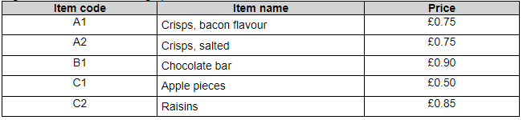
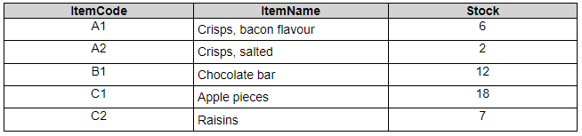
Typical exam questions
A vending machine has the following options available. Users insert coins into the vending machine and then enter the two character item code of their selection. If the user has inserted enough money, the vending machine will release the chosen item and output any change required. If the user enters an invalid item code then a suitable error message is displayed. A vending machine stores the quantity of items available in a database table called ITEMS. The current contents of ITEMS is shown: Complete the following SQL statement to display the item code for all items that have fewer than 10 in stock. [4] SELECT FROM
Answer: SELECT ItemCode // * FROM ITEMS WHERE …Stock < 10 Marks: 4 AO3 2b(4) | Guidance: Accept other fields shown in addition to ItemCode Accept Stock <=9 / etc. Ignore case. Spelling of fields and table must be correct. If WHERE missing, Stock < 10 must be after FROM clause.

Slide 18
Typical exam questions
18. A library gives each book a code made from the first three letters of the book title in upper case, followed by the last two digits of the year the book was published. For example, “Poetry from the War”, published in 2012 would be given the code POE12. Functions and procedures are both examples of sub programs. Describe one difference between a function and a procedure. [2] Describe two benefits to a programmer of using sub programs. [4]
Answer: i)1 mark per bullet, max 2. Function returns a value Procedure does not return a value ii)1 mark per bullet, max 4. Mark in pairs. e.g. Breaks down / decomposes / modularises the problem / program // structures the program …making it easier to design/create/test …each subroutine can be tested separately Reuse code (in different programs) …quicker to develop (new) programs …build on existing work / use of a library of subroutines Avoid repetition of code (in the same program) …makes program shorter / smaller … subprogram called instead of copying/pasting. … quicker to develop (new) programs Easier to maintain …as code is easier to understand/read …as code is shorter Easier to debug …as code is shorter …same bugs will not have been copied to other areas of the program. | Work can be split up in a team …to suit developers’ skill set …to work on different subprogram at the same time / develop separately Allows for abstraction / removes complexity …subprograms can be used by programmers who do not need to understand how they work. Marks: i) 2 ii) 4 Guidance: i)Allow “does not” for second mark if intention is clear (ie if it is obvious that the “not” refers to not returning a value). Allow discussion of how returned value in a function can be used (e.g. to assign to a variable or to use this returned value in some way). ii)Maximum of two benefits with expanstions to be marked as per question. Allow other sensible expansions. Allow expansions which cross over to other benefits (e.g. breaks down the problem / to make it easier to maintain). Allow can be called multiple times” Allow “file size is smaller”. Do not allow “more efficient” without further explanation.

Slide 19
Typical exam questions
Elliott plays football for OCR FC. He wants to create a program to store the results of each football match they play and the names of the goal scorers. Elliott wants individual players from the team to be able to submit this information. Describe two examples of defensive design that should be considered when developing this program. [4]
Answer: 1 mark per bullet, mark in pairs. Max 2 per point. e.g. Input sanitisation …cleaning up input data / removing unwanted data …by example (e.g. removing special characters / preventing SQL injection) Validation …checking whether input data should be allowed / is sensible / follows criteria …by example (e.g. goals cannot be less than 0) Verification … checking whether data has been entered correctly …by example (e.g. double entry / visual check) Authentication …ensuring only allowed / authorised users can gain access …by example (e.g. usernames /passwords) Maintainable code …to allow other programmers to understand the code …by example(e.g. comments, indentation, meaningful variable names) | Marks: 4 AO2 1a (2) AO2 1b (2) Guidance: Mark first answer only in each section For validation, allow one example of a type of validation (e.g. type check, range check) e.g. question so allow other sensible examples such as audit logging, encryption of data Do not allow “data is correct” as expansion for validation – validation checks that data is sensible or follows rules, NOT that it is correct. Planning for contingencies and anticipating misuse are not examples by themselves, but discussion of these may fit under other points – e.g. input sanitisation, validation.

Slide 20
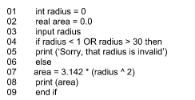
Typical exam questions
20. The area of a circle is calculated using the formula Π × r2, where Π is equal to 3.142 and r is the radius. Finn has written a program to allow a user to enter the radius of a circle as a whole number, between 1 and 30, and output the area of the circle. Explain, using examples from the program, two ways Finn can improve the maintainability of the program.
Answer: Comments / annotation… … To explain the key functions / sections … E.g. any relevant example, such as line 4 checks the input is valid Indentation… … To show where constructs / sections start and finish …E.g. indenting within IF statement Using constants… … so numbers can be updated easily …E.g. TT Marks: 6 Guidance: 1 mark for identification of an example from the programme. 1 mark for explanation of how it aids maintainability. 1 mark for contextualisation. Maximum of 3 marks per method.

Slide 21
Typical exam questions
21. A teacher researches the length of time students spend playing computer games each day. The teacher writes a program to add up and print out the total number of minutes student 2 played computer games over 5 days (Monday to Friday). total = 0 total = total + minsPlayed[2,0] total = total + minsPlayed[2,1] total = total + minsPlayed[2,2] total = total + minsPlayed[2,3] total = total + minsPlayed[2,4] print(total) Refine the program to be more efficient. Write the refined version of the algorithm. You must use either: OCR Exam Reference Language, or a high-level programming language that you have studied. [4] | e.g. total = 0 for x in range (0, 4) total += hoursplayed[2][x] next x print (total) e.g. total = 0; for (int x = 0; x <= 4; x++){ total = total + hoursplayed[2][x]; } System.out.println (total); Marks: 4 (AO3 2c) Guidance: High-level programming language / OCR Exam Reference Language response required Do not accept pseudocode / natural English. MP1 must have appropriate identifier, = and then the numeric 0 MP2 must have for or while MP3 must have the for stopping condition 4/5 MP4 must have the same identifier for MP1 and equal and + to add the data in the array (using either [x,y] or [x][y]. This could be total = total + …. Or total += ….
Answer: Initialises total as 0 and prints out total the end (as per original program) Uses iteration, e.g. FOR, WHILE …that repeats 5 times …correctly adds up values using loop index e.g. total = 0 for x = 0 to 4 total = total + hoursplayed[2, x] next x console.writeline(total)
 | S0 | S1 | s2
Mon 0 | 2 | 5 | 3
Tue 1 | 1 | 6 | 4
Wed 2 | 2 | 2 | 2
Thu 3 | 1 | 5 | 3
Fri 4 | 2 | 1 | 4

Slide 22
Typical exam questions
22. OCR Tech is an online shop that sells electronics such as TVs and game consoles. An item is classified as "In demand" if OCR Tech have between 5 and 25 inclusive in stock. A program is written that allows the user to input the current stock level and output whether the item is in demand or not. stocklevel = input("Enter stock level") if stocklevel >= 5 or =< 25 then print(Not in demand) else print(In demand) endif The program contains syntax and logic errors. Refine the program to correct the errors and write the refined version of the program. You must use either: OCR Exam Reference Language, or A high-level programming language that you have studied | Guidance: i) High-level programming language / OCR Exam Reference Language response required Do not accept pseudocode / natural language. e.g. stocklevel = input("Enter stock level") if stocklevel >= 5 and stocklevel <= 25 then print("In demand") else print("Not in demand") endif alternative example stocklevel = input("Enter stock level") if stocklevel > 5 or stocklevel > 25 then print("Not in demand") else print("In demand") endif As a matter of principle, a candidate who refines the program to work fully but in a different format to that specified should gain full marks.
Answer: i) One mark per bullet point checking both values (e.g. or changed to and if appropriate) if statement in correct format (e.g. checking against stocklevel for each condition) if statement uses correct comparisons (e.g. >= and <=) print statements in correct position print statements include string delimiters (e.g. speech marks) around both string outputs Marks: i) 5

Slide 23
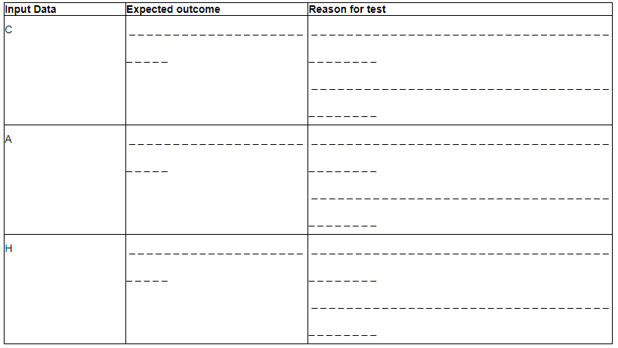

Typical exam questions
23. Charley is writing a program for music students. To make sure that there are no logic errors in the program, Charley uses a test plan. The program uses the letters in the following list to represent musical notes. C D E F G A B When the user inputs a letter from this list, the program outputs the next three notes in the list. If it gets to the end of the list, it starts again from the beginning, so the next note after B is C. Complete the test plan below by stating, for each input data, the expected outcome and a reason for the test. [6]
Answer: Correct answer: 1 mark per box Marks: 6 Guidance: Only award the mark for Reason for test, if the Expected outcome is correct enough to justify the reason given

Slide 24


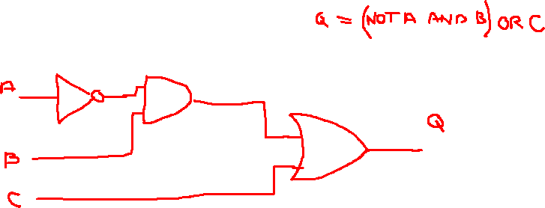
Typical exam questions
Complete the truth table below for the Boolean statement p = NOT (A AND B). [2]
Answer: Marks: 2 Guidance: 1 mark for each correct answer in table.

Slide 25

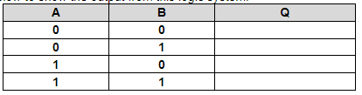
Typical exam questions
25. The logic diagram below (Fig. 2) shows a system made up of two connected logic gates. (i) Label the names of the two gates on the diagram on the right. [2] Complete the truth table below to show the output from this logic system. [4]
Answer: i)1 mark per bullet, max 2 AND / conjunction NOT / negation ii) A B Q 0 0 1 0 1 1 1 0 1 1 1 0 Marks: i) 2 ii) 4 Guidance: i)Allow Boolean notation. ii)1 mark per row

Slide 26
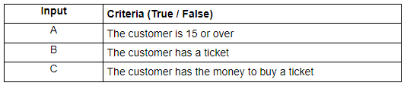

Typical exam questions
26. A cinema uses the following criteria to decide if a customer is allowed to see a film that has a 15 rating: Customers have to be 15 years of age or older to see the film. They also need to either have a ticket or have the money to buy a ticket. The table shows the inputs to the system that will output whether the customer can watch the film. Draw this system using logic gates. [2]
Answer: OR gate with two inputs // AND gate with two inputs Diagram as shown in guidance with no additional gates Marks: 2

Slide 27
Typical exam questions
27. An algorithm is written in a high‐level language. The high level code must be translated into machine code before a computer processor can execute it. Describe two methods of translating high level code into machine code. [4]
Answer: 1 mark per bullet to max 4, 2 mark max per method Compiler …translates code in one go / all at once …produces an executable file // does not need to be compiled again Interpreter …translates code line by line. …will be interpreted / translated every time it is run. Marks: 4 AO1 1b (4) Guidance: Mark first method only in each section

Slide 28
Typical exam questions
28. Dru writes the following program using a high-level language. 01 function newscore(a,b) 02 temp = a*b 03 temp = temp + 1 04 return temp 05 endfunction 06 score = 18 07 name = "Dru" 08 print (score) 09 print ("name") 10 print (newscore(score,2)) 11 print (score) Describe the advantages of writing a program in a high-level language instead of in assembly language. [2]
Answer: 1 mark per bullet to max 2 Easier/quicker for humans to write Easier/quicker to read / understand / remember Easier/quicker to maintain / debug / spot errors …because code is closer to English / uses English words Less code to write …because one HLL instruction represents many assembly instructions Portable (between processors) // will work with different types of compute Marks: 2 AO1 1b(2) Guidance: Accept “human language” as English for BP4 “Easier to use” is too vague

Slide 29
Typical exam questions
29. Graeme is a freelance programmer. He has written a program for a client and gives the client both the high level code and the machine code of the program. Describe what is meant by High level code [2] Machine code [2] State why Graeme needs a compiler. [1]
Answer: i) High level code : human oriented code / written by programmers contains words for commands / closer to English / natural language Machine independent / Portable to different systems Needs to be translated before it can be executed. Problem based One (high level) command equates to many machine code instructions. Machine code: Code for the CPU to execute / not readily understandable by humans binary instructions specific to a particular (type of) computer / not portable to different systems does not need to be translated | [max 2 marks for each type of code] ii) To translate the high level code into machine code To pick up (syntax) errors Marks: i) 4 ii) 1 Guidance: i) Award marks for correct points about machine code made under high level code and vice versa. Do not accept Machine code is in Hex ii) Translate to object code is acceptable Accept “errors” on its own, but do not accept answers referring specifically to logic or runtime errors.

Slide 30
Typical exam questions
30. Finn uses an IDE (Integrated Development Environment) to write his programs. Identify two features of an IDE that Finn might use. [2]
Answer: i) Error diagnostics (any example) Run-time environment Editor (any feature such as auto-correct, auto-indent) Translator Version control Break point Stepping Marks: i) 2 Guidance: i) 1 mark per bullet to a maximum of 2 marks. Only 1 example per bullet, e.g. auto-correct and auto-indent would only gain 1 mark.

Slide 31
Typical exam questions
31. Victoria creates a program using an Integrated Development Environment (IDE). Describe two tools or facilities that an IDE commonly provides. [4]
Answer: 1 mark per bullet, max 4. e.g. Editor …to enable program code to be entered/edited Error diagnostics / debugging …to display information about errors (syntax / run-time) / location of errors … suggest solutions Run-time environment …to enable to the program to be run … check for run time errors / test the program Translator / compiler / interpreter …to convert the high level code into machine code / low level code / binary …to enable to code to be executed / run Breakpoints …to stop/pause program execution at a specific point Watch window …to check contents of variables Stepping …to execute program line by line Syntax completion… …suggests/corrects code Keyword highlighting / colour coding keywords / pretty printing… …colours command words / variables | Marks: 4 Guidance: One mark for identifying, one mark for describing. Accept description of a tool without (or with incorrect) naming of the tool. Allow sensible descriptions which go across pairs or name other tools sensibly (e.g. editor / highlighting syntax) Allow any sensible tool that an IDE provides (e.g. auto documentation, help tools, pretty printing etc.)

Slide 32
Typical exam questions
Jim is writing a program to calculate the wages of workers in a teddy bear factory. Jim uses an Integrated Development Environment (IDE) to create the program. Describe two tools in an IDE that can help Jim when creating the program. [4]
Answer: e.g. Editor Allows Jim to enter the program code Colour coding keywords Auto-completes code as you type. Compiler Transforms the written source code into machine code. Debugging tools Highlights errors in the code Suggests possible solutions. (2 marks per tool) Marks: 4 Guidance: Do not accept me spell check Examiner's Comments It was pleasing to see that candidates were using their experience of programming to answer the question. Where they did not gain full marks, this could have improved by providing further detail about the tools, or especially by using correct technical terms to describe these tools.

