Slide 1
Typical exam questions
Ann wants to purchase a new computer and is looking at two models. 1. Identify four events that take place during the fetch-execute cycle. [4]

Slide 2
Typical exam questions
Dipesh is thinking of buying a tablet computer to replace his old desktop computer. 2. Describe how the CPU and RAM work together to enable the tablet computer to operate. [2]

Slide 3
Typical exam questions
Alicia has designed a computer using Von Neumann architecture. 3. Describe the purpose of two registers that are used by Von Neumann architecture. [4]

Slide 4
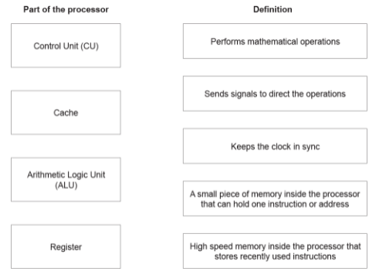
Typical exam questions
4. Draw one line from each part of the processor to its correct definition.. [4]

Slide 5
Typical exam questions
Computer A has a single core, 3.2 GHz processor. Computer B has a single core, 1.2 GHz processor. 5. Explain why Computer A will usually run faster than Computer B. [2]

Slide 6
Typical exam questions
Dipesh is thinking of buying a tablet computer to replace his old desktop computer. 6. The tablet computer also uses cache memory. Describe the purpose of cache memory.[2]

Slide 7
Typical exam questions
After upgrading the RAM, Quinn could make further changes to improve his computer's performance. 7. Identify the changes and explain how these changes would improve performance. [6]

Slide 8
Typical exam questions
Gareth has a satellite navigation system (Sat Nav) which contains an embedded system. 8. Define what is meant by an ‘embedded system’. [1]

Slide 9
Typical exam questions
Gareth has a satellite navigation system (Sat Nav) which contains an embedded system. 9. Identify three devices, other than a Satellite Navigation system, that contain embedded systems. [3]

Slide 10
Typical exam questions
The following paragraph describes embedded systems. Complete the paragraph by selecting terms from the list and writing them in the correct places. Not all terms are used. actuator applications change functions laptop larger lights microprocessor processor range smaller washing machine Embedded systems have limited ........................................................ They are often built into a ........................................................ machine. Two examples of embedded systems are a ........................................................ and automated ........................................................ in a car. [4]

Slide 11
Typical exam questions
A computer has 1024 megabytes of RAM. 11. State two items that will be stored in the RAM. [2]

Slide 12
Typical exam questions
Alicia has designed a computer using Von Neumann architecture. A computer only has 2GB of RAM. Alicia says that virtual memory can be used instead of adding more RAM. etc. 12. Explain how virtual memory can compensate for the lack of RAM in Alicia’s computer. [3] Explain why it would be beneficial for Alicia to get more RAM instead of relying on virtual memory. [3]

Slide 13
Typical exam questions
Ali’s tablet computer has an operating system. Ali’s tablet computer also has ROM (read only memory). 13. Describe the purpose of ROM in Ali’s tablet computer. [3]

Slide 14
Typical exam questions
Vicky has been on holiday and has taken lots of photos. The memory in her camera is now full and she needs to transfer her photos to an external secondary storage device. 14. Define what is meant by ‘secondary storage’. [1]

Slide 15
Typical exam questions
Vicky has been on holiday and has taken lots of photos. The memory in her camera is now full and she needs to transfer her photos to an external secondary storage device. 15. Identify the three common storage technologies Vicky can choose from. [3]

Slide 16
Typical exam questions
A law firm currently use a Local Area Network (LAN) linked to a Wide Area Network (WAN). They want to upgrade their system to utilise cloud storage. 16. Explain two advantages to the law firm of storing their data in the cloud. [3] Explain two dis-advantages to the law firm of storing their data in the cloud. [3]

Slide 17
Typical exam questions
17. Order the following units from smallest to largest: GB bit PB byte nibble MB [1]

Slide 18
Typical exam questions
18. Explain why data is stored in computers in a binary format. [1]

Slide 19
Typical exam questions
A computer has 1024 megabytes of RAM. 19. How many gigabytes of RAM does the computer have? [1]

Slide 20
Typical exam questions
Ali’s tablet computer has an operating system. Ali’s tablet computer has 100 GB of secondary storage. There is currently 80 GB available. Ali wants to transfer a series of video clips onto his tablet. Each video is, on average, 200 000 kilobytes. 20. Calculate an estimate of the number of video clips Ali can fit onto his tablet. Show your working.[4]

Slide 21
Typical exam questions
21. Convert the decimal number 191 into an 8 bit binary number. [1] Convert the hexadecimal number 3E into a decimal number. You must show your working. [2] Add together the following two 8 bit binary numbers. Express your response in an 8 bit binary form. [2] 01101010 10010110

Slide 22
Typical exam questions
In the ASCII character set, the character codes for the first three capital letters are given below. Letter ASCII character code A 0100 0001 B 0100 0010 C 0100 0011 State how the ASCII character set is used to represent text in a computer. [1] Convert the word CAB into binary using the ASCII character set. [1] Explain why the ASCII character set is not suitable for representing text in all the languages of the world. [2]

Slide 23
Typical exam questions
A radio station uses a digital camera to take a photograph of the computer scientist for their website. The photograph is stored as a bitmap image. 23. Describe how bitmap images are represented in binary. [3]

Slide 24
Typical exam questions
When recording a sound file on a computer, the sound needs to be sampled. 24. Describe how sampling is used when storing sound. [2] Explain the effect of the sampling interval on the size and quality of the sound file recorded. [3]

Slide 25
Typical exam questions
Layla is an artist. She draws images by hand. The image is then scanned and stored on a computer. Layla uploads her images and videos to a website. 25. Explain why Layla compresses the images and videos before uploading them. [2] Layla wants to reduce the file size of the images and videos by the largest amount possible. Identify the method of compression that would be most appropriate. Justify your choice. [3]

Slide 26
Typical exam questions
Zoe is organising a LAN-party. Her friends will each bring a computer to the party so that they can play games against each other. 26. Describe what is meant by a Local Area Network (LAN). [2]

Slide 27
Typical exam questions
A company, OCR Supermarkets, has supermarket stores throughout the country. The computers for each store connect to the central office using a Wide Area Network (WAN). OCR Supermarkets use a client-server network to connect the checkout computers to the store's server. 27. Describe two benefits to OCR Supermarkets of using a client-server network instead of a peer-to-peer network. [4]

Slide 28
Typical exam questions
Computer 1 enters the URL www.ocr.org.uk into a web browser. This is then converted into the IP address of the webserver that hosts the website. 28. Explain how the URL www.ocr.org.uk is converted into the IP address. [3]

Slide 29
Typical exam questions
The owners of a large bakery have a Local Area Network (LAN) with a star topology. They order their supplies over the Internet. When data is transmitted from the bakery to the supplier, network protocols are used. 29. Define what is meant by a ‘network protocol’. [1]

Slide 30
Typical exam questions
When connecting computers into a network, the use of appropriate protocols are important. For each of the scenarios below, identify the most appropriate protocol to be used and explain the function of the protocol. 30. A user wants to transfer a file directly from his computer to his friend’s computer. [2] A customer wants to securely log into her bank’s website to check her account balance. [2]

Slide 31
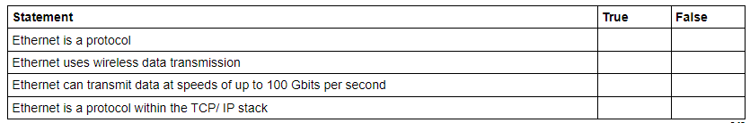
Typical exam questions
Naomi’s office has five computers connected into a Local Area Network (LAN). There is also one printer that all the devices can print to. Ethernet cables are used within the office building. Tick one box in each row to identify if the statement about Ethernet is True or False. [4]

Slide 32
Typical exam questions
A doctor's surgery stores hundreds of patients' details on its computer network. The surgery is concerned about the security of its patients' sensitive medical data. 32. Identify three errors that the surgery's staff could make, that may endanger the security of the network and outline a procedure that could be put in place to prevent each error. [6]

Slide 33
Typical exam questions
A house has computers in each room and a central router. Every room allows both Ethernet and WiFi connections to the router. The house owner is concerned about potential threats to the network from being connected to the Internet. 33. Describe three possible threats to the computers connected to the network and give one way each threat can be reduced or prevented. [9]

Slide 34
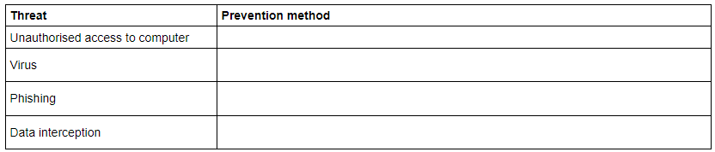
Typical exam questions
Data in computer systems is valuable and at risk of loss, damage or being stolen. The table has four potential threats to data. 34. Write one prevention method for each threat in the table. Each prevention method must be different. [4]

Slide 35
Typical exam questions
A hospital stores patients’ details on its computer network. The hospital is concerned about the security of its patients’ details. 35. Staff already use strong passwords to protect systems. Explain, with reference to system security, three other ways that the hospital could protect the network system. [6]

Slide 36
Typical exam questions
Data in computer systems is valuable and at risk of loss, damage or being stolen. 36. Name two other threats to the data in a computer system and give a method of preventing each. [6]

Slide 37
Typical exam questions
A school has all of its computers in a local area network (LAN). 37. Explain two measures which the school will need to take to ensure the security of the network. [4]

Slide 38
Typical exam questions
Amin buys a new computer with an operating system and some utilities. 38. State two functions of the operating system. [2]

Slide 39
Typical exam questions
Julian buys a new laptop with a system information utility and a diagnosis utility. 39. Describe, using examples, the purpose of the system information and diagnosis utilities. [4] System information utility Example Diagnosis utility Example

Slide 40
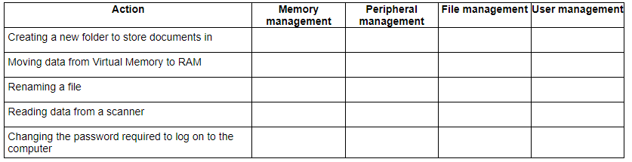
Typical exam questions
Eve’s computer has system software including an Operating System and Utility Software. 40. Tick (✓) one box in each row to identify which function of the Operating System deals with each action. [5]

Slide 41
Typical exam questions
Security on a computer can be provided directly by the operating system or by using utility programs. Utility programs include antivirus, file transfer, firewall and system cleanup. 41. State which two of these utilities can be used for security. [2]

Slide 42
Typical exam questions
Eve’s computer has system software including an Operating System and Utility Software. Eve runs the defragmentation program on her computer. 42. Explain why Eve’s computer is more efficient after the program has been run. [3]

Slide 43
Typical exam questions
William is creating a film for a school project using a digital video camera. William can choose between a full or incremental backup. 43. Identify the backup method William should use to backup the computer, justifying your choice. [3]

Slide 44
Typical exam questions
Amin buys a new computer with an operating system and some utilities. Some of the software in Amin's computer is open source. 44. Describe what is meant by open-source software. [2]

Slide 45
Typical exam questions
William is creating a film for a school project using a digital video camera. William wants to upload his videos on the Internet and is considering releasing them under a Creative Commons license. 45 Explain how a Creative Commons license will impact the use of William’s videos by other people. [3]

Slide 46
Typical exam questions
Daniel is a medical researcher trying to find a cure for a disease. He has a team of hundreds of people carrying out medical testing. Recent developments in Artificial Intelligence (AI) mean that a computer program could do the work of dozens of researchers in a much shorter time. Daniel decides to increase his use of Artificial Intelligence. Discuss the issues surrounding this decision. Consider the following in your answer: [8] ethical issues legal issues cultural issues

