Slide 1
Typical exam questions
Ann wants to purchase a new computer and is looking at two models. 1. Identify four events that take place during the fetch-execute cycle. [4]
An instruction is fetched from memory The instruction is then decoded The decoded instruction is then executed so that the CPU performs continuously The process is repeated The program counter is incremented The instruction is transferred to the MDR The address of the instruction to be fetched is placed in the MAR

Slide 2
Typical exam questions
Dipesh is thinking of buying a tablet computer to replace his old desktop computer. 2. Describe how the CPU and RAM work together to enable the tablet computer to operate. [2]
Instructions / programs(currently running) / data are stored in the RAM… these are fetched from the RAM by the CPU / Processor … where the instructions are executed / instructions are processed / data is processed Marks: 3 Guidance: If the candidate has described the functions of RAM and the CPU separately, only award the 2nd bullet if it is clearly stated that instructions are fetched from RAM. Mention of the fetch – execute cycle in the CPU is enough to award bullet 3.

Slide 3
Typical exam questions
Alicia has designed a computer using Von Neumann architecture. 3. Describe the purpose of two registers that are used by Von Neumann architecture. [4]
Answer: 1 mark per bullet to max 2 per register MAR // memory address register Stores the address/location where data will be read/written/accessed/fetched // address/location of data/instruction being processed // address/location of data/instruction next to be processed MDR // memory data register Stores the data/instruction that is fetched/read from memory // stores the data that is to be written to memory // stores the data/instruction from the address in the MAR // data/instruction next to be processed Program counter Stores the address/location of the next instruction to be run // stores the address/location of the current instruction being run Accumulator Stores the result of manipulation/process/calculation Marks: 4 AO1 1a (2) AO1 1b (2) Guidance: MAR stores address is not enough for description MDR stores the data is not enough for description Allow: Current instruction register // IR Stores the instruction currently being processed Accept MBR // Memory buffer register for MDR

Slide 4
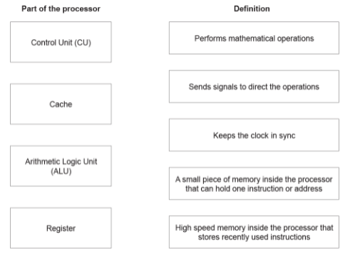
Typical exam questions
4. Draw one line from each part of the processor to its correct definition.. [4]

Slide 5
Typical exam questions
Computer A has a single core, 3.2 GHz processor. Computer B has a single core, 1.2 GHz processor. 5. Explain why Computer A will usually run faster than Computer B. [2]
faster/higher clock speed 3.2GHz will run more Fetch-Execute (F-E) cycles per second …therefore the more instructions can be executed per second // by calculation

Slide 6
Typical exam questions
Dipesh is thinking of buying a tablet computer to replace his old desktop computer. 6. The tablet computer also uses cache memory. Describe the purpose of cache memory.[2]
To store instructions / data that is frequently used / previously used / next to be used Data does not need to be fetched from RAM Speeds up access Marks: 2

Slide 7
Typical exam questions
After upgrading the RAM, Quinn could make further changes to improve his computer's performance. 7. Identify the changes and explain how these changes would improve performance. [6]
Answer: i)Max 2 per difference, 1 for RAM, 1 for ROM e.g. RAM is volatile ROM is non-volatile RAM stores currently running instructions / programs / applications / OS / data ROM stores boot-up instructions / bios RAM can be changed ROM (normally) cannot be changed ii)2 from More instructions / programs / applications can run at the same time / be held in RAM Open software faster / respond faster More memory space for current programs Run more memory intensive programs / relevant example e.g. computer games / graphic rendering reduces use of Virtual Memory …..less use of hard drive which is slower to access iii)e.g. Increase processor clock speed Run more FE cycles per second Faster response Smoother actions Less likely to freeze | Add more cores Run more tasks simultaneously Better performance for programs that are programmed for multi-core systems E.g. new computer games Increase cache size Cache stores frequently used instructions / programs / data Can store more so increase access speed to more frequently used instructions / programs / data New graphics card Can carry out more processes for CPU Can improve speed and quality of graphics Change hard disk drive to SSD faster read / write speed Marks: i) 4 ii) 2 iii) 6 Guidance: i)Do not allow e.g. ROM is not for 2nd mark. Mark in pairs

Slide 8
Typical exam questions
Gareth has a satellite navigation system (Sat Nav) which contains an embedded system. 8. Define what is meant by an ‘embedded system’. [1]
Answer: A computer system that is built into another device Marks: 1 Guidance:

Slide 9
Typical exam questions
Gareth has a satellite navigation system (Sat Nav) which contains an embedded system. 9. Identify three devices, other than a Satellite Navigation system, that contain embedded systems. [3]
Answer: Three devices from: Dishwasher MP3 player Washing machine Mobile phone (not Smartphone) Manufacturing equipment Marks: 3 Guidance: 1 mark to be awarded for each correct example identified to a maximum of 3 marks. There are many other examples of devices with embedded systems which may be acceptable.

Slide 10
Typical exam questions
The following paragraph describes embedded systems. Complete the paragraph by selecting terms from the list and writing them in the correct places. Not all terms are used. actuator applications change functions laptop larger lights microprocessor processor range smaller washing machine Embedded systems have limited ........................................................ They are often built into a ........................................................ machine. Two examples of embedded systems are a ........................................................ and automated ........................................................ in a car. [4]
Answer: 1 mark for each completed term Embedded systems have limited functions. They are often built into a larger machine. Two examples of embedded systems are a washing machine and automated lights in a car. Marks: 4 Guidance:

Slide 11
Typical exam questions
A computer has 1024 megabytes of RAM. 11. State two items that will be stored in the RAM. [2]
Answer: Operating system Other programs that are running / in current use Data in current use Marks: 2 Guidance: Accept examples for the second and third bullet points as long as it is clear that the programs / data are currently in use Accept instructions for programs

Slide 12
Typical exam questions
Alicia has designed a computer using Von Neumann architecture. A computer only has 2GB of RAM. Alicia says that virtual memory can be used instead of adding more RAM. etc. 12. Explain how virtual memory can compensate for the lack of RAM in Alicia’s computer. [3] Explain why it would be beneficial for Alicia to get more RAM instead of relying on virtual memory. [3]
Answer: i)1 mark per bullet to max 3 VM is used when RAM is full …part of the secondary storage used as (temporary) RAM/VM Data from RAM is moved to the secondary storage/VM (to make space in RAM) RAM can then be filled with new data When data in VM is needed it is moved back to RAM ii)1 mark per bullet to max 2 More RAM will improve the performance of the computer // More RAM will speed up the access to data Excessive use can cause disk thrashing … …which decreases performance VM is slower to access than RAM direct (because it has to go back to RAM first) Moving data between RAM and VM takes processor time Marks: i) 3 AO2 1a (1) AO2 1b (2) ii) 2 AO2 1b (2) Guidance: i)Many candidates are giving disadvantages of VM, or that the computer can now run more programs, which are NAQ

Slide 13
Typical exam questions
Ali’s tablet computer has an operating system. Ali’s tablet computer also has ROM (read only memory). 13. Describe the purpose of ROM in Ali’s tablet computer. [3]
Answer: 1 mark per bullet to max 2 e.g. Store BIOS … the boot-up instructions Stores data that should not be changed Stores data that must be retained when the computer turns off Store firmware/OS fundamentals Marks: 2 Guidance: BOD non-volatile BOD cannot be changed

Slide 14
Typical exam questions
Vicky has been on holiday and has taken lots of photos. The memory in her camera is now full and she needs to transfer her photos to an external secondary storage device. 14. Define what is meant by ‘secondary storage’. [1]
Answer: Long term/non-volatile storage of data/files External/auxiliary storage of data Marks: 1 Guidance: 1 mark only to be awarded for a correct definition.

Slide 15
Typical exam questions
Vicky has been on holiday and has taken lots of photos. The memory in her camera is now full and she needs to transfer her photos to an external secondary storage device. 15. Identify the three common storage technologies Vicky can choose from. [3]
Answer: Optical Magnetic Solid state Marks: 3 Guidance: 1 mark only to be awarded for each correct definition.

Slide 16
Typical exam questions
A law firm currently use a Local Area Network (LAN) linked to a Wide Area Network (WAN). They want to upgrade their system to utilise cloud storage. 16. Explain two advantages to the law firm of storing their data in the cloud. [3] Explain two dis-advantages to the law firm of storing their data in the cloud. [3]
Answer: Two advantages from: It would offer additional storage (1) so the firm can take on more cases (1) It is a very efficient method of backing up data (1) and so saves the firm time and money (1) It would allow their employees to work from anywhere (1) so they can take cases from other countries (1) It is environmentally friendly (1) Easy to increase availability of storage (1) You don't need specialist network skills (1) so the firm don't need to employ more staff (1) The third party provides security (1) so the firm saves money on staff and software/hardware (1) The third party provides backup (1) so the firm saves money on staff and software/hardware (1) Cheaper as don't need own infrastructure (1) Each advantage needs to be contextualised to gain 2 marks. | Answer: Two disadvantages from: You need a constant internet connection (1) which lawyers who travel a lot may not always have (1) Reliant on third party to carry out security procedures (1) but the firm are still legally responsible if things go wrong (1) Reliant on third party for back up connection (1) Data stored in the cloud will be vulnerable to hacking and other threats (1) which the firm have no control over (1) Issues regarding data ownership (1) Implications of Data Protection Act (1) Each disadvantage need to be contextualised to gain 2 marks Marks: 4 Guidance: 1 mark is to be awarded for each correct disadvantage with a mark for a discussion of the disadvantage related to the law firm. To a maximum of 2 disadvantages. The total number of marks to be awarded for this task is 4 marks. Responses which are not contextualised will gain a maximum of 1 mark per disadvantage (to a maximum of 2 disadvantages)

Slide 17
Typical exam questions
17. Order the following units from smallest to largest: GB bit PB byte nibble MB [1]
Answer: bit, nibble, byte, MB, GB, PB 1 Marks: 1 Guidance: Correct Answer Only

Slide 18
Typical exam questions
18. Explain why data is stored in computers in a binary format. [1]
Answer: e.g. Circuit only needs to check for two states / uses switches… …electricity flowing or not flowing / on or off / 1 and 0 …resulting in more reliable circuits. Marks: 2 Guidance: Examiner's Comments A number of candidates were able to make the connection between the use of binary and the design of computer circuitry which is what was being addressed. Many other candidates made some relevant point which allowed them to gain one of the marks, but missed this crucial link.

Slide 19
Typical exam questions
A computer has 1024 megabytes of RAM. 19. How many gigabytes of RAM does the computer have? [1]
Answer: 1GB Marks: 1 Guidance: Accept 1.024 The units are not necessary Examiner's Comments Was generally well answered.

Slide 20
Typical exam questions
Ali’s tablet computer has an operating system. Ali’s tablet computer has 100 GB of secondary storage. There is currently 80 GB available. Ali wants to transfer a series of video clips onto his tablet. Each video is, on average, 200 000 kilobytes. 20. Calculate an estimate of the number of video clips Ali can fit onto his tablet. Show your working.[4]
Answer: 1 mark per bullet e.g. 200000 / 1000 200 / 1000 1Gb = 5 videos // 80 * 5 // 80 / 0.2 400 videos or 80GB = 80000 MB 80000MB = 80000000KB 80000000 / 2000000 400 videos Marks: 4 Guidance: Accept bullets 1 and 2 as division by 1000000 or 1048576 Bullets 1 and 2 may be combined

Slide 21
Typical exam questions
21. Convert the decimal number 191 into an 8 bit binary number. [1] Convert the hexadecimal number 3E into a decimal number. You must show your working. [2] Add together the following two 8 bit binary numbers. Express your response in an 8 bit binary form. [2] 01101010 10010110
Answer: 10111111 Marks: 1 Guidance: Correct Answer Only | Answer: Working; (3* 16) + 14 OR 00111110 62 Marks: 2 Guidance: 1 mark for correct answer, 1 for valid method of working | Answer: i) 0000 0000 ii) overflow Marks: i) 2 ii) 1 Guidance: i) Correct Answer Only 1 mark per nibble ii) Correct Answer Only

Slide 22
Typical exam questions
In the ASCII character set, the character codes for the first three capital letters are given below. Letter ASCII character code A 0100 0001 B 0100 0010 C 0100 0011 State how the ASCII character set is used to represent text in a computer. [1] Convert the word CAB into binary using the ASCII character set. [1] Explain why the ASCII character set is not suitable for representing text in all the languages of the world. [2]
Answer: i) Each character is assigned a unique character code Each letter is converted to its character code (which is a binary number) Marks: i) 1 | ii) 0100 0011 0100 0001 0100 0010. ii) 1 Guidance: ii)Correct answer only but spaces don't matter | iii) ASCII uses 8 bits… …and so can only represent 255 / 256 distinct characters… …many more characters are needed for coping with all languages (e.g. Unicode 16bits) ASCII does contain characters used in some languages Marks: iii) 2 Guidance: iii)Accept answers referring to 7 bits are equally valid

Slide 23
Typical exam questions
A radio station uses a digital camera to take a photograph of the computer scientist for their website. The photograph is stored as a bitmap image. 23. Describe how bitmap images are represented in binary. [3]
Answer: i)1 mark per bullet to max 3. Image made of / split up into pixels Each pixel given a binary code… …which represents the colour of that pixel Each colour is given a different/unique binary code. Metadata stored alongside the image Marks: i) 3 AO1 1b (3) Guidance: i)BP1 needs idea of picture made up of pixels, not just mention of the word “pixel” Not enough to say “each colour is given a binary code”, must have the idea of this being unique or different for each different colour. Accept examples of metadata such as height/width, geolocation, etc. Do not accept file size/file name.

Slide 24
Typical exam questions
When recording a sound file on a computer, the sound needs to be sampled. 24. Describe how sampling is used when storing sound. [2] Explain the effect of the sampling interval on the size and quality of the sound file recorded. [3]
Answer: i) The height / amplitude of the sound wave is measured … at regular intervals … and converted to binary. Marks: i) 2 Guidance: i)Remember to transfer marks between (i) and (ii) if necessary… many candidates may make this point in their answer to part (ii) | Answer: ii) If the interval is smaller / if you sample more often you have more data to store… … so larger file but the sound reproduced is closer to the original… …so better quality. Marks: ii) 3 Guidance: i)Remember to transfer marks between (i) and (ii) if necessary… many candidates may make this point in their answer to part (ii)

Slide 25
Typical exam questions
Layla is an artist. She draws images by hand. The image is then scanned and stored on a computer. Layla uploads her images and videos to a website. 25. Explain why Layla compresses the images and videos before uploading them. [2] Layla wants to reduce the file size of the images and videos by the largest amount possible. Identify the method of compression that would be most appropriate. Justify your choice. [3]
Answer: i) 1 mark per bullet to max 2 Reduces the file size… …takes up less space on the server Faster upload to server Faster download for users Marks: i) 2 | Answer: ii) 1 mark for lossy 1 mark per bullet to max 2 Lossy will most likely reduce the file size by a large amount than lossless Lossy will remove data that is not noticeable // the changes will allow for further reduction without the user noticing Marks: ii) 3 Guidance: ii)Award FT marks for justifying lossless appropriately to max 2

Slide 26
Typical exam questions
Zoe is organising a LAN-party. Her friends will each bring a computer to the party so that they can play games against each other. 26. Describe what is meant by a Local Area Network (LAN). [2]
Answer: Computers are connected to each other Restricted to a small geographical area / site / other suitable example Dedicated wired or WiFi connections Marks: 2 Guidance: For the first bullet point candidates should be describing a network – just the idea that computers are connected to “something” is not enough. For the third bullet point, just “connected by cables” is not enough as there is no indication these are dedicated cables for the network..

Slide 27
Typical exam questions
A company, OCR Supermarkets, has supermarket stores throughout the country. The computers for each store connect to the central office using a Wide Area Network (WAN). OCR Supermarkets use a client-server network to connect the checkout computers to the store's server. 27. Describe two benefits to OCR Supermarkets of using a client-server network instead of a peer-to-peer network. [4]
Answer: 2 marks per benefit E.g. All files can be stored centrally … so workers can access files from any computer … all computers can update the central database / file … Peer-to-peer files might be stored on their own computers / spread across many computers Backups are central … all data is backed up each time … individual computers do not need to backup their own data … Peer-to-peer may need to perform their own backups. | Monitor clients …to ensure they are working correctly Upgrade software centrally …so you do not have to install on each computer individually Central security (antivirus / firewall) … do not need to install protection on all computers …Peer-to-peer individual security may need to be installed on individual computers Marks: 4 Guidance: Do not allow: -easy to share data -“more secure”

Slide 28
Typical exam questions
Computer 1 enters the URL www.ocr.org.uk into a web browser. This is then converted into the IP address of the webserver that hosts the website. 28. Explain how the URL www.ocr.org.uk is converted into the IP address. [3]
Answer: i)1 mark per bullet to max 3 URL sent to DNS // request sent to DNS for/with URL DNS looks up/finds to IP in its database DNS returns IP IF not found, DNS sends to higher level DNS ii)1 mark per bullet to max 3 e.g. Destination IP/address Sender IP/address Packet Number Packet size Number of packets Error detection method/value Marks: i) 3 ii) 3 Guidance: i)Request sent to DNS is NE without saying the URL is sent. Only penalise missing or incorrect term for DNS once then FT ii)Do not award MAC address

Slide 29
Typical exam questions
The owners of a large bakery have a Local Area Network (LAN) with a star topology. They order their supplies over the Internet. When data is transmitted from the bakery to the supplier, network protocols are used. 29. Define what is meant by a ‘network protocol’. [1]
Answer: A network protocol defines rules for data transmission A network protocol defines standards for data transmission Marks: 1 Guidance: 1 mark only to be awarded for a correct definition.

Slide 30
Typical exam questions
When connecting computers into a network, the use of appropriate protocols are important. For each of the scenarios below, identify the most appropriate protocol to be used and explain the function of the protocol. 30. A user wants to transfer a file directly from his computer to his friend’s computer. [2] A customer wants to securely log into her bank’s website to check her account balance. [2]
Answer: i)1 mark for protocol, 1 mark for description FTP / file transfer protocol Uses a client-server model // sends from client to server // sends from server to client ii)1 mark for protocol, 1 mark for description e.g. HTTPS / hyper text transfer protocol secure Encrypts the connection/data // Uses SSL/secure socket layer Marks: i) 2 AO2 1b (2) ii) 2 AO2 1b (2) Guidance: i)If protocol wrong, no mark for description

Slide 31
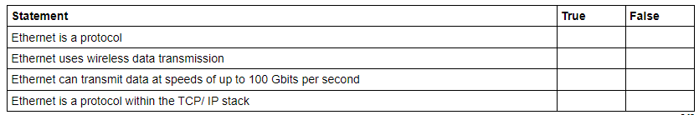
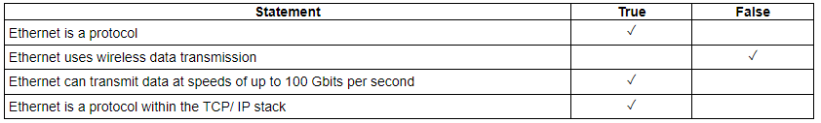
Typical exam questions
Naomi’s office has five computers connected into a Local Area Network (LAN). There is also one printer that all the devices can print to. Ethernet cables are used within the office building. Tick one box in each row to identify if the statement about Ethernet is True or False. [4]
Answer: 1 mark for each row. Marks: 4 Guidance: 2 ticks in 1 row = 0 mark

Slide 32
Typical exam questions
A doctor's surgery stores hundreds of patients' details on its computer network. The surgery is concerned about the security of its patients' sensitive medical data. 32. Identify three errors that the surgery's staff could make, that may endanger the security of the network and outline a procedure that could be put in place to prevent each error. [6]
Answer: Brings in files via any medium (1- AO2 1a)… …not allowing/stopping external devices being used on the network (1-AO2 1b) Downloading infected files from the internet (1 - AO2 1a)… …blocking/restricting access tinsecure websites (1 - AO2 1b) Allowing physical access to the surgery's network (1 - AO2 1a)… …locking of doors/key cards/any physical security procedure (1 - AO2 1b) Sending/sharing sensitive data with third parties (1- AO2 1a)… … blocking/restricting access to USB ports/email/internet/printing (1 - AO2 1b) Marks: 6 Guidance: 1 mark to be awarded for each correct identification to a maximum of 3 marks. (AO2 1b) 1 mark to be awarded for each correct outlining of a procedure to a maximum of 3 marks. (AO2 1b) Allow any reasonable combination of error and reasonable procedure to mitigate the risk.

Slide 33
Typical exam questions
A house has computers in each room and a central router. Every room allows both Ethernet and WiFi connections to the router. The house owner is concerned about potential threats to the network from being connected to the Internet. 33. Describe three possible threats to the computers connected to the network and give one way each threat can be reduced or prevented. [9]
Answer: 1 mark for naming threat, 1 for description, 1 for prevention. Max 3 per threat e.g. Virus / trojan / worm / malware Piece of software/code/a program that replicates itself // causes damage e.g. editing/deleting files Running anti-virus/anti-malware software // don’t download from unknown sources // don’t click on unknown links Spyware / malware / keylogger Piece of software/code/a program that records actions/key presses and sends this data to a third party for analysis Running anti-spyware/anti-malware software/firewall | Data interception / passive Data is sent to another device and is intercepted by a third party Encryption Phishing An e-mail has a link that when clicked directs the user to a fake website that collects personal data Network policy // firewall Pharming A piece of code installed that redirects user to fake website that collects personal data Anti-malware // firewall Hacker Person attempting to gain unauthorised access to the network/computers/ data/files // unauthorised access and then deleting/editing data/files Firewall // strong password // biometrics // penetration testing | Brute force attack Person/software using every combination of passwords to gain access Firewall//strong passwords Social engineering Person being the weak point of the system // by example e.g. any example of deception e.g. Strong passwords // check validity of sources Marks: 9 AO1 1b (3) AO2 1a (3) AO2 1b (3)

Slide 34
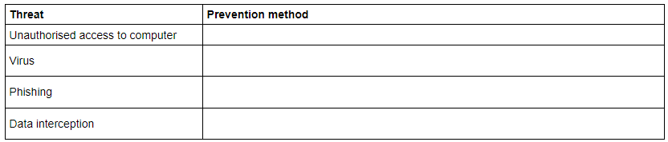
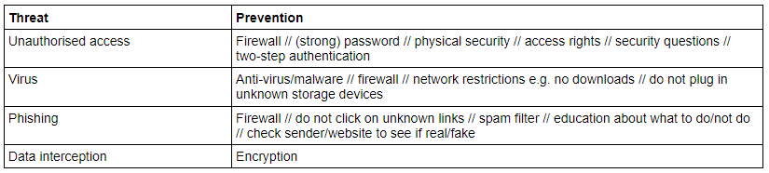
Typical exam questions
Data in computer systems is valuable and at risk of loss, damage or being stolen. The table has four potential threats to data. 34. Write one prevention method for each threat in the table. Each prevention method must be different. [4]
Answer: 1 mark for a suitable prevention Marks: 4 Guidance: Mark first in box Do not mark repeat

Slide 35
Typical exam questions
A hospital stores patients’ details on its computer network. The hospital is concerned about the security of its patients’ details. 35. Staff already use strong passwords to protect systems. Explain, with reference to system security, three other ways that the hospital could protect the network system. [6]
Answer: Firewall (1 – AO2 1a) prevents unauthorised access (1 – AO2 1b) Anti-malware (1 – AO2 1a) removes viruses/spyware from infecting the system (1 – AO2 1b) Encryption (1 – AO2 1a) any intercepted data is rendered useless (1 – AO2 1b) User access levels (1 – AO2 1a) users have restricted access (1 – AO2 1b) Network policies (1 – AO2 1a) rules that define acceptable use (1 – AO2 1b) Marks: 6 AO2 1a (3) AO2 1b (3) Guidance: 1 mark to be awarded for each correct type to a maximum of 3 marks. (AO2 1a)

Slide 36
Typical exam questions
Data in computer systems is valuable and at risk of loss, damage or being stolen. 36. Name two other threats to the data in a computer system and give a method of preventing each. [6]
Answer: 1 mark for each suitable threat, and 1 mark for suitable prevention e.g. Spyware (1) anti-spyware (1) Pharming (1) Check web address is valid(1) DOS/DDOS (1) Use of proxy server/firewall (1) Ransomware (1) Use of antimalware (1) SQL injection (1) Network forensics/suitable form validation (1) Social engineering // people as a weak point (1) training (1) Poor network policy (1) education/setting rules (1) Hardware failure/loss (1) Backup (1) Marks: 4 Guidance: Award different types of virus e.g. worm, trojan separately. Do not award hacking, brute-force - both covered in unauthorised access. BOD malware

Slide 37
Typical exam questions
A school has all of its computers in a local area network (LAN). 37. Explain two measures which the school will need to take to ensure the security of the network. [4]
Answer: e.g. Passwords protected user accounts … to ensure that only authorised people can access the network. Network policy restrictions e.g. students only allowed to log in during school hours, from certain computers … ensures that attempts to enter in the system are likely to be genuine. Different levels of access / each user can only access the files they need … prevents accidental damage to files. Firewall… … to prevent unauthorised access / hacking into the network. Marks in pairs. Award one mark for a correctly identified measure and another mark for an appropriate expansion explaining how this measure improves security Marks: 4 Guidance: Filtering / censoring is not answering the question (unless candidates explain that web sites known to pose a security threat – e.g. because they are known to distribute viruses – are filtered)

Slide 38
Typical exam questions
Amin buys a new computer with an operating system and some utilities. 38. State two functions of the operating system. [2]
Answer: e.g. Provides interfaces between user and computer / Determines look and feel of the computer Provides a platform for software to run Manages peripherals used by the system Manages memory Marks: 2

Slide 39
Typical exam questions
Julian buys a new laptop with a system information utility and a diagnosis utility. 39. Describe, using examples, the purpose of the system information and diagnosis utilities. [4] System information utility Example Diagnosis utility Example
Answer: System information: displays important data about the current state of the computer e.g. temperature, free memory, network speed, % processor used Diagnosis: attempts to detect / resolve items that are not working correctly e.g. missing drivers, network connection Marks: 4 Guidance: 1 mark each for explaining “system information” and “diagnosis” + 1 mark for each example – accept relevant examples, but not examples related to virus / malware for diagnosis. Examples should be specific examples of the use of these utilities rather than general descriptions.

Slide 40
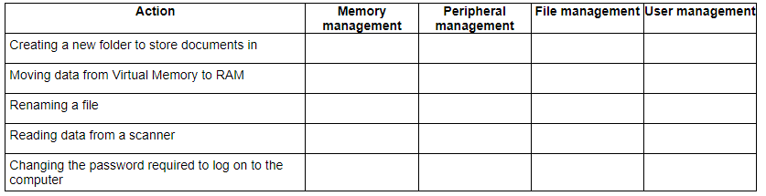
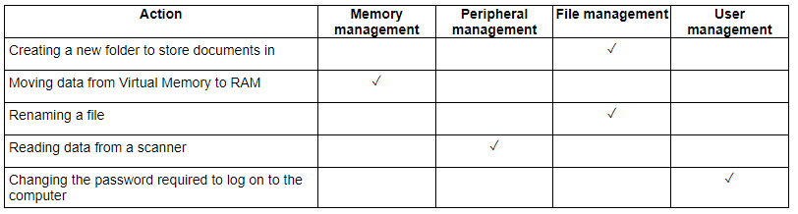
Typical exam questions
Eve’s computer has system software including an Operating System and Utility Software. 40. Tick (✓) one box in each row to identify which function of the Operating System deals with each action. [5]
Answer: 1 mark per row Marks: 5 Guidance: No mark awarded if 2+ ticks on each row

Slide 41
Typical exam questions
Security on a computer can be provided directly by the operating system or by using utility programs. Utility programs include antivirus, file transfer, firewall and system cleanup. 41. State which two of these utilities can be used for security. [2]
Answer: antivirus firewall Marks: 2

Slide 42
Typical exam questions
Eve’s computer has system software including an Operating System and Utility Software. Eve runs the defragmentation program on her computer. 42. Explain why Eve’s computer is more efficient after the program has been run. [3]
Answer: 1 mark per bullet to max 3 Takes less time to read/access a file because the data/files/pages are contiguous …. so it does not need to move as far to read the next piece of data/file/page …because it is in the next memory location Takes less time to save new data/files because there is larger free space together …so it does not need to split the data/file … and can store them in contiguous spaces Marks: 3

Slide 43
Typical exam questions
William is creating a film for a school project using a digital video camera. William can choose between a full or incremental backup. 43. Identify the backup method William should use to backup the computer, justifying your choice. [3]
Answer: i)1 mark per bullet to max 3 e.g. Incremental: Only the changes need to be backed up The software/OS/settings are unlikely to have changed between backups Small number of files likely to be used/edited between backups Take less time to backup Each backup will take less memory space to store Full: Backup all the data/files and software It might not take a significant time to back up entire system He might only have a small number of files to be backed up each time Safer as have more past versions to revert to User may have changed settings on computer Faster to restore the backup Needs to do a full before he can do an incremental Marks: i) 3 AO2 1a (1) AO2 1b (2) Guidance: i)Discussion must match the backup given. Either method is acceptable, marks are awarded for the justification. Allow marks for why the other is not appropriate. If there is no method given, or both, then read the answer and mark their justifications. It must be clearly given which method each point refers to.

Slide 44
Typical exam questions
Amin buys a new computer with an operating system and some utilities. Some of the software in Amin's computer is open source. 44. Describe what is meant by open-source software. [2]
Answer: The source code is distributed with the software The customer can modify the source code The customer can redistribute the source code (with the same licence / restrictions) Marks: 2

Slide 45
Typical exam questions
William is creating a film for a school project using a digital video camera. William wants to upload his videos on the Internet and is considering releasing them under a Creative Commons license. 45 Explain how a Creative Commons license will impact the use of William’s videos by other people. [3]
Answer: 1 mark per bullet to max Allows free distribution // other people can use/edit his work Other people can redistribute his work Can choose to restrict other people to be able to use/edit/share the videos Work is still copyrighted // others cannot claim it as their own No-derivative …William can set that if others edit it they cannot redistribute it with the edits attribution …Can insist e.g. on having his name on it if re-used // referencing // must be credited Can insist on non-commercial use // others cannot sell/profit from his work // personal use only Marks: 3 AO1 1b (1) AO2 1a (1) AO2 1b (1) Guidance: “People need to ask to use it” is not enough.

Slide 46
Typical exam questions
Daniel is a medical researcher trying to find a cure for a disease. He has a team of hundreds of people carrying out medical testing. Recent developments in Artificial Intelligence (AI) mean that a computer program could do the work of dozens of researchers in a much shorter time. Daniel decides to increase his use of Artificial Intelligence. Discuss the issues surrounding this decision. Consider the following in your answer: [8] ethical issues legal issues cultural issues
Guidance: The following is indicative of possible factors/evidence that candidates may refer to but is not prescriptive or exhaustive: Indicative Content: Ethical Replacing people with machines Loss of jobs Community will suffer Work will be completed faster May find a cure faster More reliable calculations Save more lives Legal More secure than people seeing personal data May be at risk if not backed up May be at risk of threats e.g. hackers Who is responsible if there is an error Cultural Removal of people from workforce Change in demand for skills Need people to manage the hardware/software instead of medical expertise Skills may be lost | Marks: 8 AO2 1a (4) AO2 1b (4)

