Slide 1

Mrs Crozier’s Photoshop Tips

Slide 2
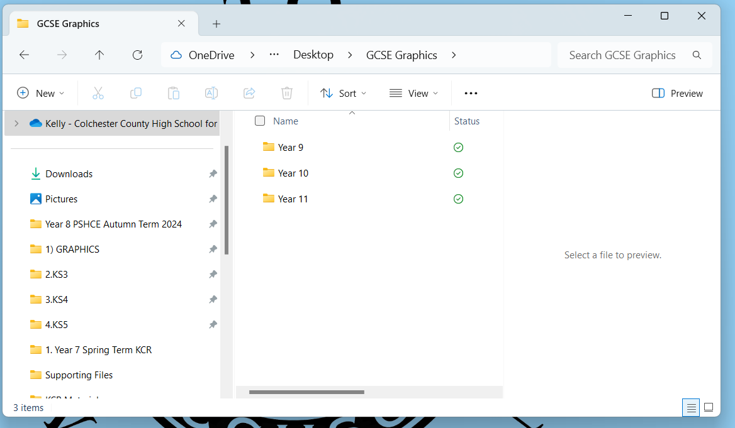
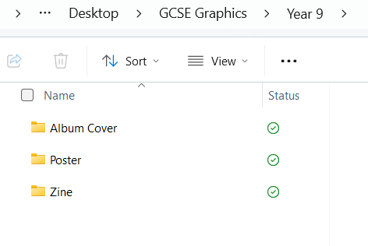

File Organisation:
First thing’s first…
This is important!
You might be asked to reprint files from Year 9 or 10 at the end of the GCSE course as part of your final coursework submission. You MUST be able to find them if necessary! It is just good housekeeping to organise your files correctly.

Slide 3
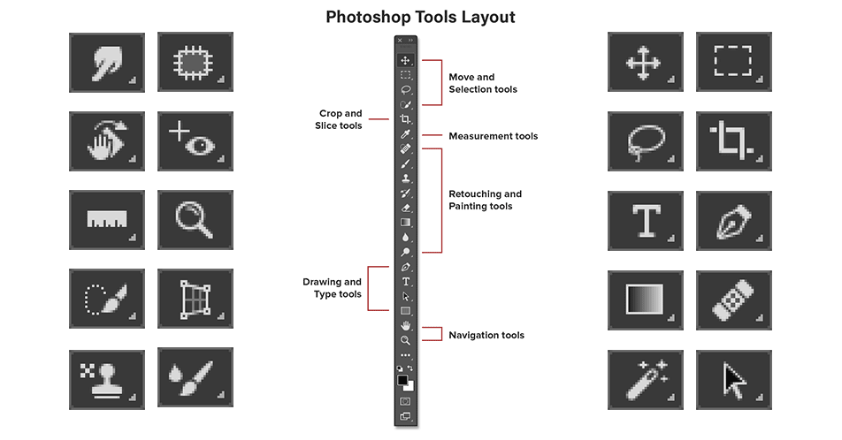
Hover over any tool with the mouse to see the name of the tool.
Any tool with a small triangle in the corner has multiple tools nester under it. Click and hold to see the selection available, and click to select.

Slide 4
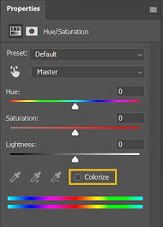
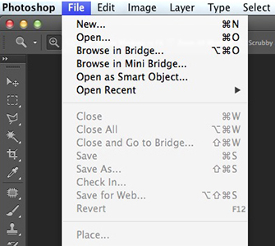
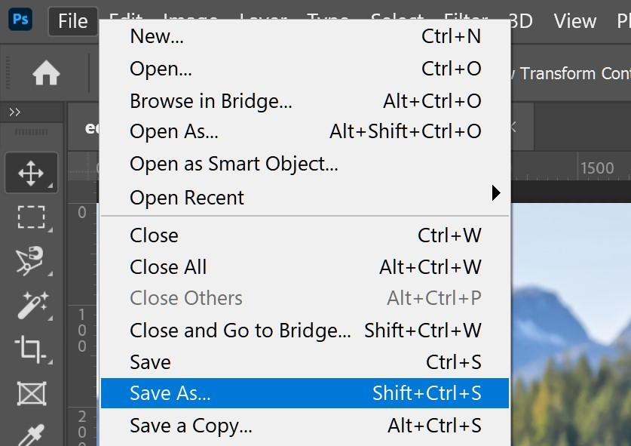
Photoshop Tips:
Open:
Go to the file menu and select Open. Navigate to the image or file you want to open and click to select it. Remember to save and and store all files on OneDrive to ensure you have access both at school and at home.
Save As:
To rotate your whole image, go to Image > Image Rotation and select the appropriate menu item. To rotate individual layer items, go to Edit > transform > free transform. Hover over the corners of the selected box until the double headed arrows appear which will let you rotate your item wherever you like.
Change colour:
A quick and basic way to play with colour in your image. Go to Image > Adjustments > Hue & Saturation. Use the top slider to change the colour hues across your image. You can also select just a portion of your image and change the hues only for the selected area.

Slide 5
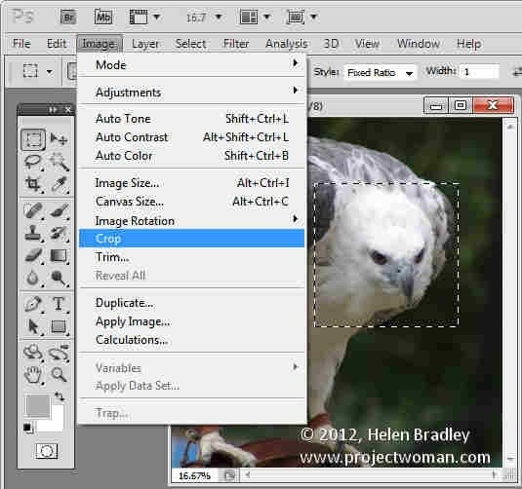
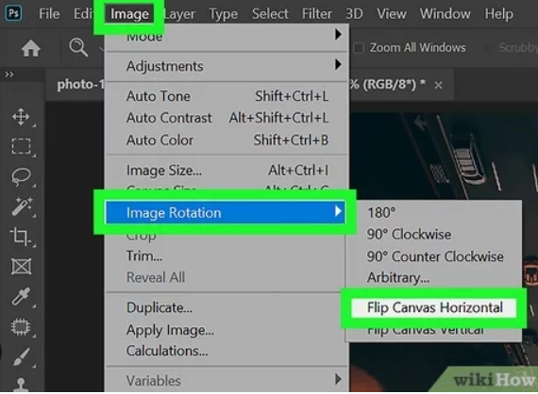
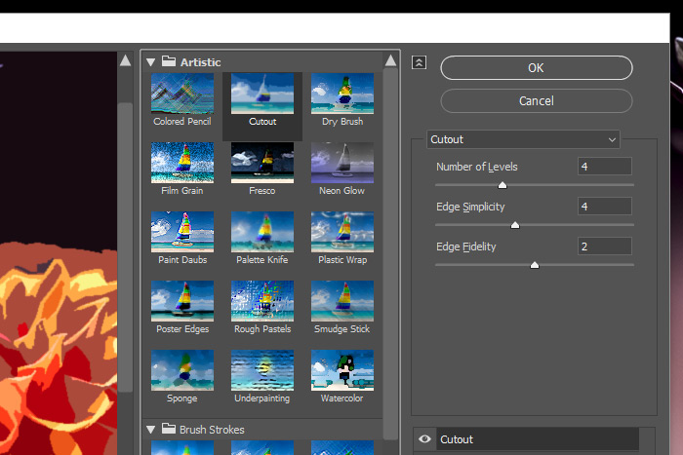
Photoshop Tips:
Crop:
Select the area you want to keep using the selection tool (dotted square). Go to image > crop to delete everything outside of the square. To crop a more organic shape, use the lasso tool to draw a selection and use the same method to crop.
Rotate or Flip:
To rotate your whole image, go to Image > Image Rotation and select the appropriate menu item. To rotate individual layer items, go to Edit > transform > free transform. Hover over the corners of the selected box until the double headed arrows appear which will let you rotate your item wherever you like.
Filters:
The filters menu can give you lots of interesting effects, however these should not be considered an end point in themselves. Use sparingly and only when they bring something new and relevant to your idea!

Slide 6
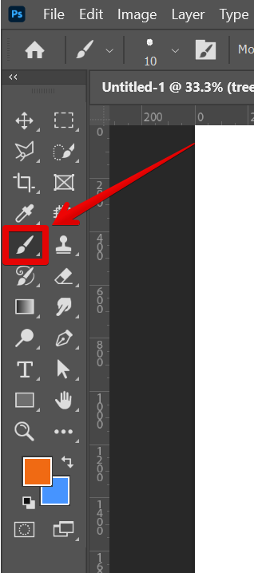
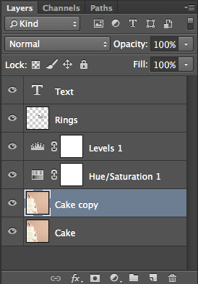
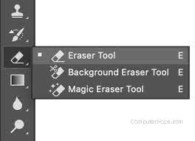

Photoshop Tips:
Eraser:
This tool will allow you to erase areas of your image or layer. You can adjust the size of the brush, its hardness, and it’s opacity.
Layers:
This will allow you to select and add effects to each different layer of your composition, Try experimenting with layer effects, under the dropdown (Marked here as ‘normal’.
Brush:
This tool will allow you to freehand paint colours onto your canvas. . You can adjust the size of the brush, its hardness, and it’s opacity.

Slide 7
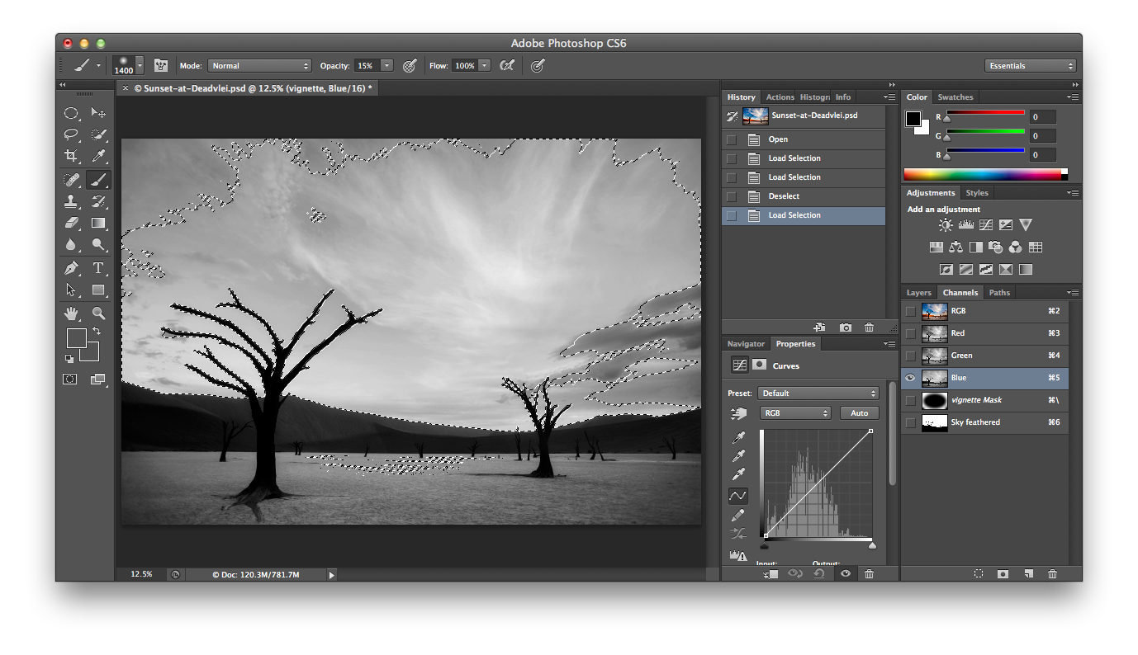
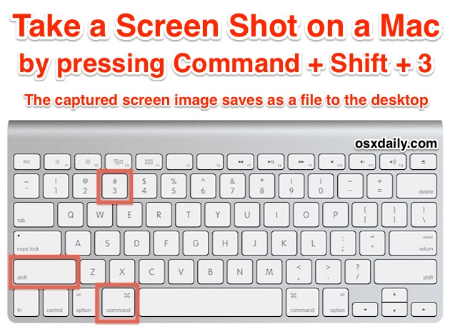
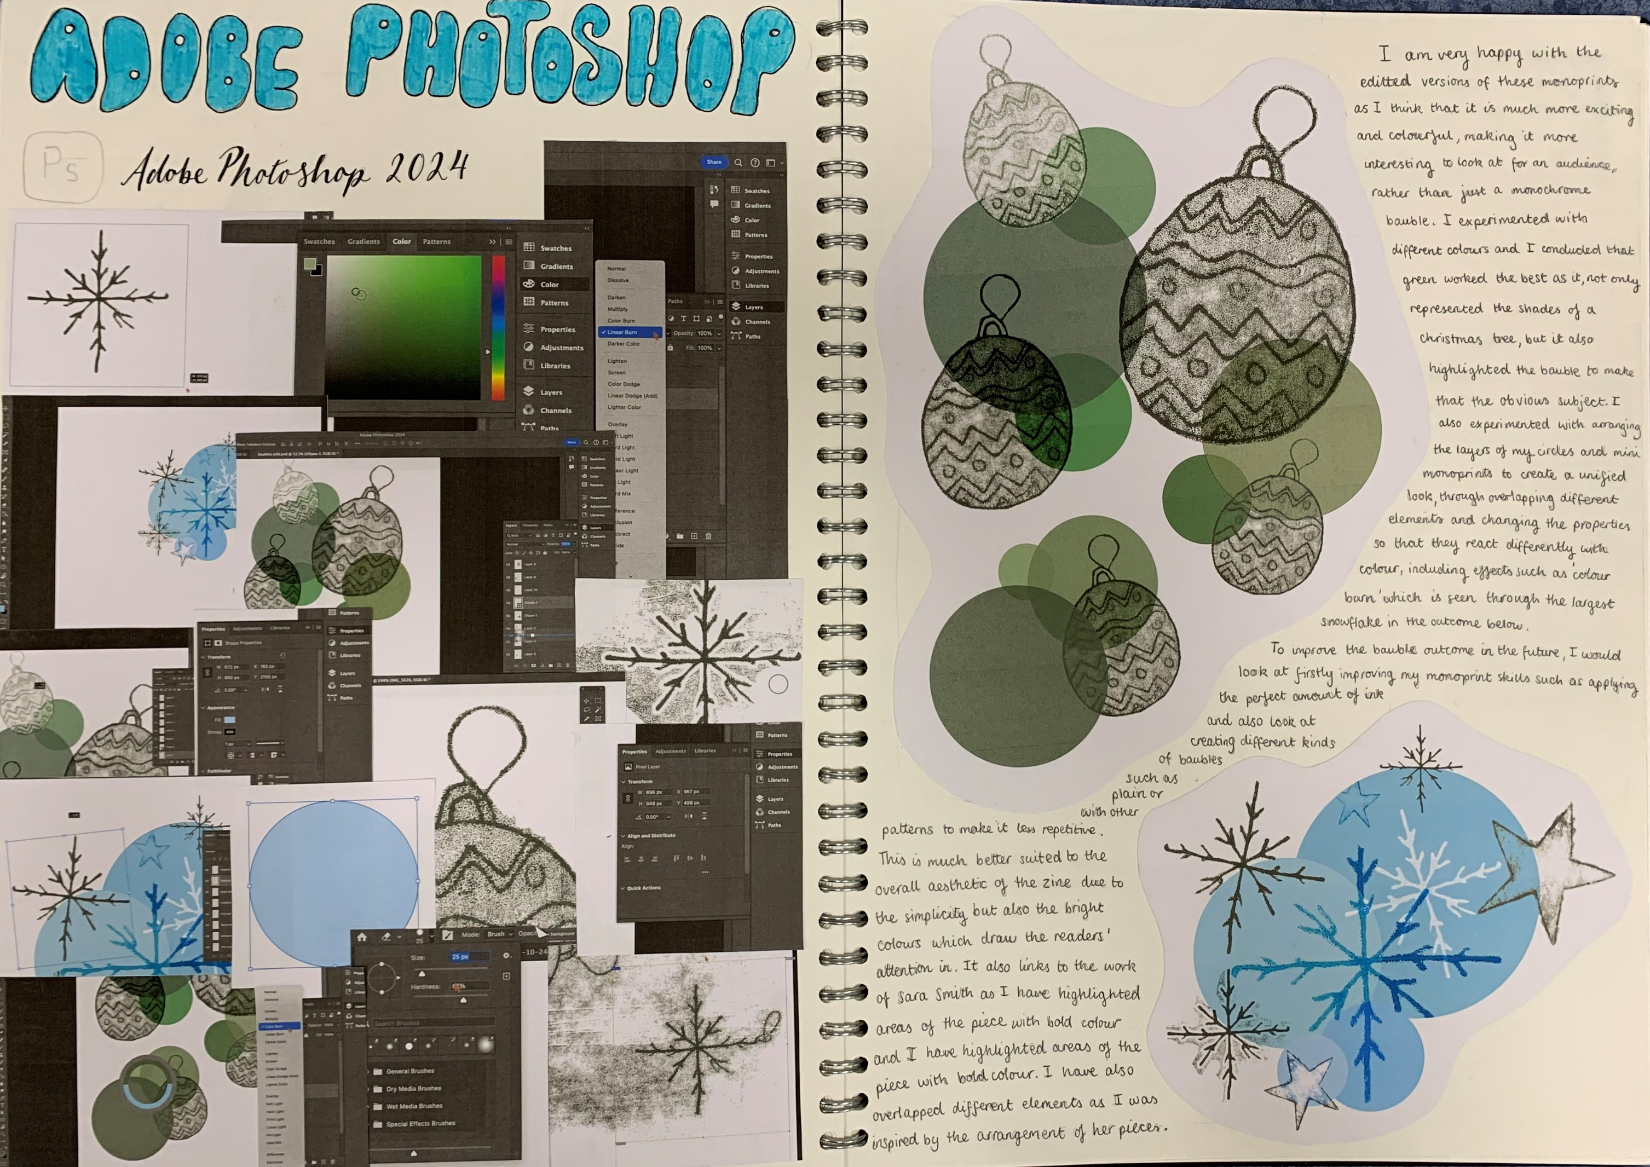
On a PC, use the snipping tool
Screenshots will help you to record (A03) the processes and stages you go through whilst you experiment. Move them to your OneDrive file once saved.

