Slide 1
By hand in, you should have:
Mind Map
5-7 ideas for your cover. Think about lyrics, text, symbols, colours etc.
Mood Board
Already completed for homework
Initial ideas thumbnails sketches of possible routes for development (5-7) with annotations
Planning and experimentation
Development of your unique outcome. Consider typography, graphics, photography, textures, colours. Practice things in lots of ways. Save thumbnails of your developments to print and annotate in your book.
Artist Research
Hipgnosis research and response plus AT LEAST one other relevant to your own personal route of inquiry (See suggestions document on TEAMS.)
Final plan (In colour)
You should know EXACTLY what you are going to do before you enter the exam!
Outcome
Final artwork displayed on a digital mockup and printed at A3 for your book.
Evaluation
How successful was your outcome? What could you improve/adapt? Ensure that you refer back to the brief.

Slide 2
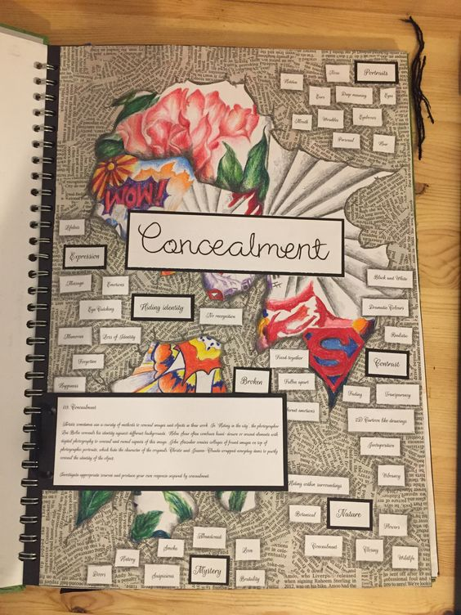
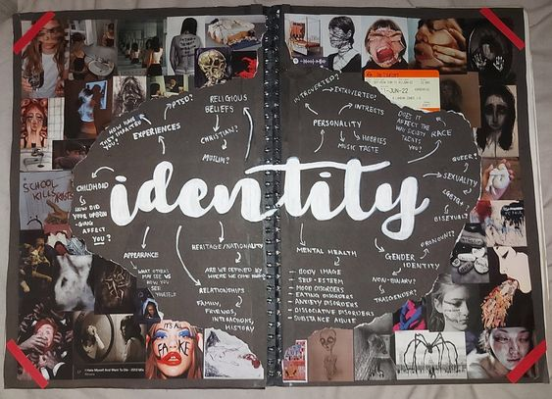
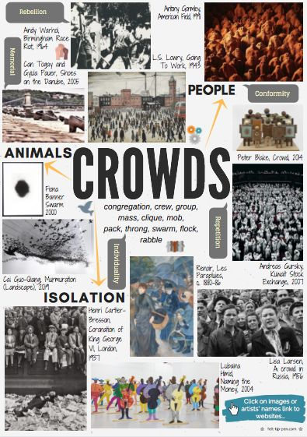
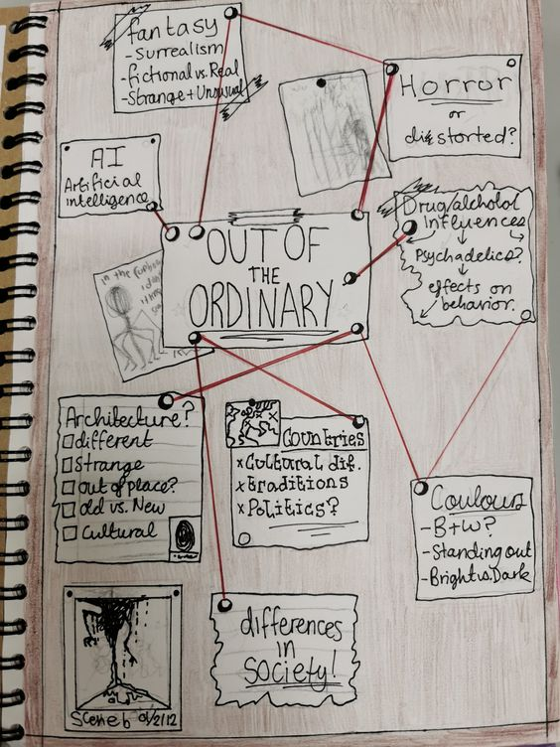
Your mind map might feature imagery and original artwork as well as written or printed words
Mind Map: WAGOLL
Digitally or traditionally created

Slide 3
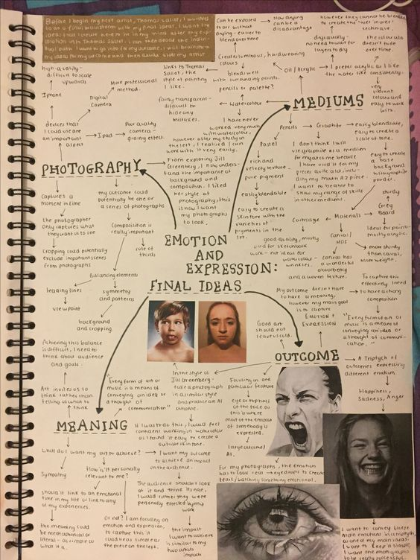
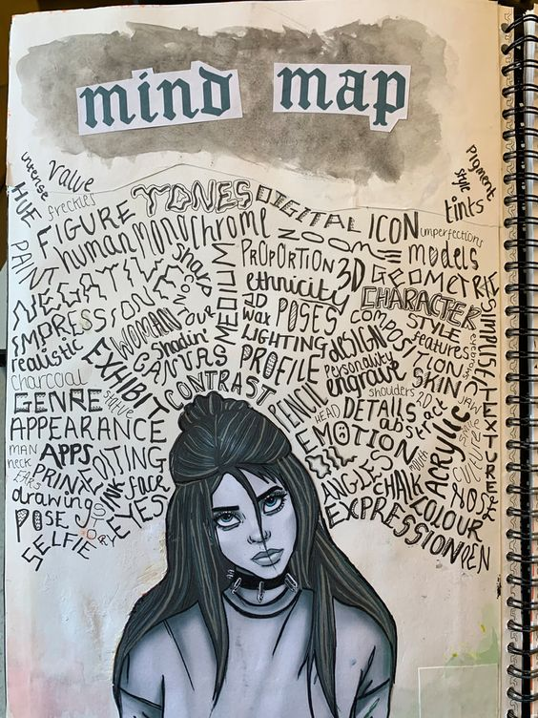
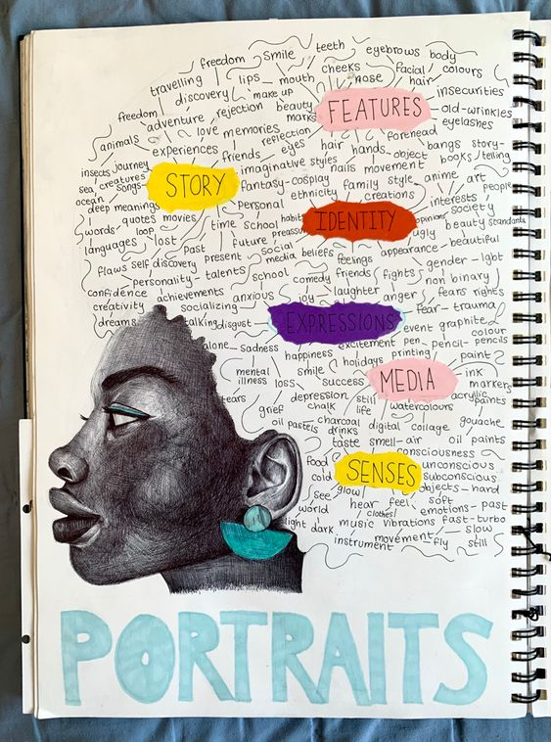

Slide 4
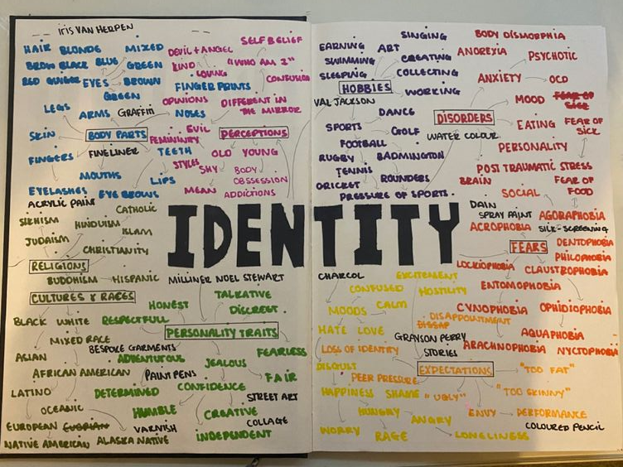
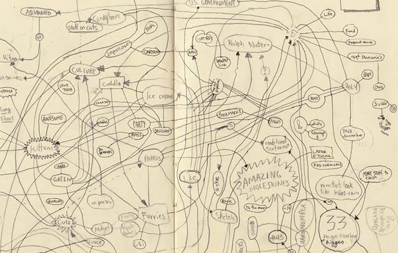
Even if you present your mind map very simply, you can still make it aesthetically pleasing by considering layout, colour and clarity.

