Slide 1
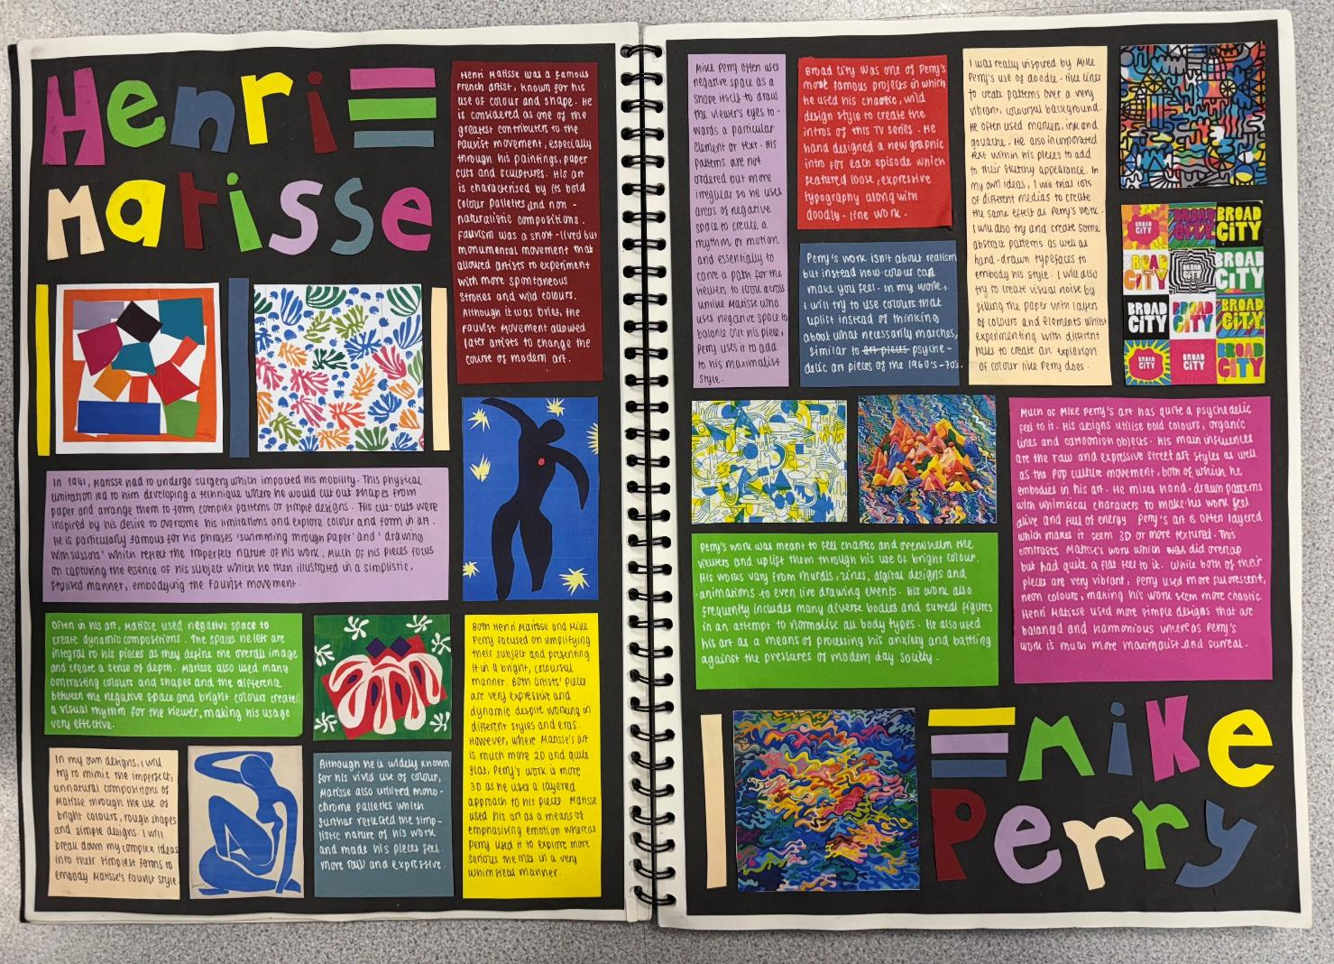
Matisse & Perry:
WAGOLL
Research / Context (AO1):
Do not merely describe. You must analyse, contextualise and evaluate too for higher marks (DACE Method)
Add your own opinions – how do you see this research informing your work?
Refer back as work progresses.
“The investigation process shows exceptional critical understanding of the context of own ideas and the sources which have informed them” (16-18/18 for a grade 9)

Slide 2
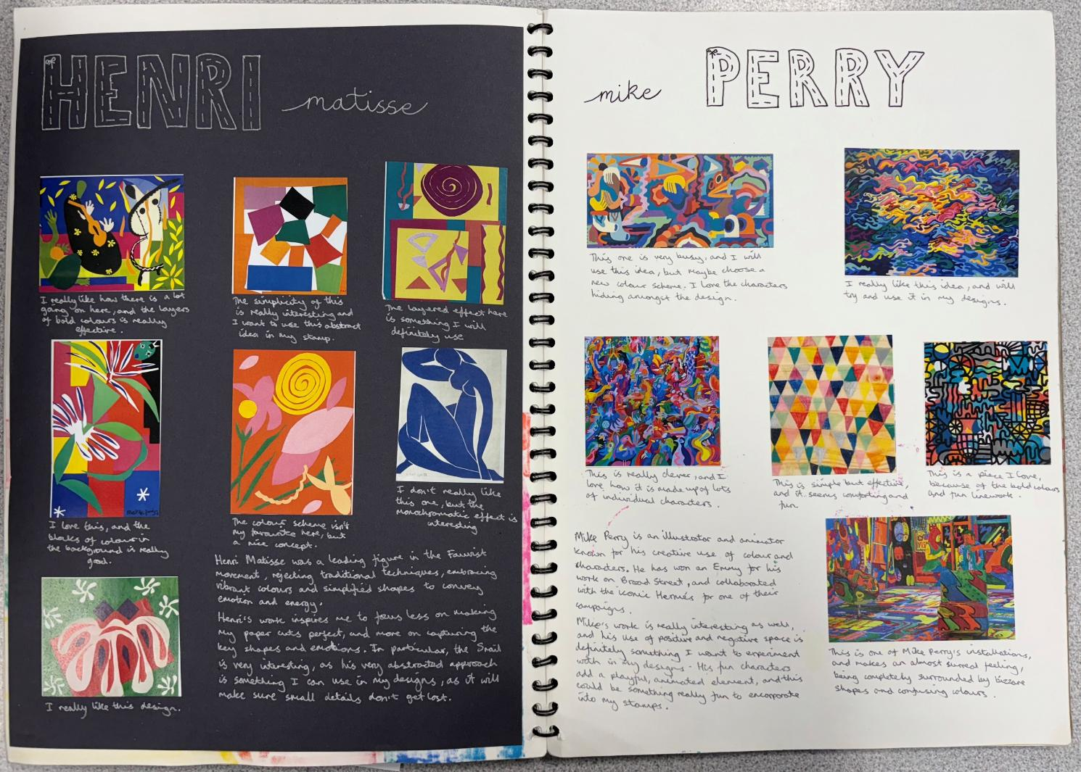
Include relevant images of the
artists work:
Remember, we are looking at Matisse’s papercut pieces, NOT his paintings!

Slide 3
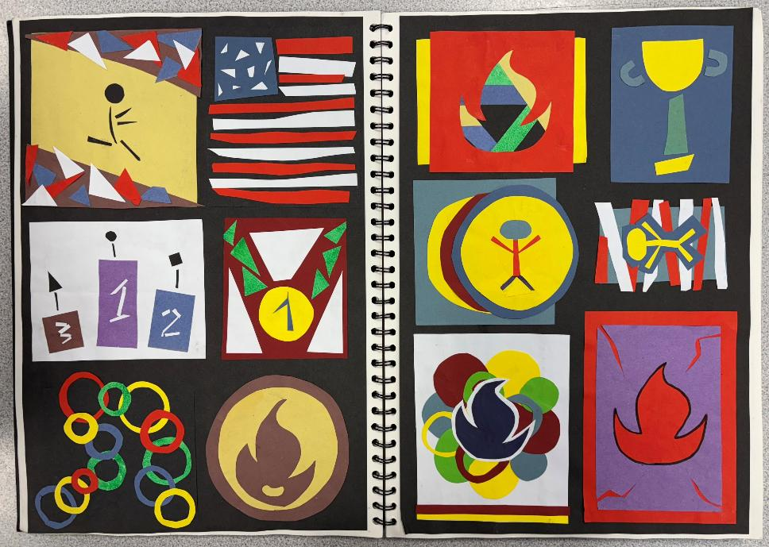
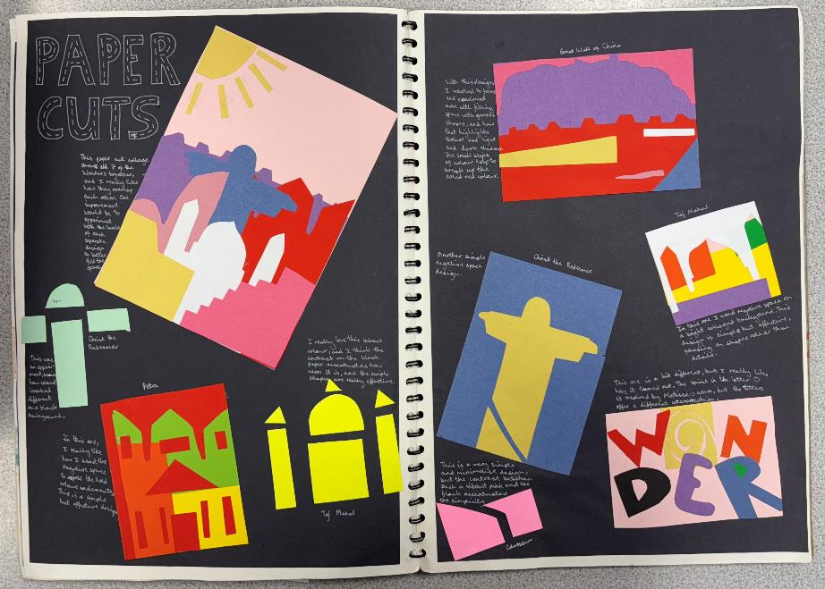
Refining the idea (AO2):
Explore and experiment with the media, linking back to your initial ideas for your outcomes.
Annotate your experiments and then re-work your ideas depending on your findings.
Take creative risks and learn from any mistakes.
“Exceptional ability to select and experiment with media, materials and processes appropriate to personal intentions”
“Exceptional ability to explore ideas through a process of experimentation and review”
(16-18/18 for a grade 9)
Main areas of focus:
COLOUR – SHAPE – NEGATIVE SPACE

Slide 4
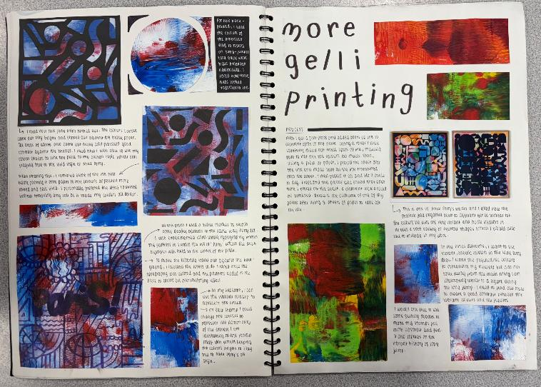
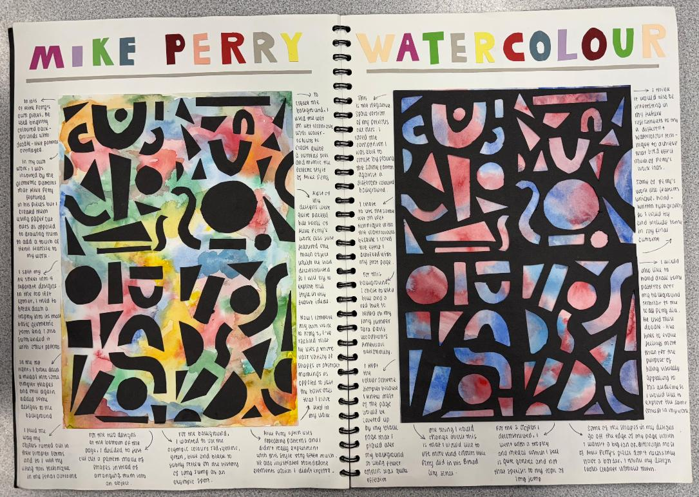
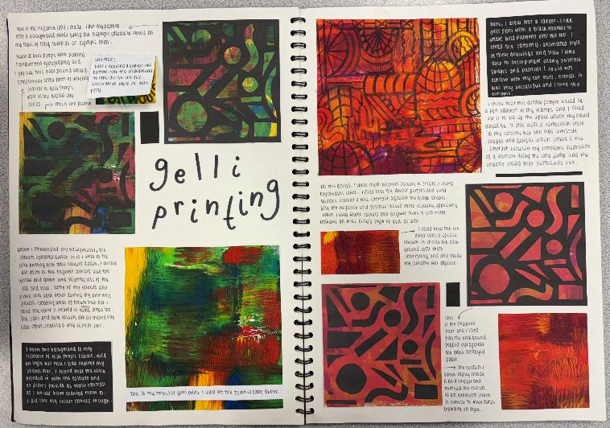
Make sure that the flow of your pages makes sense: Artist research THEN working in the style of the artist THEN final outcome and evaluation: Anyone should be able to pick up your sketchbook and read it like a book to understand your process.

Slide 5
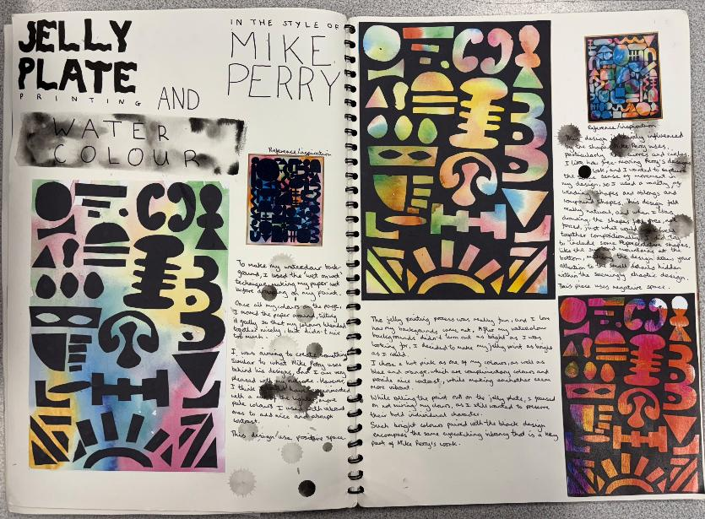
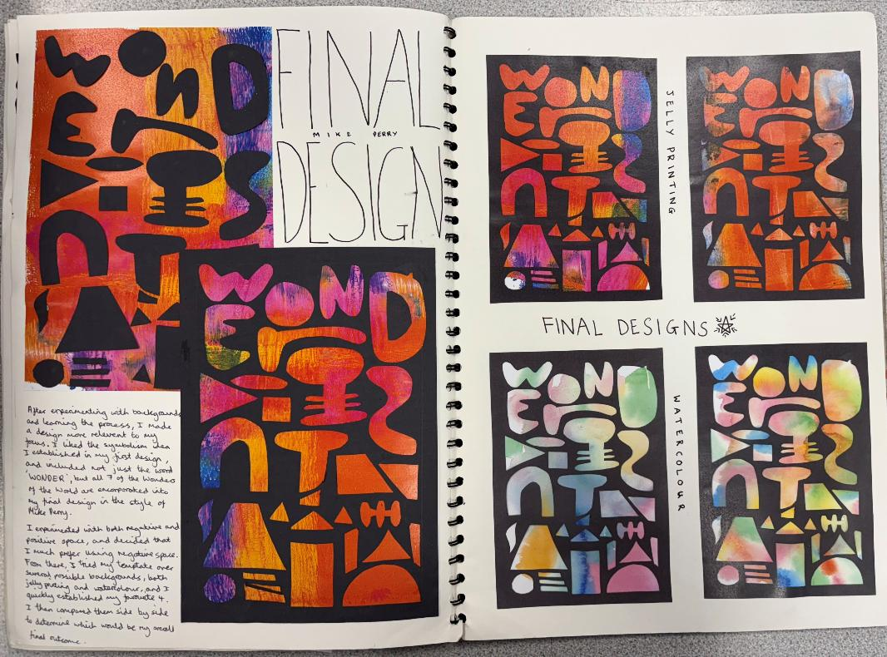
“Exceptional ability to produce a personal and meaningful response”
“Exceptional ability to realise intentions”
(16-18/18 for a grade 9)
Presenting Ideas and outcomes (AO4):
Present does not just mean the final outcome, it also reflects how you present ideas throughout your project. Your final outcome should bring together all your research and planning to a well-informed outcome that shows your strengths.
Your final outcome should make sense as a visual conclusion to your project.

