Slide 1
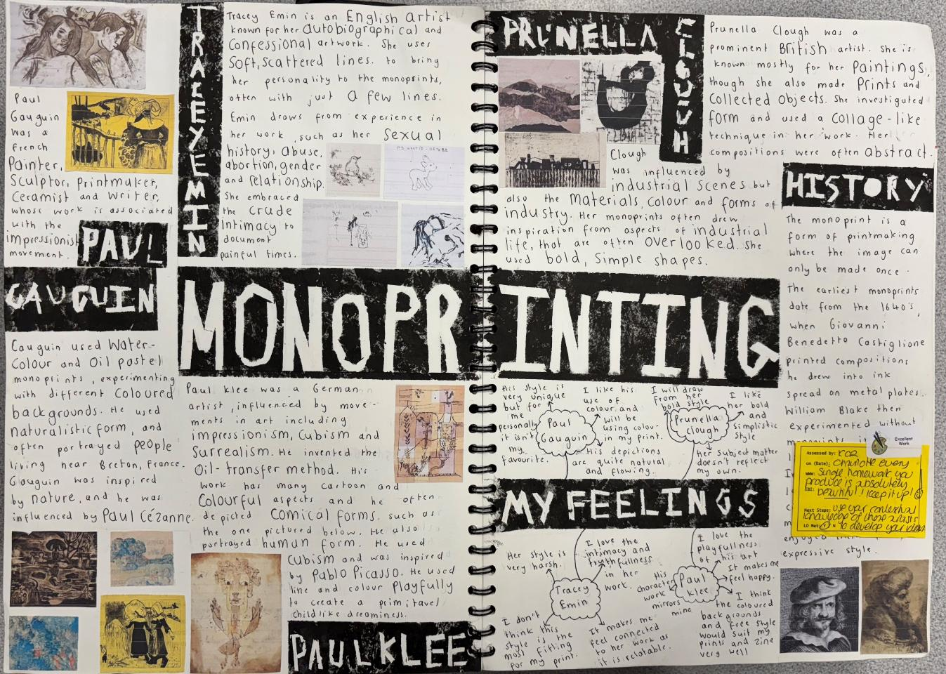
Graphic Monoprint: WAGOLL
Research / Context (AO1):
Do not merely describe. You must analyse, contextualise and evaluate too for higher marks (DACE Method)
Add your own opinions – how do you see this research informing your work?
Refer back as work progresses.
“The investigation process shows exceptional critical understanding of the context of own ideas and the sources which have informed them” (16-18/18 for a grade 9)

Slide 2
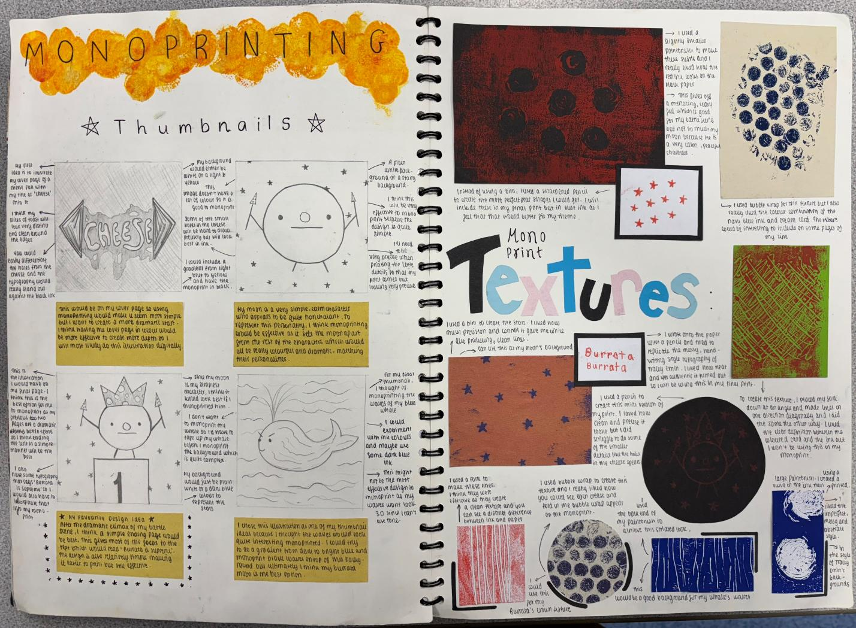
Developing the idea:
Create quality thumbnails with annotations to explain your ideas and your intentions for development.
Explain how these ideas link to the context of your work (Artists/research/theme)
“The investigation process shows exceptional critical understanding of the context of own ideas and the sources that have informed them” (16-18/18 for a grade 9)

Slide 3
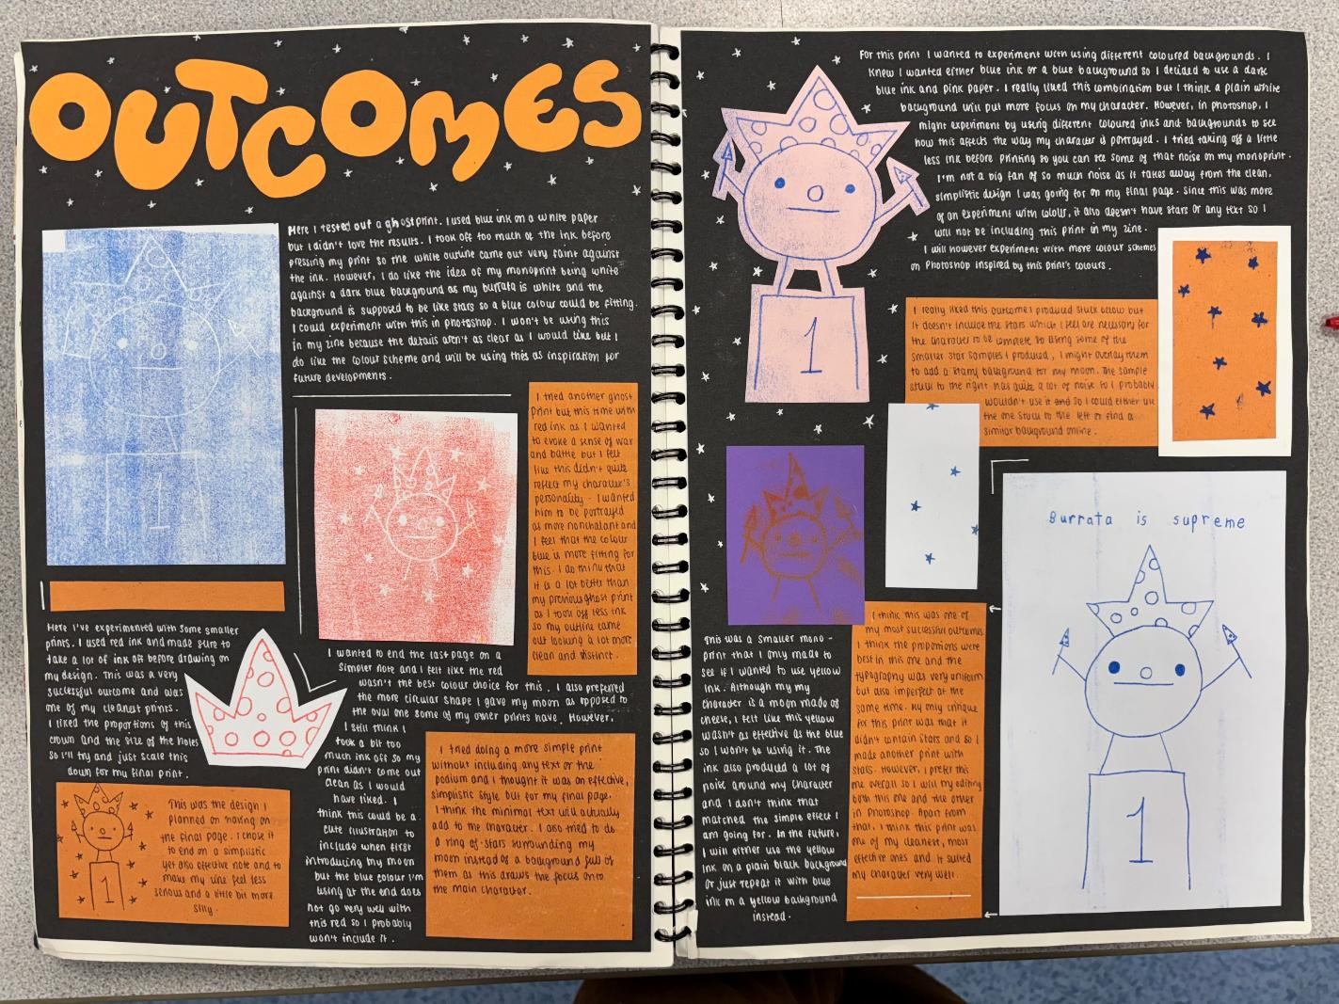
Refining the idea (AO2):
Explore and experiment with a range of media and processes, including digital.
Annotate your experiments and then re-work your ideas depending on your findings.
Take creative risks and learn from any mistakes.
“Exceptional ability to select and experiment with media, materials and processes appropriate to personal intentions”
“Exceptional ability to explore ideas through a process of experimentation and review”
(16-18/18 for a grade 9)

Slide 4
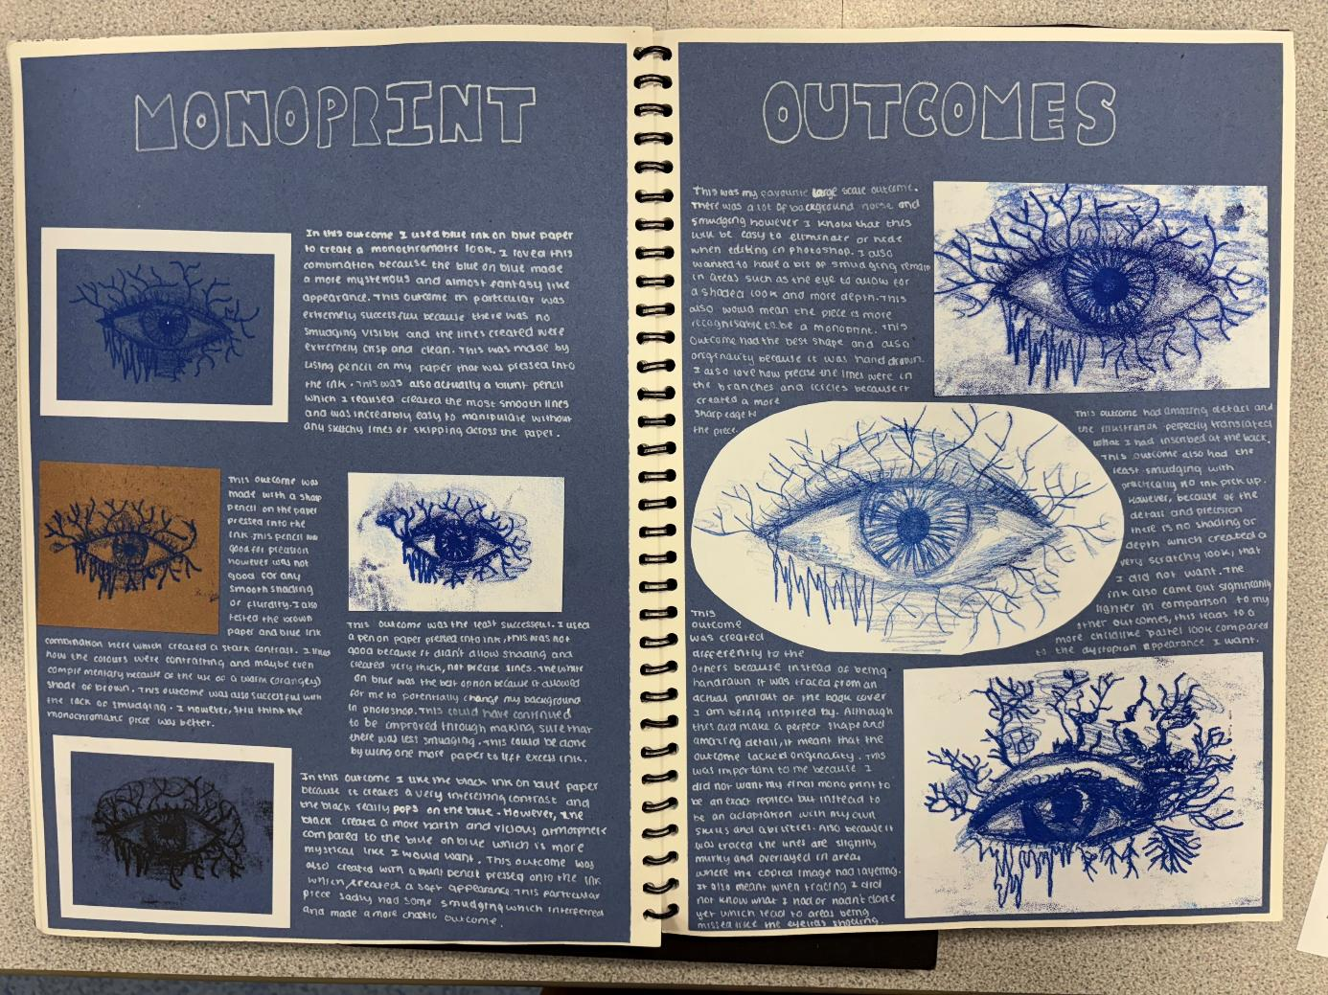
Recording Ideas (AO3):
Work from first hand observations.
Take high quality photos and work from your own imagery where possible.
Use a variety of recording techniques.
“Exceptional ability to record ideas, observations and insights related to personal work and the work of others through visual and other methods.”
“Exceptional ability to record relevant to intentions” (16-18/18 for a grade 9)

Slide 5
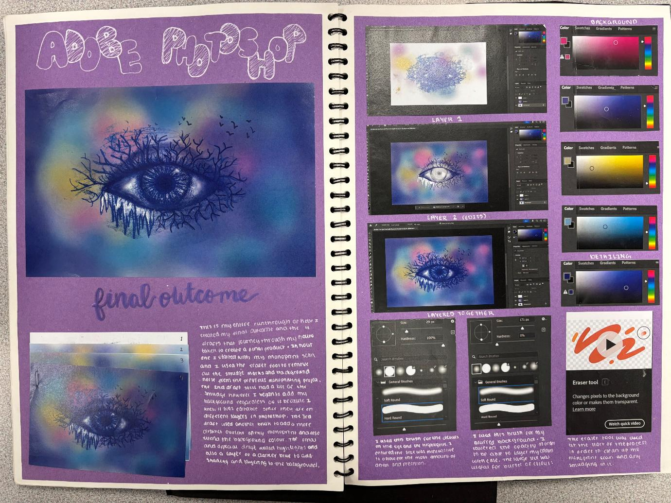
Presenting Ideas and outcomes (AO4):
Present does not just mean the final outcome, it also reflects how you present ideas throughout your project. Your final outcome should bring together all your research and planning to a well-informed outcome that shows your strengths.
Your final outcome should make sense as a visual conclusion to your project.
“Exceptional ability to produce a personal and meaningful response”
“Exceptional ability to realise intentions” (16-18/18 for a grade 9)
Note: This visual does not show a final outcome per-se, more just a conclusion to this section of the project (Monoprint)

