Slide 1
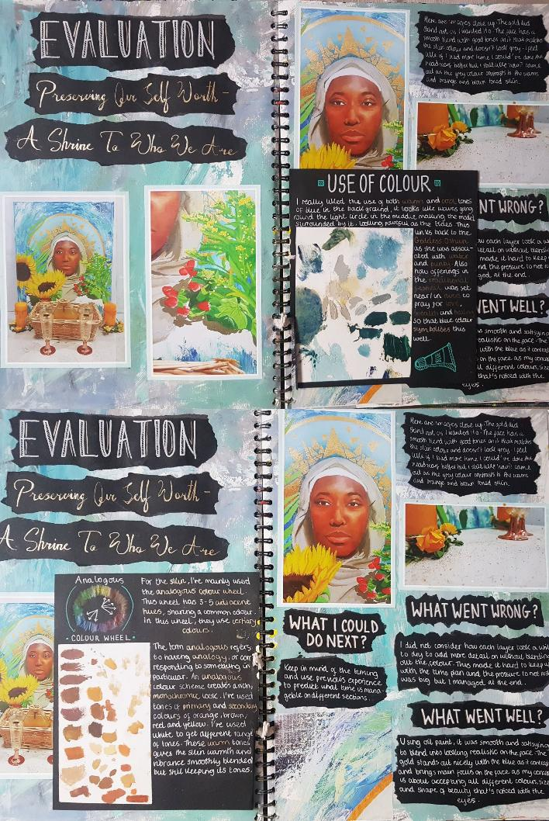
Analysing and evaluating: WAGOLL
Artists and designers often record ideas, observations and insights that come to them as they produce their work. These insights can help them to analyse and evaluate the effectiveness of the work that has been produced.
Being able to analyse a work is an essential part of evaluating it. Recording this evaluation ensures that the creative process is communicated clearly.
Evaluation is an opportunity to:
discuss your development and final work
help others understand what you were trying to achieve
explain your successes and weaknesses
demonstrate your knowledge and understanding of art and design

Slide 2
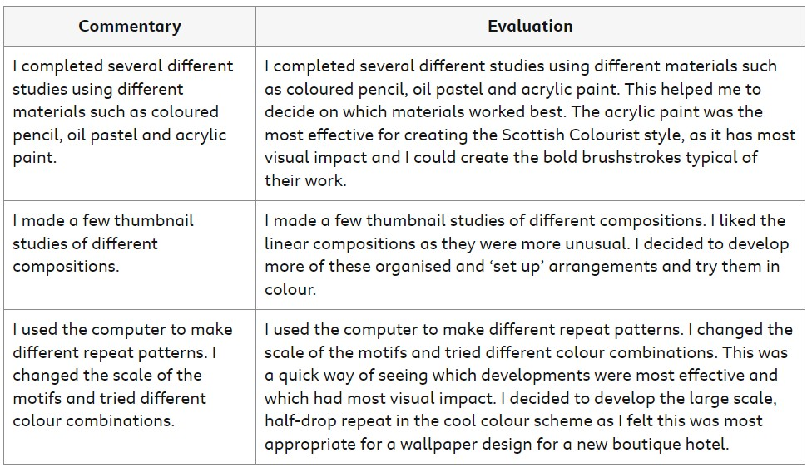
How to write an evaluation in art
Evaluation
Evaluation may include some commentary/explanation, but it will also include critical comment.
To evaluate, you need to reflect on your work and make judgements about its effectiveness or success. Read through the examples to help you understand the difference between commentary and evaluation.

Slide 3
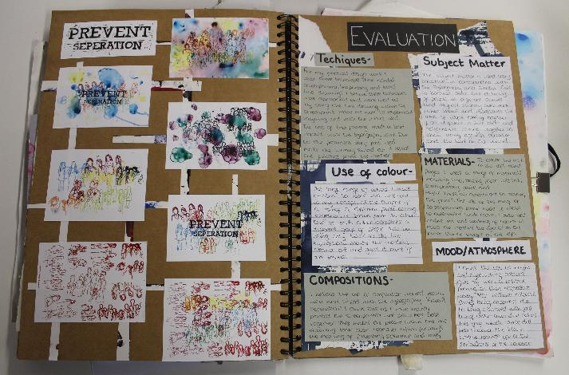
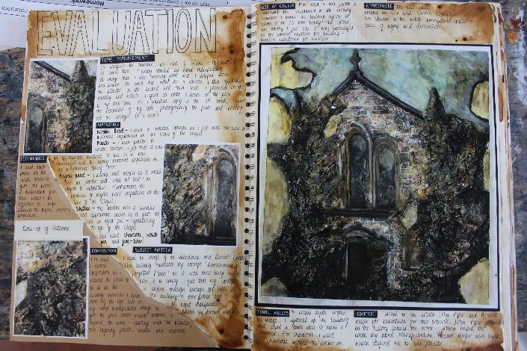
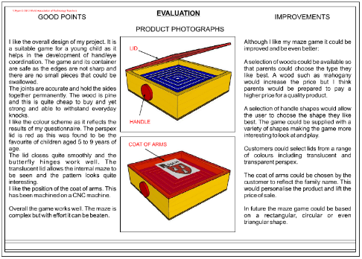
Review and reflect on your final piece:
How have you used visual elements such as line, colour and shape, and what was the effect?
What materials did you use, and why? Did they work successfully?
What meaning and messages did you want to convey and were you successful?
What is your opinion of your final piece? What elements do you think are successful and why?
What would you do differently in the future and why?
How well does your work link back to the artists/designers you have studied?
Have you achieved what you set out to achieve? Refer back to your initial idea (Art) or brief (Graphics).

Slide 4
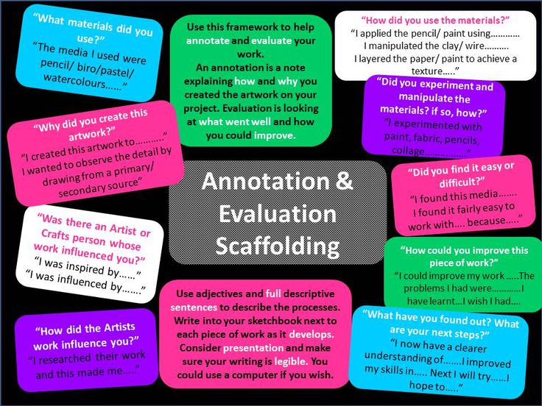
If you need extra support:
Further reading:
Analysing and evaluating - Analysing and evaluating - National 5 Art and Design Revision - BBC Bitesize

