Slide 1
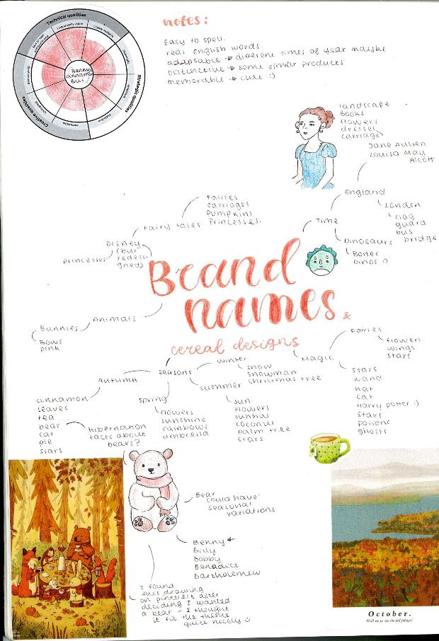
Character Design: WAGOLL
Key Character Design Tips for GCSE Graphics Students:
Document Your Process: Keep a record of your entire design process, from brainstorming to final design. This is crucial for your GCSE coursework. Include sketches, mood boards, colour palettes, and written explanations. Show where you have worked from primary sources where possible.
Annotate Your Work: Explain your design choices. Why did you choose a particular pose? Why did you select those colours? This shows that you're thinking critically about your work.
Experiment & Explore: Don't be afraid to try new things and experiment with different styles. The more you explore, the more you'll learn. This will provide evidence for all assessment objectives.
Good luck with your character designs! Remember to be creative and have fun!

Slide 2
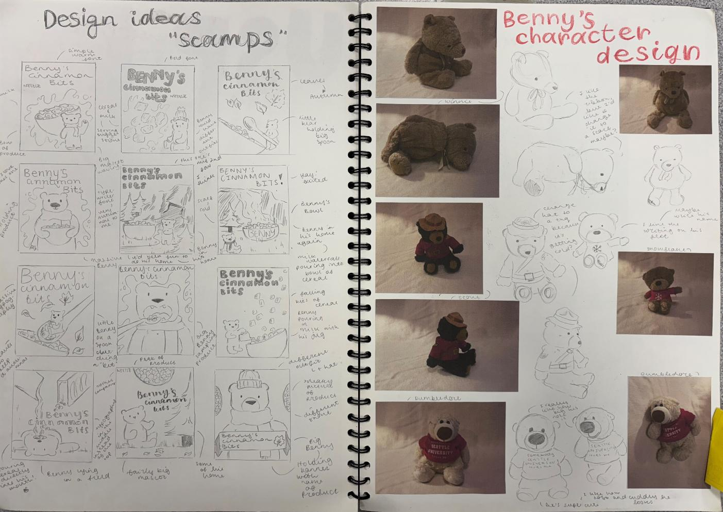
Character Design: Scamps
Develop (AO1)
Exploration: Start with quick, small sketches (thumbnails or scamps). Focus on exploring different shapes, poses, and proportions. Don't worry about detail at this stage. Aim for variety. Try different silhouettes – can you recognize the character just from its shape?
Variations: Create many thumbnails. The more you explore, the better your final design will be.
“The investigation process shows exceptional critical understanding of the context of own ideas and the sources which have informed them” (16-18/18 for a grade 9)

Slide 3
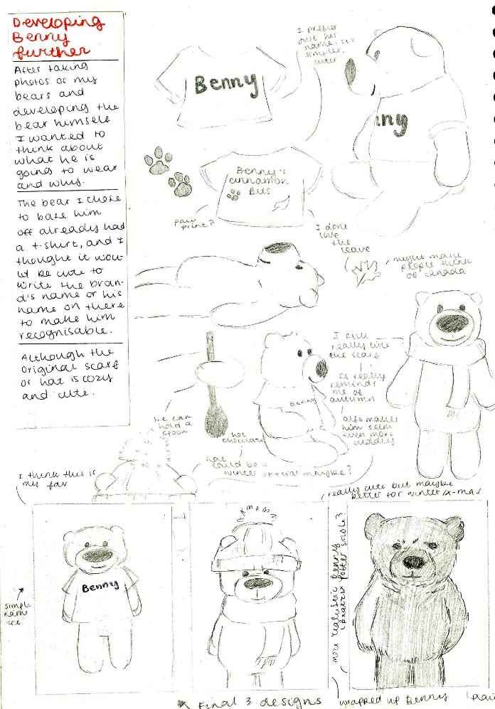
Refine (AO2)
“Exceptional ability to select and experiment with media, materials and processes appropriate to personal intentions”
“Exceptional ability to explore ideas through a process of experimentation and review”
(16-18/18 for a grade 9)
Choose Your Favourites: Select 2-3 of your strongest thumbnails and develop them further. These sketches should be larger and more detailed.
Pose & Anatomy: Think about the character's pose. Is it dynamic and action-oriented, or static and thoughtful? If your character is humanoid or animalistic, consider basic anatomy. Don't get bogged down in realism unless it's necessary for your design, but a basic understanding will improve your sketches.
Facial Features & Expressions: Experiment with different facial features and expressions to convey the character's personality.
Clothing & Accessories: Design the character's clothing and accessories. These should complement their personality and backstory.

Slide 4
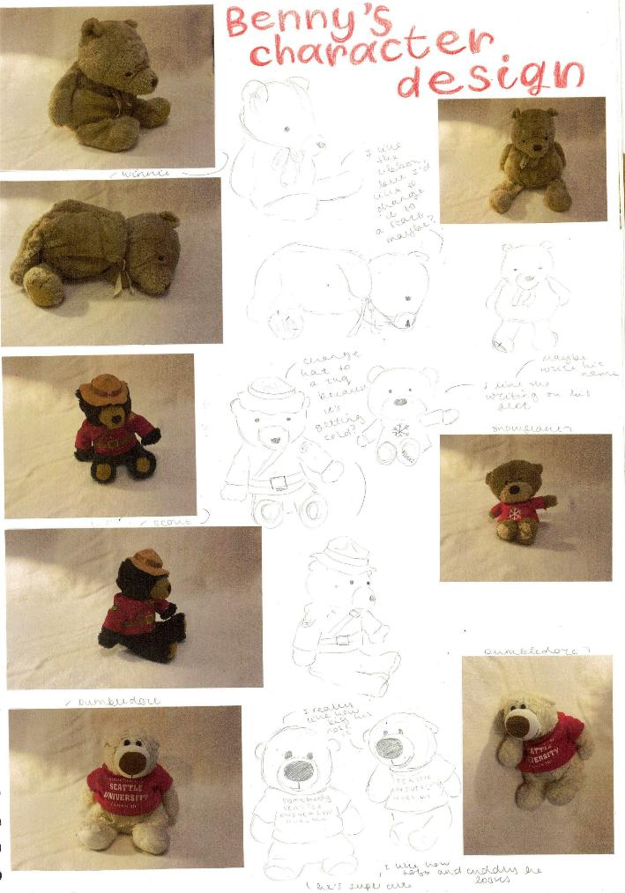
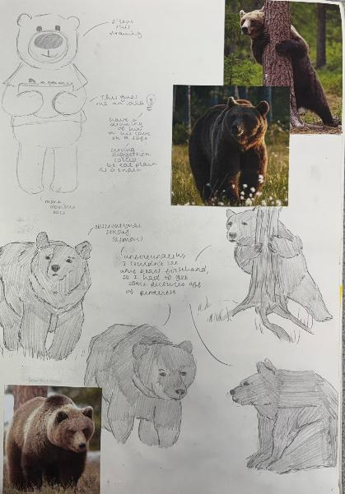
Character Design:
Development & Feedback
Feedback & Iteration:
Get Feedback: Show your sketches to others (teachers, classmates, friends) and get their feedback. What works well? What could be improved?
Revise & Refine: Use the feedback to revise and refine your sketches. This is an iterative process. Don't be afraid to make changes. Remember to work from primary sources if you can, taking your own photographs and sketching from life.
Sketches from secondary sources
Sketches from primary sources

Slide 5
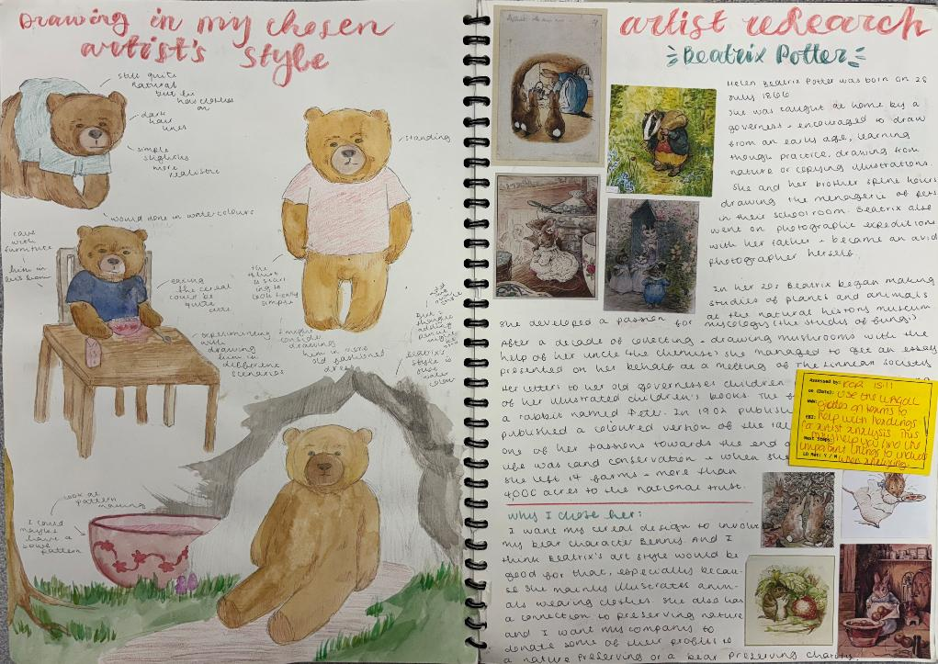
Don’t forget to contextualise! Are you working in the style of an artist of designer? How has your work been influenced by theirs?
Final Line Art:
  Clean Up: If you're going for a clean, polished look, create a final line drawing of your character. This could be done digitally or traditionally.
  Vary Line Weight: Use varying line weight to add depth and interest to your drawing. Thicker lines can be used for outlines and areas of shadow, while thinner lines can be used for details.
Colour Palette:
  Colour Theory: Consider basic colour theory. What emotions do different colours evoke?
  Limited Palette: Start with a limited colour palette (3-5 colours) and then expand if needed. This will help to create a cohesive design.
  Test Colours: Experiment with different colour combinations. Digital tools make this easy.
Rendering & Shading:
  Add Depth: Add shading and highlights to your character to give it form and dimension. Think about where the light source is coming from.
  Textures (Optional): If appropriate, add textures to your character's clothing or skin.

Slide 6
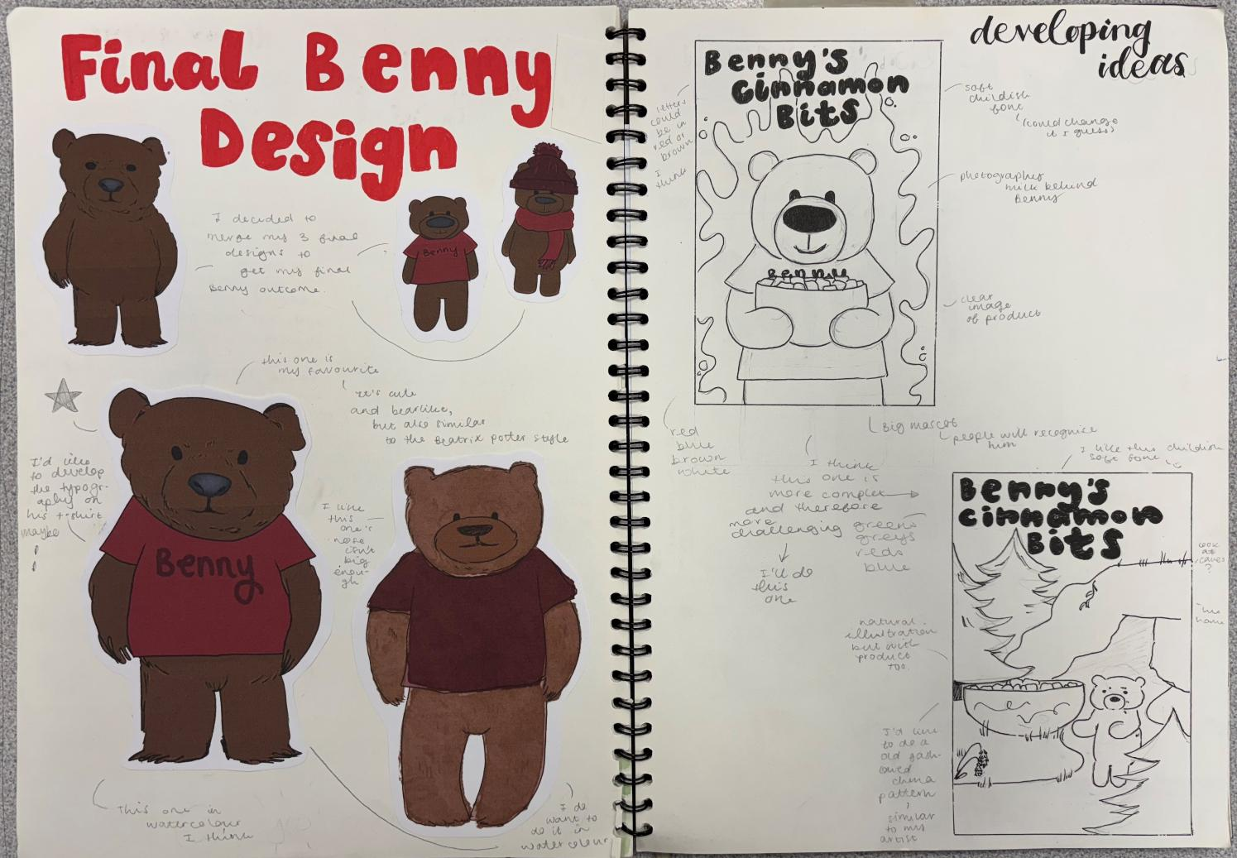
Presentation
  Background: Consider placing your character against a simple background to help it stand out.
  Character Sheet: You may wish to create a character sheet that includes your final design, a colour palette, and a brief description of the character. This is a great way to showcase your work and demonstrate your design process. Include your thumbnails and development sketches to show how your character evolved.

Slide 7
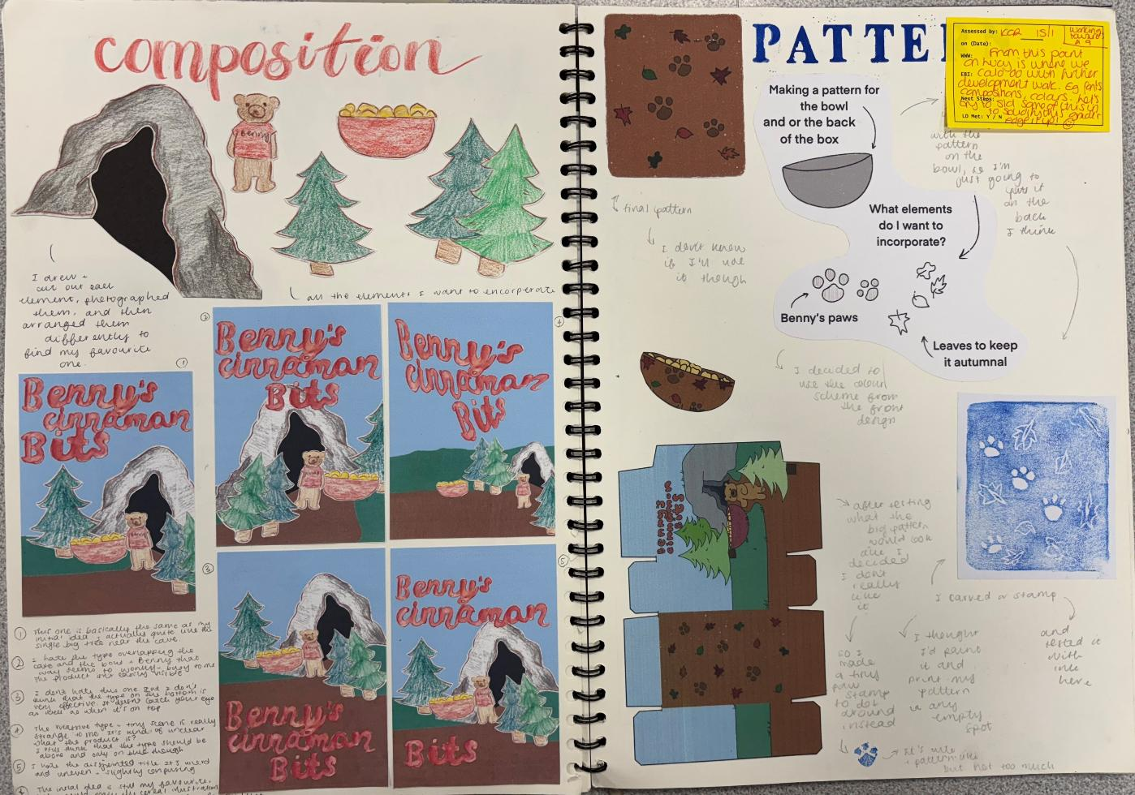
Consider how the character will work as part of a composition. Does it sit within a scene? How large will the character be within the scene? How have you come to these decisions (visual evidence!)
Recording Ideas (AO3):
Work from first hand observations.
Take high quality photos and work from your own imagery where possible.
Use a variety of recording techniques.
“Exceptional ability to record ideas, observations and insights related to personal work and the work of others through visual and other methods.”
“Exceptional ability to record relevant to intentions” (16-18/18 for a grade 9)

Slide 8
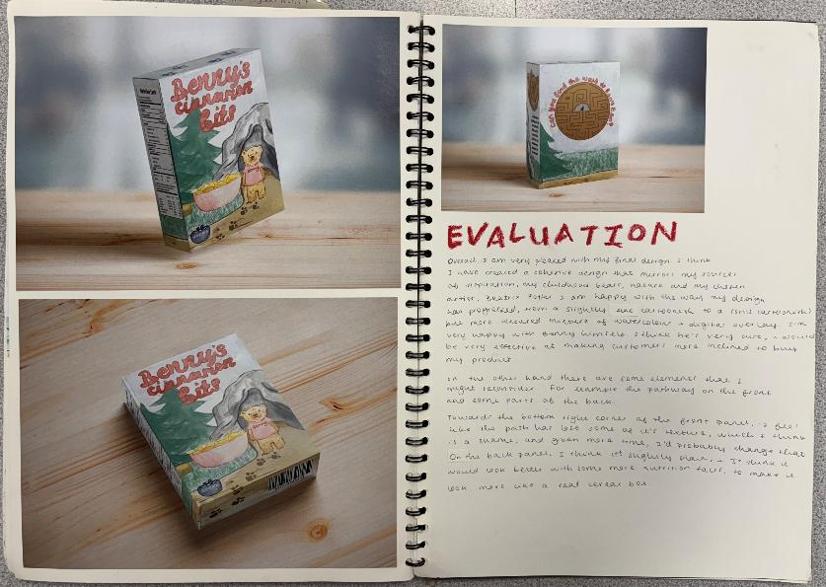
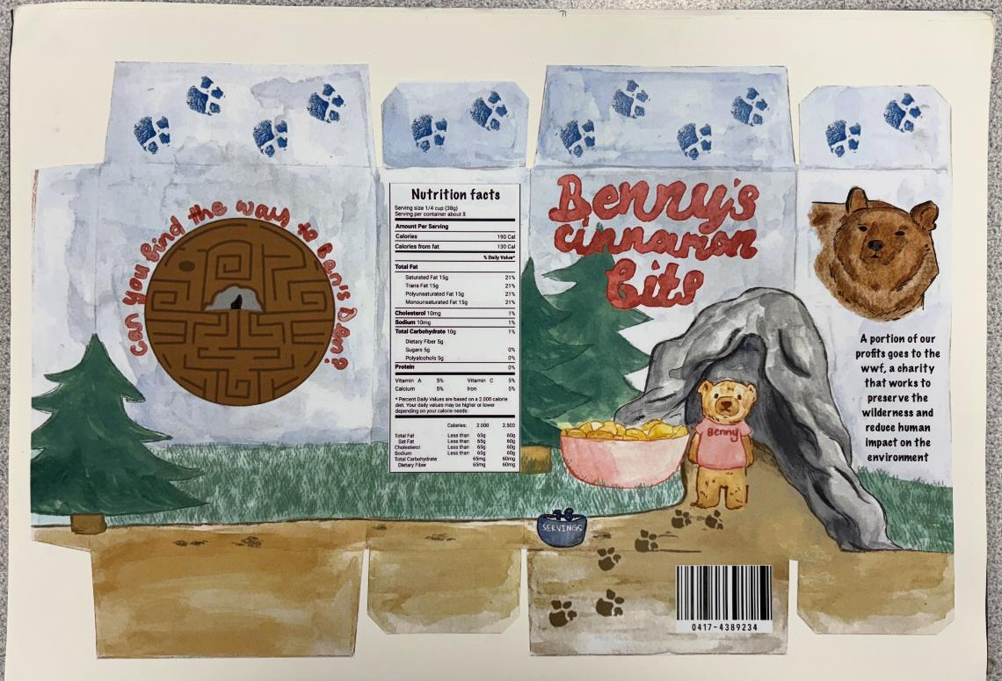
Presenting Ideas
and outcomes (AO4):
Present does not just mean the final outcome, it also reflects how you present ideas throughout your project. Your final outcome should bring together all your research and planning to a well-informed outcome that shows your strengths.
Your final outcome should make sense as a visual conclusion to your project.
“Exceptional ability to produce a personal and meaningful response”
“Exceptional ability to realise intentions” (16-18/18 for a grade 9)

