Slide 1
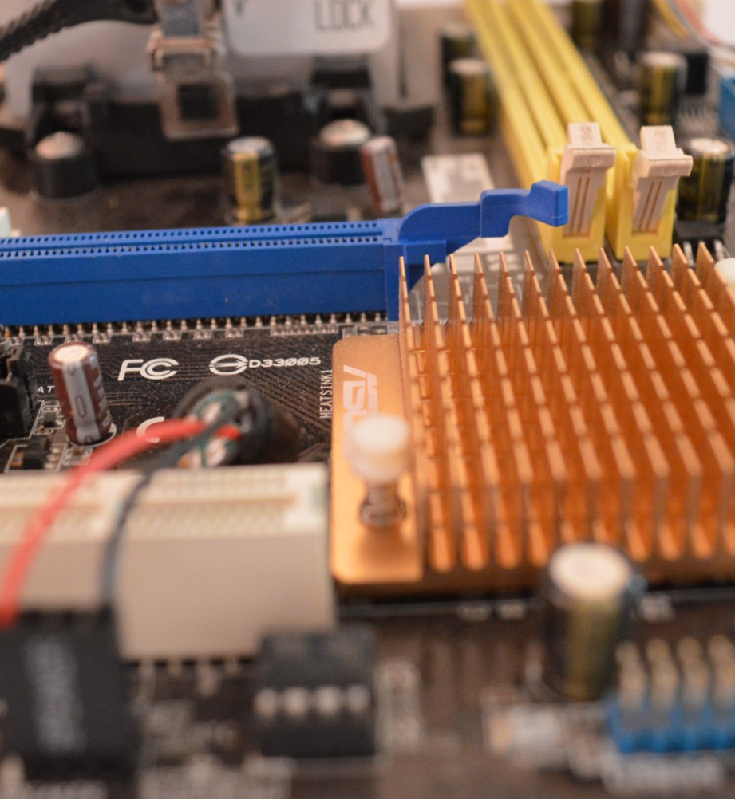
Computer Science
Transition workbook
The course is assessed by
2 exams (50% each exam)
The topic of Computer Science is at the heart of the modern world
Studying it can make you extremely sought after in todays job market
The transition from GCSE to A level is significant, this includes:
  An increased emphasis on technical content
  An increased emphasis independent research
This workbook is designed to allow you to practice some of these skills and build on your existing knowledge.
Please complete by your first lesson back in September.

Slide 2
1
“Tell me about yourself”
Why did you choose Computer Science?
Expected time to complete: ½ hour
In this simple task you get the opportunity to tell me your choices and reasons behind choosing to study Computer Science. Please answer all questions as best you can.
1. Why did you choose to study A level Computer Science?
2. What other courses have you chosen to study at Key Stage 5, and what made you choose this combination?
3. What are you hoping to achieve from studying Computer Science?
4. How would you describe yourself as a learner at GCSE? What skills where you good at, what areas would you like to improve on?
5. What are your other hobbies and interests outside of school? Anything related to Computing?

Slide 3
2
Independent research task
Emerging computer technology
Expected time to complete: 2 hours
In this task you get to investigate any area of emerging computer technology which interests you.
You can pick any area which interests you, but examples could be:
Artificial intelligence
Robotics
Automated self driving cards
Quantum computing
In no more than ONE side of A4 summarise the area you have chosen under the following four headings:
What is it?
What are the possible Social, Moral, Cultural and Ethical benefits of this technology on society
What are the possible Social, Moral, Cultural and Ethical risks of this technology on society
My conclusion on this technology and what it will mean for our world 10 years from now
Additional help:
For additional help and support in structuring your answer you might like to watch some of the videos from the following Craig ‘n’ Dave playlists:
OCR:
SLR 17 – Ethical, morale and cultural issues
https://student.craigndave.org/videos/slr-17-ethical-moral-and-cultural-issues
AQA:
SLR 19: Moral, social, legal, cultural issues
https://student.craigndave.org/videos/slr19-moral-social-legal-cultural-issues

Slide 4
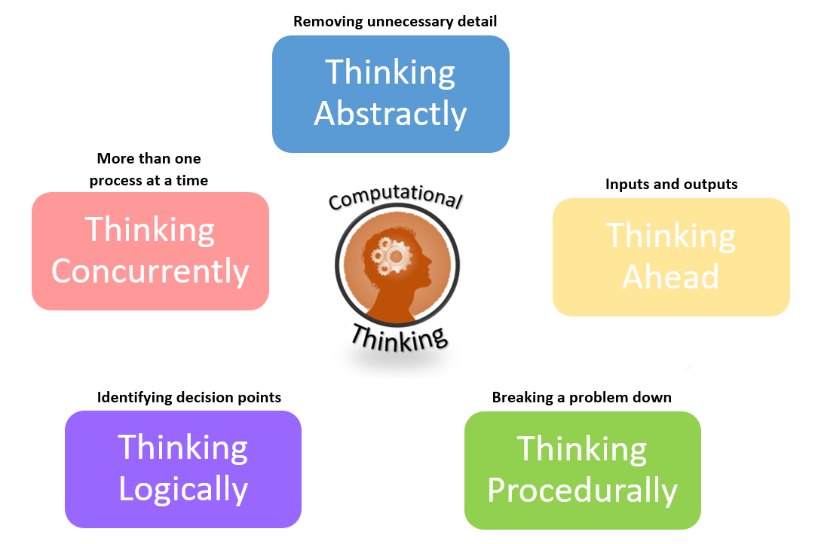
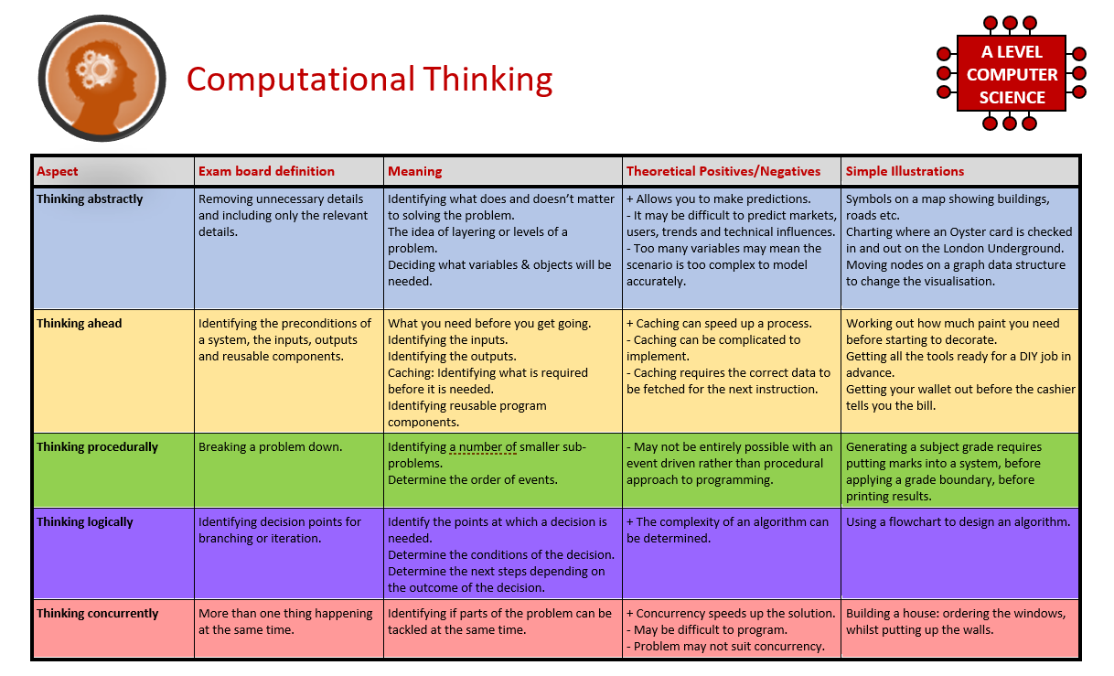
3
What is “computational thinking”?
Thinking like a computer
Expected time to complete: 2 hours
At the heart of Computer Science is the ability to look at problems, analyse them, break them down and solve them in a way which involves a variety of “Computational Thinking” skills.
Download the “Computational thinking and Computational methods placemats” from Craig n Dave:
  https://student.craigndave.org/specification-key-terminology-and-cheat-sheets
Create your own spider diagram / mind map which shows your clear understanding of the 5 different computational thinking strands
  Keep it to a single side of A4 / A3
Your goal is to imagine someone else has to revise from your mind map. Ask yourself:
  Does it make sense?
  Is it clear?
  Does it cover all of the important concepts?
Note:
Although the five strands listed (and the download resources provided for this task) are from the OCR AS / A’Level specification, the concepts of “Computational Thinking” are just as applicable to the AQA course.
Indeed many of the strands listed are explicitly covered in the AQA specification in different locations.

Slide 5
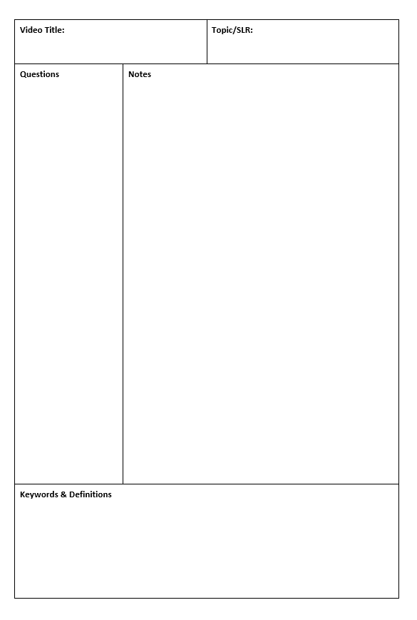
4
Note taking practice task
The Cornell method of note taking
Expected time to complete: 1½ hours
The expectation to do independent research at A Level will increase dramatically from GCSE.
There is a real skill to taking decent notes outside of lesson which are of value. Research has proven that one of the most effective methods is the “Cornell” note taking method.
To start download the “Cornell note taking template” from Craig n Dave:
  https://craigndave.org/cornell-note-taking/
Pick any two of the following videos from Craig ‘n’ Dave:
  AQA: https://student.craigndave.org/videos/aqa-alevel-slr06-procedural-functional-data-abstraction
  AQA: https://student.craigndave.org/videos/aqa-alevel-slr13-sample-resolution-and-rate
  AQA: https://student.craigndave.org/videos/aqa-alevel-slr13-encryption-vernam-cipher
  AQA: https://student.craigndave.org/videos/aqa-alevel-slr20-bit-rate-baud-rate-bandwidth-and-latency
  OCR: https://student.craigndave.org/videos/ocr-alevel-slr01-alu-cu-registers-and-buses
  OCR: https://student.craigndave.org/videos/ocr-alevel-slr04-paging-segmentation-and-virtual-memory
  OCR: https://student.craigndave.org/videos/ocr-alevel-slr05-stages-of-compilation
  OCR: https://student.craigndave.org/videos/ocr-alevel-slr14-data-structures-part-2-graphs
Write the title of the video and its topic in the top boxes (use a different sheet for each video).
In the main “Notes” section, write notes from the video. You can do this in any way you like, a suggestion might be to rewind slightly when the canvas changes, thinking carefully about what was important in the previous few minutes.
Having recorded the notes, review them:
  Turn each part into a question in the section on the left.
  For example, the notes may say, “The value of the program counter is passed to the memory address register”.
  The question then becomes, “which register is the value of the program counter passed to?”
  Sometimes these questions are easy, and at times they are more difficult to write.
  There may also be more than one valid question.
  You will need to decide for yourself which are the most appropriate questions for revision.
Finally pull out all the key words and their definitions words the notes and list them in the bottom section.

Slide 6

5
Key terms task
Getting to grips with terminology
Expected time to complete: 2 hours
An important aspect of being successful with your study of Computer Science is getting to grips with subject related terminology. There are over 240 specific terms you will need to learn!
Below are a handful of the key terms you will need to become familiar with.
Control Unit Register Busses
Von Neuman Architecture Optical Storage Operating System
Intermediate Code Device Driver Compiler
Assembly Language Machine Code Lossy Compression
Hashing Normalisation TCP/IP Stack
Packet Switching ASCII Problem Decomposition
Research each of the key terms and write a definition.
Resist the urge to simply cut and paste a definition from the first website you find.
Many definitions found on The Internet are overly complicated and wordy.
Ask yourself:
  Does my definition make sense?
  Is it succinct, to the point?
  Does the definition have appropriate depth and detail for A’Level?
  Could I give this definition to another student so they could revise from it?

Slide 7

6
An introduction to the basics of programming tasks
Programming basics
Expected time to complete: 6 hours
Learning to “code” is a fun and essential part of A Level Computer Science. This task is ideal if you haven't done the GCSE in Computer Science or you simply want a nice refresher ahead of starting your A Level course.
Head over to the web site: https://www.learnpython.org/
Complete the following python tutorials under the heading:
  • Hello, World!
  • Variables and Types
  • Lists
  • Basic Operators
  • String Formatting
  • Basic String Operations
  • Conditions
  • Loops
  • Functions
Each section presents you with theory, code to run and exercises to try out.
If you want to practice writing your own python programs you can download and install a simple python development tool here: https://www.python.org/downloads/
Additional note:
This task is most suited to students who intend to do the A Level and have not previously gained much / or any programming experience from the GCSE Computer Science course.
Although the language chosen here is Python, and that may not be what you will be using at A Level, it is the underlying programming concepts which are important.
The list of topics above cover the standard set of programming concepts you would be expected to know having completed a GCSE and Computer Science and so will prepare you well for the A level.

Slide 8
7
Critical thinking task
Why is Computer Science important?
Expected time to complete: 2 hours
It is easy to say, “Computer Science is essential in todays world”, but are you able to think critically about this statement and back it up? “Thinking Critically” is an essential skill at A Level.
It involves you:
Looking at a topic / concept in depth
Taking account of different views / perspectives
Considering positives and negatives
Evaluating links and effects on other concepts
Drawing your own conclusions backed up with evidence
On the following slide answer the questions:
  What is Computer Science?
  What are the benefits and risks of Computer Science at a local level (think about your local community / town / city / county)
  What are the benefits and risks of Computer Science at a national level
  What are the benefits and risks of Computer Science at a global level
Additional help:
For additional help and support in structuring your answer you might like to watch some of the videos from the following Craig ‘n’ Dave playlists:
OCR:
SLR 17 – Ethical, morale and cultural issues
https://student.craigndave.org/videos/slr-17-ethical-moral-and-cultural-issues
AQA:
SLR 19: Moral, social, legal, cultural issues
https://student.craigndave.org/videos/slr19-moral-social-legal-cultural-issues

Slide 9
7
Critical thinking task
Why is Computer Science important?
Expected time to complete: 2 hours
What is Computer Science?
Enter your answer here
What are the benefits and risks of Computer Science at a local level
Enter your answer here
Try to make at least 4 valid points
What are the benefits and risks of Computer Science at a national level
Enter your answer here
At least 2 of your points should be about the potential risks of Computer Science
At least 2 of your points should be about the potential benefits of Computer Science
Try to make at least 4 valid points
At least 2 of your points should be about the potential risks of Computer Science
At least 2 of your points should be about the potential benefits of Computer Science
What are the benefits and risks of Computer Science at a global level
Enter your answer here
Try to make at least 4 valid points
At least 2 of your points should be about the potential risks of Computer Science
At least 2 of your points should be about the potential benefits of Computer Science

Slide 10
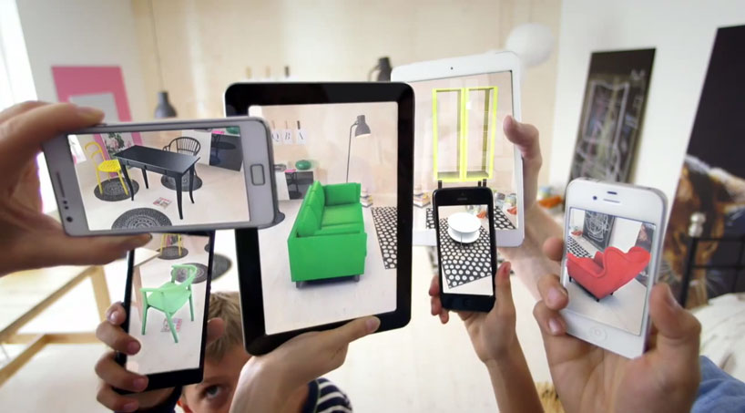
8
Applying technical knowledge in context task
Augmented reality
Expected time to complete: 1½ hours
A key skill at A Level is being able to take a topic and then discuss it in the context of different scenarios.
Most theory-based exam questions will be asked in the form of a scenario, simply regurgitating what you know on the topic without contextualising your answer to the scenario will often result in low marks!
The topic for this exercise is “Augmented Reality”. It is a truly fascinating area of technology which has the potential to change almost every aspect of our daily lives.
Watch this brief video to learn more: https://www.youtube.com/watch?v=vQtwWzfzKXI
After watching the video complete the next slide which asks you to discuss the benefits, limitations and risks of augmented reality in the context of:
Medicine & health care
Gaming & entertainment
Schools & learning
Travel & tourism
Social media
Transport & navigation
Image by Oyundari Zorigtbaatar (20 March 2016) https://creativecommons.org/licenses/by-sa/4.0/legalcode

Slide 11
8
Applying technical knowledge in context task
Augmented reality
Expected time to complete: 1½ hours
Medicine & health care
Discuss the benefits, limitations and risks of augmented reality in this context:
Enter your answer here
Gaming & entertainment
Discuss the benefits, limitations and risks of augmented reality in this context:
Enter your answer here
Schools & learning
Discuss the benefits, limitations and risks of augmented reality in this context:
Enter your answer here
Travel & tourism
Social media
Transport & navigation
Enter your answer here
Discuss the benefits, limitations and risks of augmented reality in this context:
Discuss the benefits, limitations and risks of augmented reality in this context:
Enter your answer here
Discuss the benefits, limitations and risks of augmented reality in this context:
Enter your answer here

Slide 12
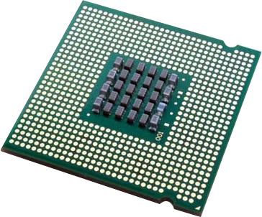
9
Systems architecture task
Looking under the hood of the processor
Expected time to complete: 2 hours
The CPU “Central Processing Unit” is the central core of any computer system. You will study what it contains and how it works it in depth at A Level.
Start by watching the following 3 videos from Craig ‘n’ Dave (choose from OCR or AQA exam board)
  OCR: https://student.craigndave.org/videos/ocr-alevel-slr01-alu-cu-registers-and-buses
  OCR: https://student.craigndave.org/videos/ocr-alevel-slr01-fetch-decode-execute-cycle
  OCR: https://student.craigndave.org/videos/ocr-alevel-slr01-performance-of-the-cpu
  AQA: https://student.craigndave.org/videos/aqa-alevel-slr17-the-processor-and-its-major-components
  AQA: https://student.craigndave.org/videos/aqa-alevel-slr17-alu-cu-registers-and-buses
  AQA: https://student.craigndave.org/videos/aqa-alevel-slr17-performance-of-the-cpu
Produce a fully annotated diagram on a single sheet of A4 / A3 paper which shows how the CPU works.
Make sure the diagram includes and covers:
  Major CPU components and what they are for:
    Arithmetic Logic Unit (ALU)
    Control Unit (CU)
    Cache
  The main registers
    Program Counter (PC)
    Memory Address Register (MAR)
    Current Instruction Register (CIR)
    Memory Data/Buffer Register (MDR / MBR)
  Fetch-decode-execute cycle
  Include annotations which explain how the performance of a CPU can be improved by:
    Increasing the clock speed
    Increasing the cache size
    Increasing the number of cores

Slide 13
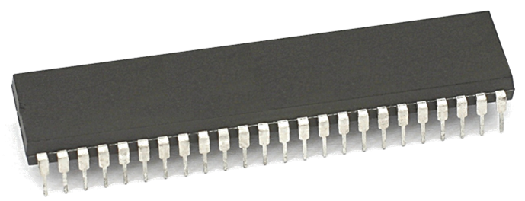
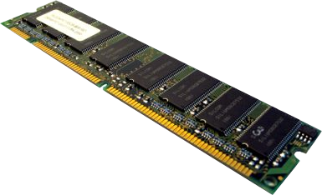
10
Memory task
Different types of memory
Expected time to complete: 1 hour
Computer memory comes in many different forms, some of the main ones are:
Random Access Memory (RAM)
Read Only Memory (ROM)
Virtual Memory
Carry out some research into these forms of memory and then complete the tasks on the following slide.
Additional help:
For additional help and support in completing this task you might like to watch some of the following videos from Craig ‘n’ Dave:
RAM and ROM:
https://student.craigndave.org/videos/ocr-gcse-slr1-2-ram-and-rom
The need for Virtual Memory:
https://student.craigndave.org/videos/ocr-gcse-slr1-2-the-need-for-virtual-memory

Slide 14
10
Memory task
Different types of memory
Expected time to complete: 1 hour
Random Access Memory (RAM)
<Enter a definition for RAM>
Read Only Memory (ROM)
<Enter a definition for ROM>
Virtual Memory
<Enter a definition for Virtual Memory>
<State if RAM is volatile or non volatile>
<State if RAM is read only or read & writeable>
<Describe what sort of information RAM typically holds>
<State if ROM is volatile or non volatile>
<State if ROM is read only or read & writeable>
<Describe what sort of information ROM typically holds>
<Explain why virtual memory is needed>

Slide 15

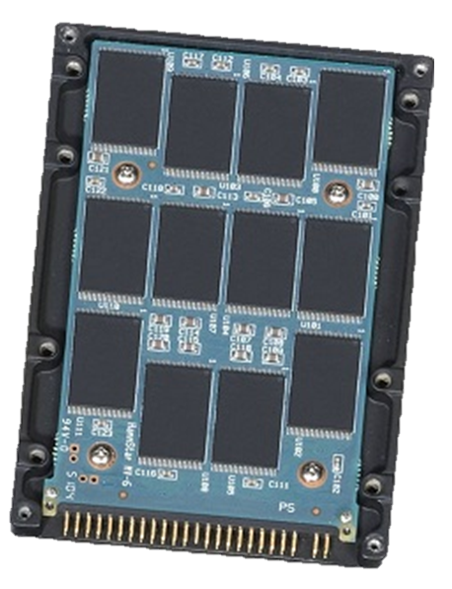

11
Storage task
Types of secondary storage
Expected time to complete: 1 hour
Virtually all secondary storage devices in use today fit into one of three broad categories:
Magnetic
Optical
Solid state
Carry out some research into these categories and then complete the tasks on the following slide.
Additional help:
For additional help and support in completing this task you might like to watch some of the following videos from Craig ‘n’ Dave:
Magnetic, Flash and Optical storage:
https://student.craigndave.org/videos/ocr-alevel-slr03-magnetic-flash-and-optical-storage
Comparing capacity and speed of storage media:
https://student.craigndave.org/videos/aqa-alevel-slr18-comparing-capacity-and-speed-of-storage-media

Slide 16
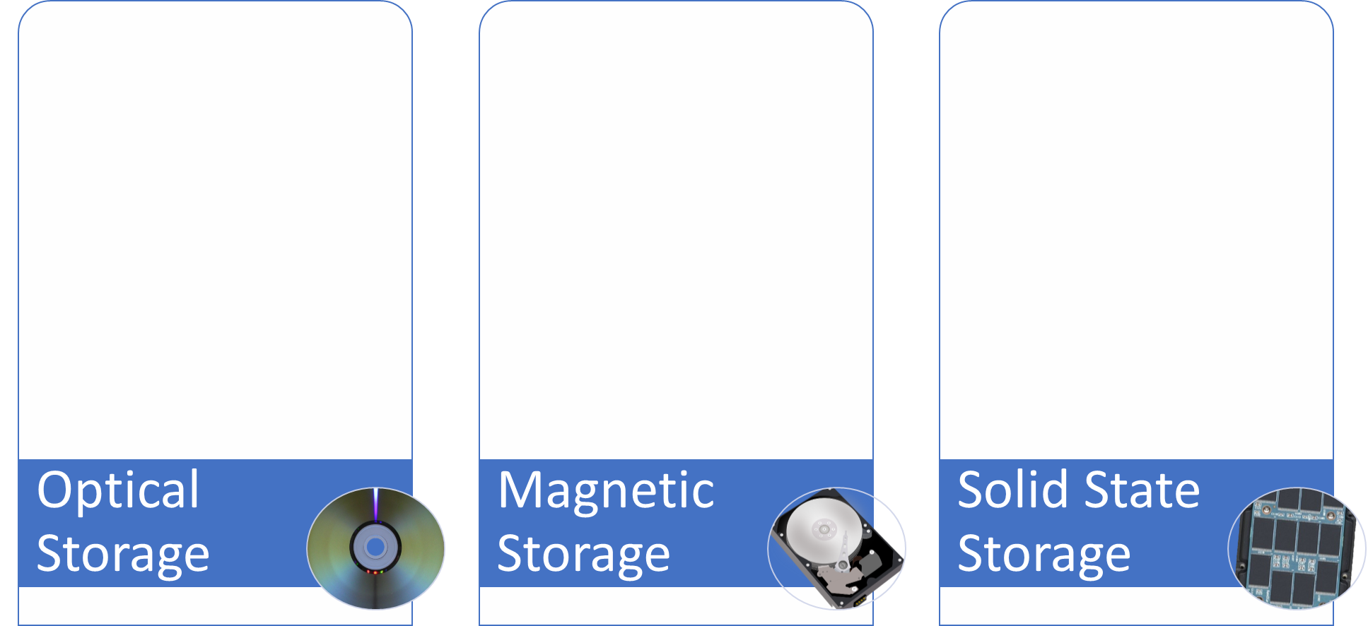
11
Storage task
Types of secondary storage
Expected time to complete: 1 hour
How does it work?
How does it work?
How does it work?
Enter your answer here…
Enter your answer here…
Enter your answer here…
Advantages / Positives
Advantages / Positives
Advantages / Positives
Enter your answer here…
Enter your answer here…
Enter your answer here…
Disadvantages / Negatives
Disadvantages / Negatives
Disadvantages / Negatives
Enter your answer here…
Enter your answer here…
Enter your answer here…
Examples of typical usage
Examples of typical usage
Examples of typical usage
Enter your answer here…
Enter your answer here…
Enter your answer here…
Typical storage capacity range
Typical storage capacity range
Typical storage capacity range
Enter your answer here…
Enter your answer here…
Enter your answer here…

Slide 17










12
Networks task
Types of networks
Expected time to complete: 2 hours
Use the following symbols:
Carry out some research on computer networks, in particular LANs, WiFi, Network topologies and connectivity devices.
Use the symbols on the right (feel free to revise them) to create an appropriate network over the floorplan on the next slide.
Make sure your network meets all the following requirements:
Each member of the main office needs a desktop PC
Angela, Pam, Dwight and Oscar also use an office issued smart phone
The following rooms new access to WiFi:
  Meeting room (top right)
  Reception
  Conference Room
  Main office
Use a circle with a transparent fill (so you can see the network underneath) with a width and height of 12.5cm to provide the WiFi coverage needed to cover the rooms above:
  The circles need to have a WAP at the centre
  The 12.5cm diameter circles represent the maximum range of each WAP
  They WAP icons must be attached to a wall
  You must use the minimum number of WAP possible to provide the coverage needed
All desktop PCs use wired connections in a star network configuration
  The top left server room, conference room and main office need to be on one subnet with its own switch
  All other rooms are on a separate subnet and will require its own hardware for this
  The two subnets need to be appropriately connected together
The top left room needs to have a server placed in it and connected appropriately to the local subnet
The server room needs hardware to appropriately connected the LAN to “The Internet”
Reception needs a photocopier and it needs connecting to the local subnet
A firewall should be placed somewhere appropriate
Desktop PC
Tablet
Phone
Router
WAP
Switch
Firewall
Server
Photocopier
Indicates a wireless enabled device
Additional help:
For additional help and support in structuring your answer you might like to watch some of the videos from the following Craig ‘n’ Dave playlists:
OCR: SLR 11 – Networks
https://student.craigndave.org/videos/slr-11-networks
AQA: SLR21 – Network and the Internet
https://student.craigndave.org/videos/slr21-networks-the-internet

Slide 18
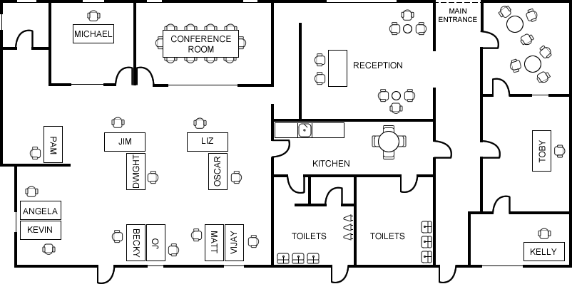
12
Networks task
Types of networks
Expected time to complete: 2 hours

Slide 19


13
Systems software task
Operating systems
Expected time to complete: 2 hours
Operating systems are arguably the most important piece of software installed on a computer.
Carry out some research into the following areas:
The purpose of operating systems
The roles of operating systems
The purpose of interrupts
How interrupts work as part of the fetch-decode-execute cycle
Complete the tasks on the following slides.
Additional help:
For additional help and support in structuring your answer you might like to watch some of the videos from the following Craig ‘n’ Dave playlists:
OCR: SLR 4 – Operating systems – Systems software
https://student.craigndave.org/videos/slr-4-operating-systems-systems-software
AQA: SLR14 – Hardware & software
https://student.craigndave.org/videos/slr14-hardware-software

Slide 20
13
Systems software task
Operating systems
Expected time to complete: 2 hours
List at least 8 different roles an Operating System perform.
The purpose and roles of an Operating System
<Enter answer here>
<Enter answer here>
<Enter answer here>
<Enter answer here>
<Enter answer here>
<Enter answer here>
<Enter answer here>
<Enter answer here>

Slide 21
13
Systems software task
Operating systems
Expected time to complete: 2 hours
Rearrange the elements in the diagram below to show hoe the fetch-decode-execute cycle handles interrupts.
No
No
Fetch next instruction
Decode instruction
Execute instruction
Any higher priority interrupts to be processed?
Any higher priority interrupts to be processed?
Yes
Fetch next instruction
Decode instruction
Execute instruction
Yes
Pop registers off the memory stack
Put registers on the memory stack
Interrupt service routine loaded
When interrupt code complete

Slide 22
13
Systems software task
Operating systems
Expected time to complete: 2 hours
Drag the labels into their correct place on the following diagram:
Explain what this diagram is showing:
Hardware
User
Applications
Operating System

Slide 23
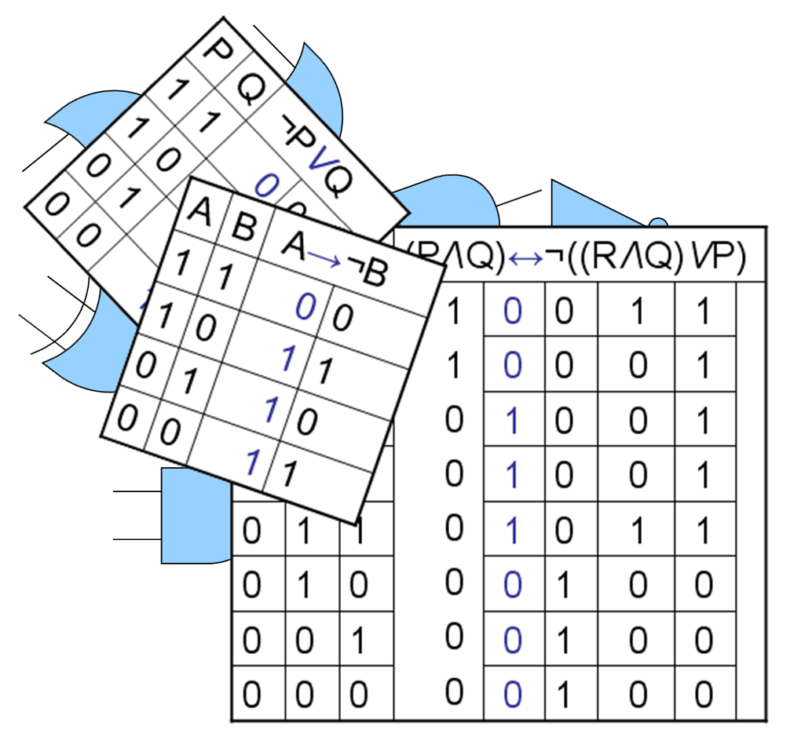
14
Computational logic task
Truth tables to circuit diagrams
Expected time to complete: 2 hours
An important area of computer science is understanding the logic gates and diagrams which are used to represent the physical circuitry of computer systems.
Carry out some research into the following areas:
Logic gates:
  AND
  NAND
  NOR
  NOT
  OR
  XOR
Truth tables
Boolean expressions
Circuit diagrams
Complete the tasks on the following slides.
Additional help:
For additional help and support in structuring your answer you might like to watch some of the videos from the following Craig ‘n’ Dave playlists:
OCR: SLR 15 – Boolean algebra
https://student.craigndave.org/videos/slr-15-boolean-algebra
AQA: SLR16 – Logic gates & Boolean algebra
https://student.craigndave.org/videos/slr16-logic-gates-boolean-algebra

Slide 24
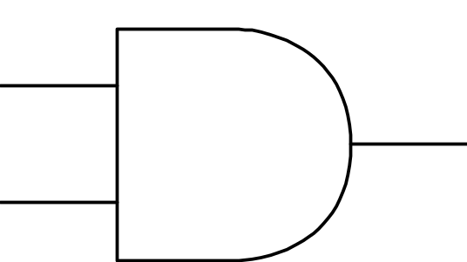
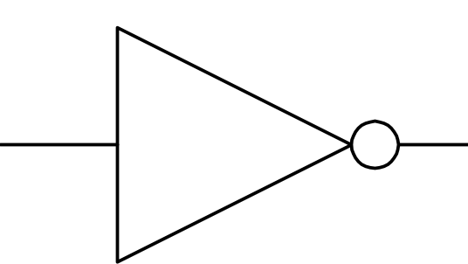




14
Computational logic task
Truth tables to circuit diagrams
Expected time to complete: 2 hours
Drag the labels into their correct place on the following diagram:
OR
AND
XOR
NOT
NAND
NOR

Slide 25
14
Computational logic task
Truth tables to circuit diagrams
Expected time to complete: 2 hours
Draw the circuit diagram which would represent the following Boolean expression:
AQA Boolean Expression: F = (A B) ● C
OCR Boolean Expression: F = ¬(¬C ∧ (A V B)
Complete the truth table for the circuit diagram you have drawn
A | B | C | D | E | F
0 | 0 | 0
0 | 0 | 1
0 | 1 | 0
0 | 1 | 1
1 | 0 | 0
1 | 0 | 1
1 | 1 | 0
1 | 1 | 1
A
B
F
C

Slide 26

15
Binary task
Representing negative numbers in binary
Expected time to complete: 1½ hours
In GCSE computer science you will have learnt how to represent positive whole numbers in binary e.g. 47
At A Level you will need to know how to represent negative as well e.g. -47
Start to recapping (or learning if you didn’t do the GCSE) how to represent positive whole numbers between 0-255 in binary
Now research how to represent negative numbers in binary using the method known as:
Two’s complement
Complete the tasks on the following slides.
Additional help:
For additional help and support in structuring your answer you might like to watch some of the following videos from Craig ‘n’ Dave:
GCSE recap: How to represent positive binary values 0-255
https://student.craigndave.org/videos/aqa-gcse-slr13-number-bases
A Level: Representing negative binary values using Two’s Complement
https://student.craigndave.org/videos/aqa-alevel-slr11-twos-complement

Slide 27
15
Binary task
Representing negative numbers in binary
Expected time to complete: 1½ hours
Write out the positive binary number 107, the answer should be displayed in 8 bits.
How would you represent the lowest negative number possible using Two’s Complement, given 8 bits.
128 | 64 | 32 | 16 | 8 | 4 | 2 | 1
Binary weighting
Binary weighting
Binary value
Binary value
Write out the negative binary number -107 using Two’s Complement, the answer should be displayed in 8 bits.
How would you represent the largest positive number possible using Two’s Complement, given 8 bits.
Binary weighting
Binary weighting
Binary value
Binary value

Slide 28
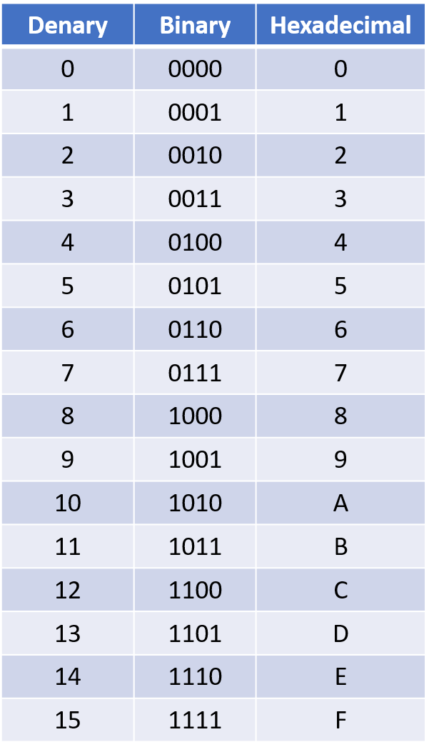
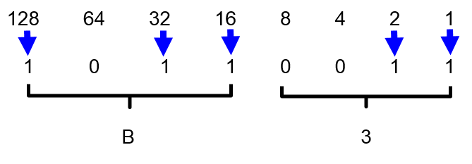
16
Binary task
Converting between base-2, base-10 and base-16
Expected time to complete: 1½ hours
As humans we have use the decimal or denary number system (base-10), made up of the unique digits 0-9.
Computer systems at the most basic level use only binary 1’s and 0’s (base-2).
As a computer scientist you will also need to become familiar with the hexadecimal number system (base-16).
You will also need to be comfortable with converting numbers between these three base systems.
Research the following areas:
Base-2 binary number system
Base-10 decimal/denary number system
Base-16 hexadecimal number system
How to convert between base-2, base-10 and base-16
Complete the tasks on the following slides.
Additional help:
For additional help and support in structuring your answer you might like to watch some of the following videos from Craig ‘n’ Dave:
Base 2, 10 and 16 number systems:
https://student.craigndave.org/videos/aqa-alevel-slr10-base-2-10-and-16-number-systems
Converting between binary, hex and decimal:
https://student.craigndave.org/videos/aqa-alevel-slr11-aqa-converting-between-binary-hex-and-decimal

Slide 29
16
Binary task
Converting between base-2, base-10 and base-16
Expected time to complete: 1½ hours
Convert the base-2 binary number 11000101 into base-10 and base-16.
(Show all your working)
Convert the base-16 hexadecimal number 9F into base-2 and base-10.
(Show all your working)
You may wish to cut and paste this standard binary weighting line to help lay out parts of your answer
128 | 64 | 32 | 16 | 8 | 4 | 2 | 1
Binary weighting
Binary value

Slide 30

17
Linear search programming task
Algorithms: from theory to practice
Expected time to complete: 4 hours
A core concept of computer science is that of data structures and algorithms.
It is also an area which many students struggle with during examinations.
Probably the most basic algorithm is that of the “linear search”.
If you have done the GCSE course you will have learnt about this searching algorithm already.
Start by learning or refreshing your knowledge of the linear search algorithm by using the videos on this page:
https://www.craigndave.org/algorithms-linear-search
Once you are happy with the theory complete the exercises on the following slides.

Slide 31
17
Linear search programming task
Algorithms: from theory to practice
Expected time to complete: 2 hours
Describe what the linear search algorithm does.
What are the applications of the linear search algorithm?
Write out the steps of the linear search algorithm in simple-structured English.
Draw a simple diagram which illustrates the linear search algorithm.

Slide 32
17
Linear search programming task
Algorithms: from theory to practice
Expected time to complete: 2 hours
Write out pseudocode for the linear search algorithm.
The algorithm should use an array called items which is pre-populated with the following values: "Florida","Georgia","Delaware","Alabama","California“
The algorithm should ask the user to “Enter the state to find:”
If the algorithm locates the state entered by the user in the array it should report back to the screen “Item found at position n”
If the algorithms can not locate the state entered by the user in the array it should report back to the screen “Item not found”

Slide 33
17
Linear search programming task
Algorithms: from theory to practice
Expected time to complete: 2 hours
Have a go at coding the linear searching algorithm in a programming language of your choice.
The program should work use an array called items which is pre-populated with the following values: "Florida","Georgia","Delaware","Alabama","California“
The program should ask the user to “Enter the state to find:”
If the program locates the state entered by the user in the array it should report back to the screen “Item found at position n”
If the program can not locate the state entered by the user in the array it should report back to the screen “Item not found”
Cut and paste the code you have written into the box below:

